Slide 1
Stability at low sampling rates and high stiffnesses
Indrajit Desai and Abhishek Gupta (Mechanical Eng.)
and
Debraj Chakraborty (Electrical Eng.)

Slide 2
Big Picture
Demands from the Networking Engineer
Demands from the User
Control Engineer

Slide 3
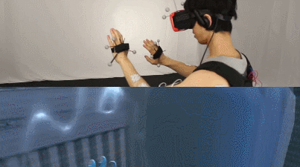
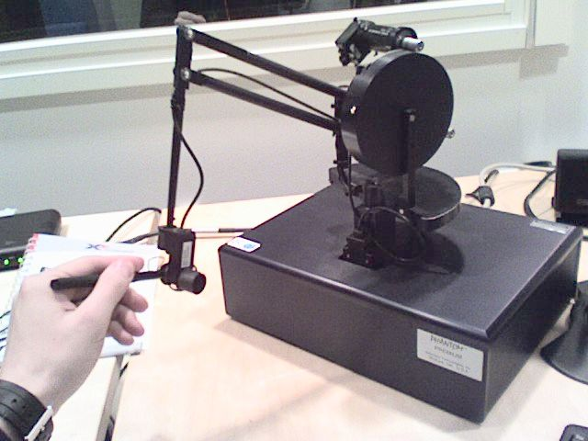
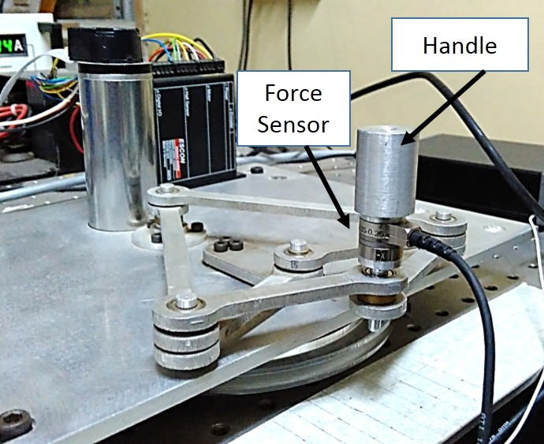
The “wall” in haptics
A wall is the basic construct in haptics.
Most solid shapes are made of (tiny) walls.
Virtual Wall
(from www.coolwearables.com)
Our primary devices

Slide 4
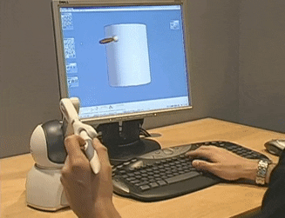
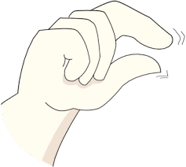
User Req. 2: The wall should feel like a spring
The wall is a (stiff) spring
No force
We want:
$$y$$
F_{h} = - ky
Then the user will feel just the spring and not the device he is actually holding
Unfortunately this is not completely possible
y
Free
space
Measured
wall
y
$$F_{h}$$
y
Motor
controller
$$F_{u}$$
Virtual Environment

Slide 5
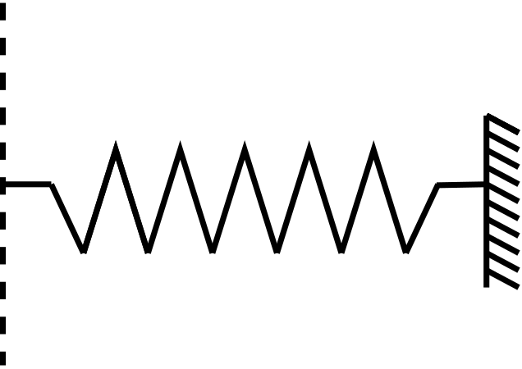
Instead of a spring we get
$$y$$
The wall is modeled as a (stiff) spring
$$y$$
F_{h}
F_{u}
$$m$$
$$b$$
$$k$$
Virtual Environment
Haptic Device
Controller
y
Free
space
Measured
wall
y
The control problem in haptics: It is the job of the controller (F_{u} ) to change the above equation into
F_{h} = - ky
$$F_{h}$$
Motor
controller
$$F_{u}$$
Virtual Environment

Slide 6
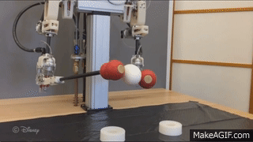
User requirement 1: Stability of the Wall
$$x$$
Free
space
Measured
wall
$$x$$
$$F_{h}$$
$$x$$
controller
$$F_{u}$$
Virtual Environment
Free
space
$$F_{h}$$
+
Device
Dynamics
Measured
wall
-
$$x$$
$$x$$
+
$$F_{u}$$
Human force input
Haptic Device
Device displacement
controller
-
Controller knows the wall position
Virtual Environment
The F_{h} to x map must be stable (BIBO) always: In free space, at the interface and inside the wall
Controller
The controller is chosen based on the value of x (switching controller!)

Slide 7
Implementation and Networking requirement:(Slow) Sampling
+
Human force input
Haptic Device
Device displacement
-
Actuator Force feedback
Digital Controller
D/A
A/D
Sampling time T
Conventional control theory advices sampling at least 2-3 times the system bandwidth
System BW depends on the users specs and consequently the controller we design
Human force input is limited to 6Hz (sometimes 10Hz)
Human sensory BW is much higher 200-300Hz
Most commercial devices have decided to sample at 1000Hz

Slide 8
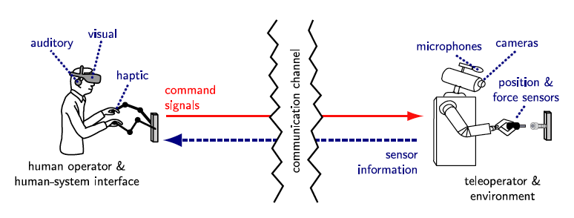
Slow Sampling is even more crucial in tele-haptics (no results yet)
As explained before: low sampling rates (i) bring down cost, same channel can be used for other purposes
Tele-haptics also demands tolerance to large delays (not yet studied by us)

Slide 9
Big Picture
Demands from the Networking Engineer
Low sampling rates (40Hz)
Large delay tolerance
Demands from the User
Stability (safety) (100Hz)
Fast tracking of force commands (6Hz)
Real feel of the specific environment (300Hz)
Control Engineer
Play safe at 1000Hz
Numbers given are for quick understanding and estimates: the actual values depend on many design parameters

Slide 10
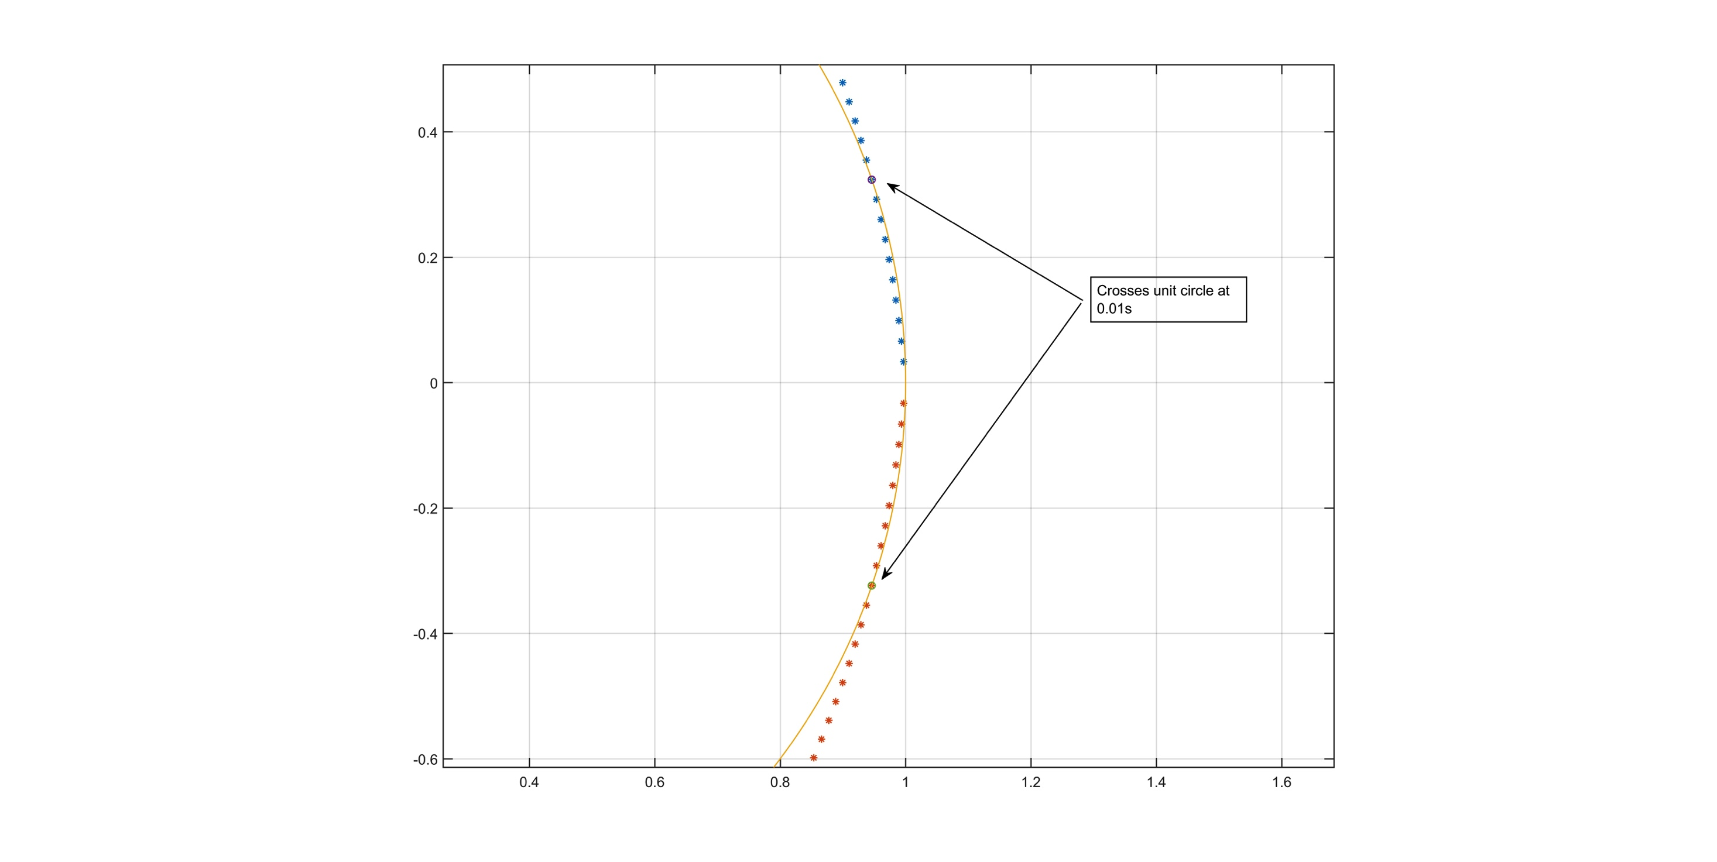
The most common haptic controller
Open Loop Impedance Control (OLIC)
+
y
F_h
+
H(s)
Human force input
Haptic Device
Device displacement
-
-
k_{e}
Environment to be simulated
D/A
A/D
Sampling time T
Improper way to write
The poles go outside the unit circle with increasing sample time at around 100Hz (for this specific example)
Colgate (1997) derived a passivity based stability criterion:

Slide 11
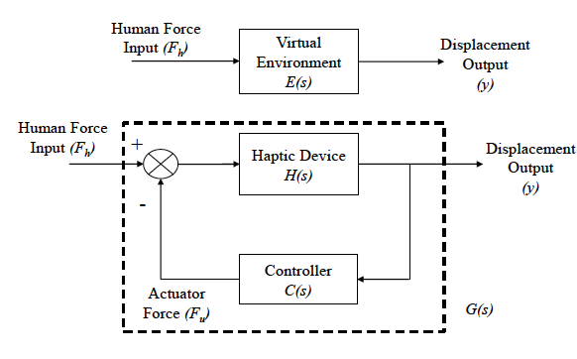
Our Method: (Old) Model matching theory in a virtual reality wrapping
We noticed that the two user requirements of (a) mimicking a given system (b) while preserving stability is exactly the H-infinity model matching problem.
The requirements above are:
E(s) and the closed loop system G(s) must match for a large range of input frequencies
C(s) must be stabilizing i.e. G(s) must be stable

Slide 12
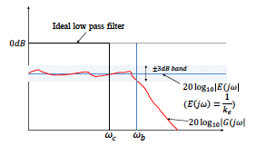
Model Matching Approach
Given a error tolerance of γ H-infinity model matching theory lets us efficiently search for a stabilizing controller C(s) such that
Clearly such a controller will not exist
Hence we bring in a weighting function of cutoff freq ω_{c} and solve for C(s) using the following constraint
the BW achieved can be made to be larger
than ω_{c}

Slide 13
Model Matching Approach offers flexibility
P1: Given a error tolerance, we can search for the maximum BW achievable while preserving stability
P2: Given a required BW, we can search for the minimum error achievable for all frequencies up to the BW.
P3: Given a error tolerance and acceptable minimum BW we can try to search for controllers at various sampling rates

Slide 14
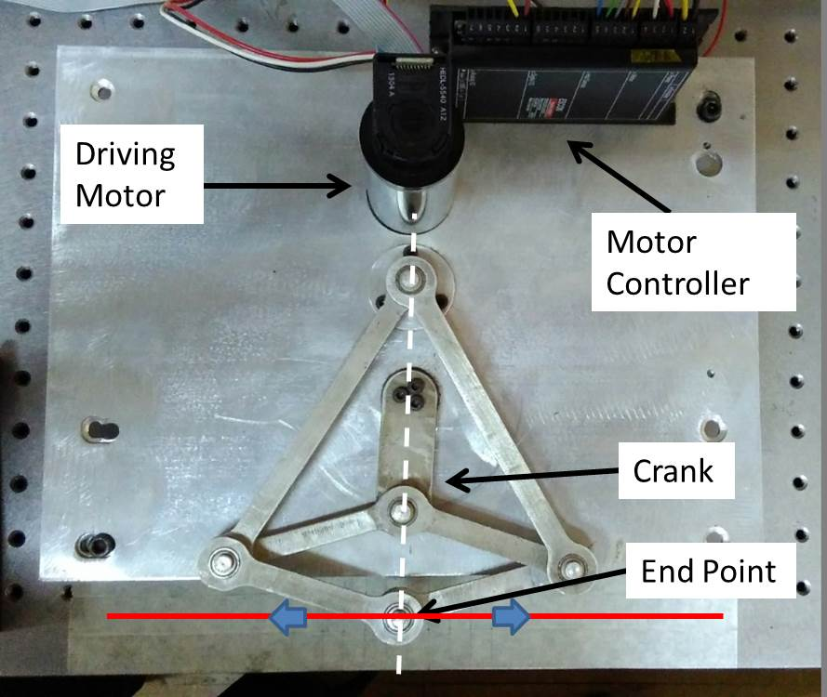
Peaucellier Mechanism Setup
(such a indigenous setup is required since the commercial devices (Phantom) do not allow us to change the sampling rate

Slide 15
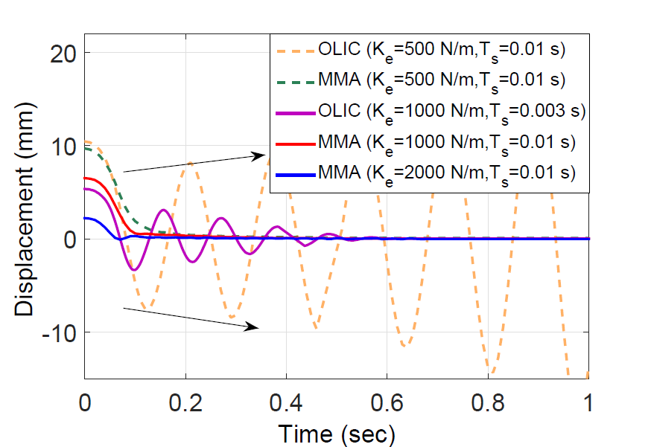
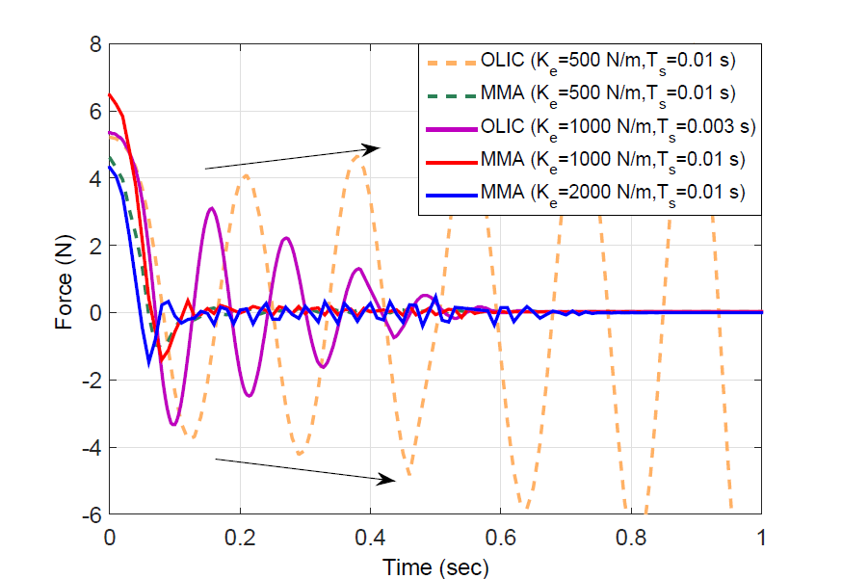

Slide 18
Thank You

