Slide 1
Transformation using static markers

Slide 2
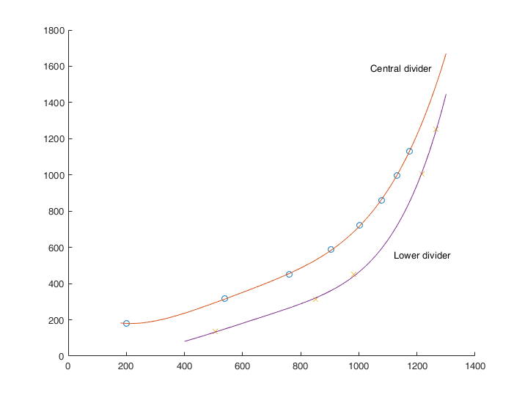
Mapping polynomials

Slide 3
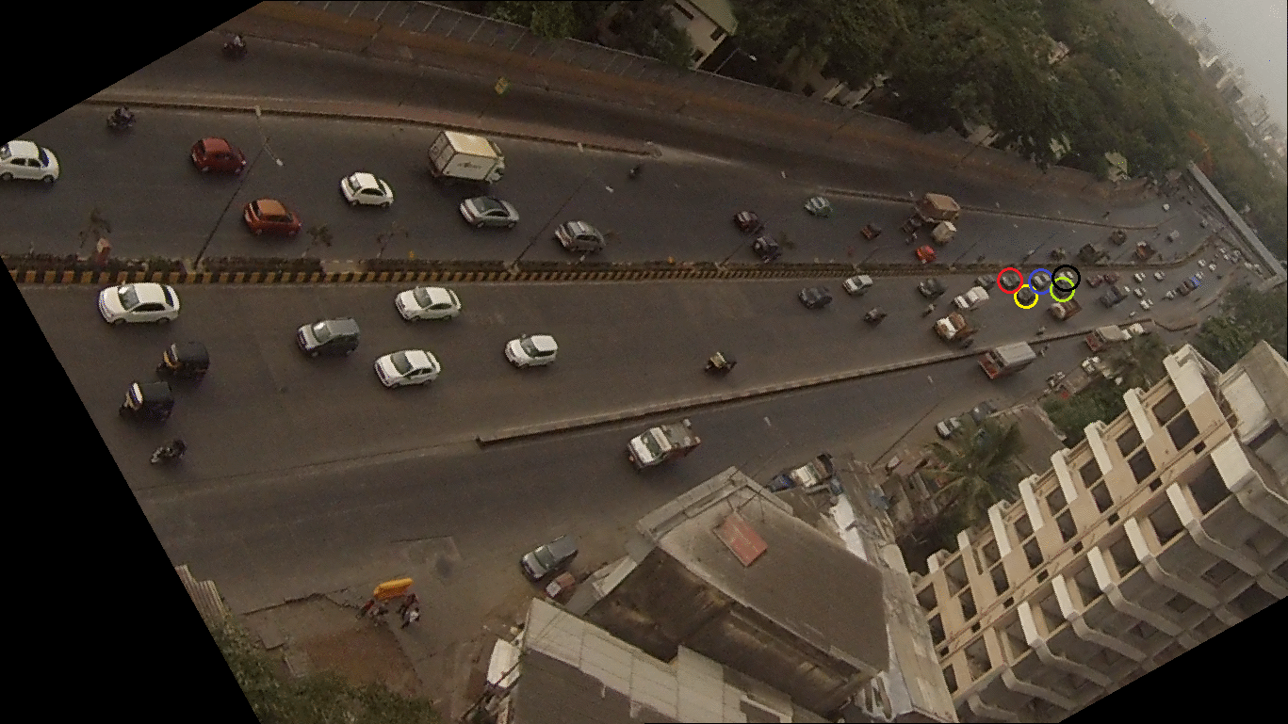
From camera image to satellite image

Slide 4
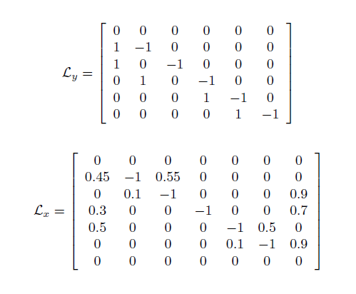
Actual v/s simulation
Corresponding Laplacian

Slide 5
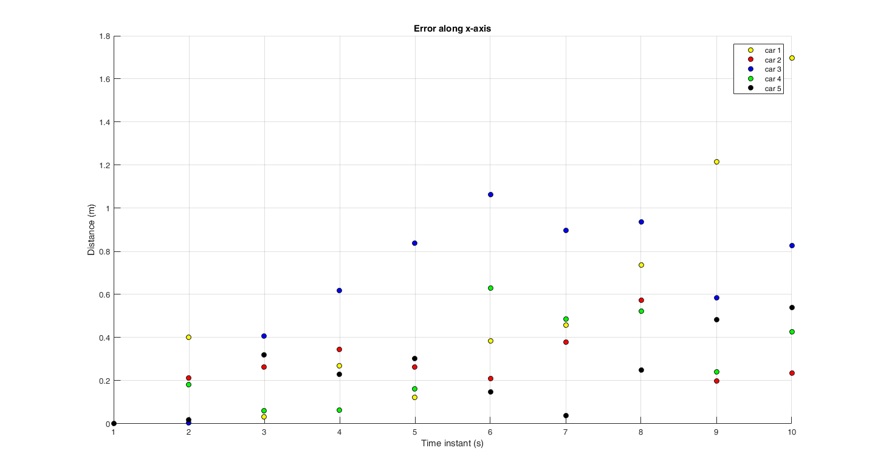

Slide 6
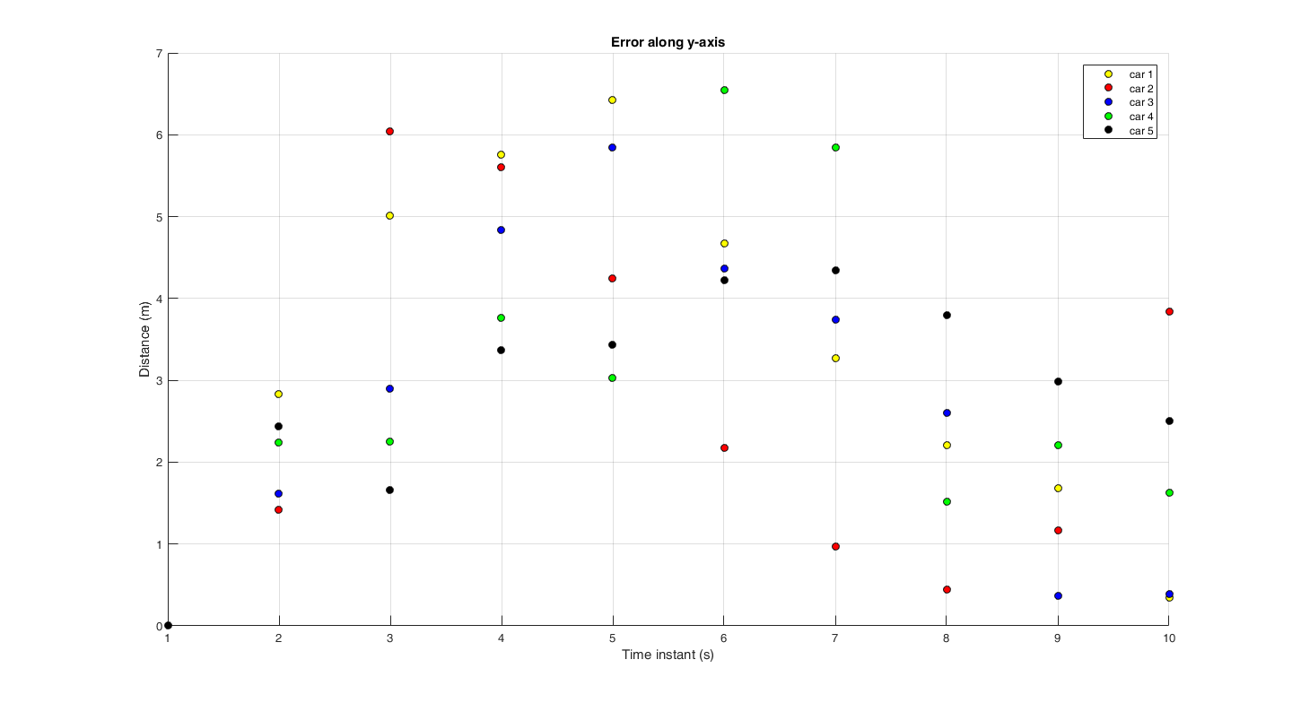

Slide 7
Actual v/s simulation: overtaking

Slide 8
Actual v/s simulation: overtaking + lane changing

