Slide 1

“Mixed Signal VLSI DESIGN”
A Tutorial On
Design of a Two Stage OPAMP
Arun N. Chandorkar
Department of Electrical Engineering
Indian Institute of Technology, Bombay
Powai, Mumbai-400076,India
E-Mail: anc@ee.iitb.ac.in
16th March 2009

Slide 2
OPAMP
An OPAMP is most used building Block
in systems like:
Analog Systems
Wireless systems
RF Systems
Design of an OPAMP is very interesting
as well as instructive.
Hence this Tutorial on OPAMP Design

Slide 3
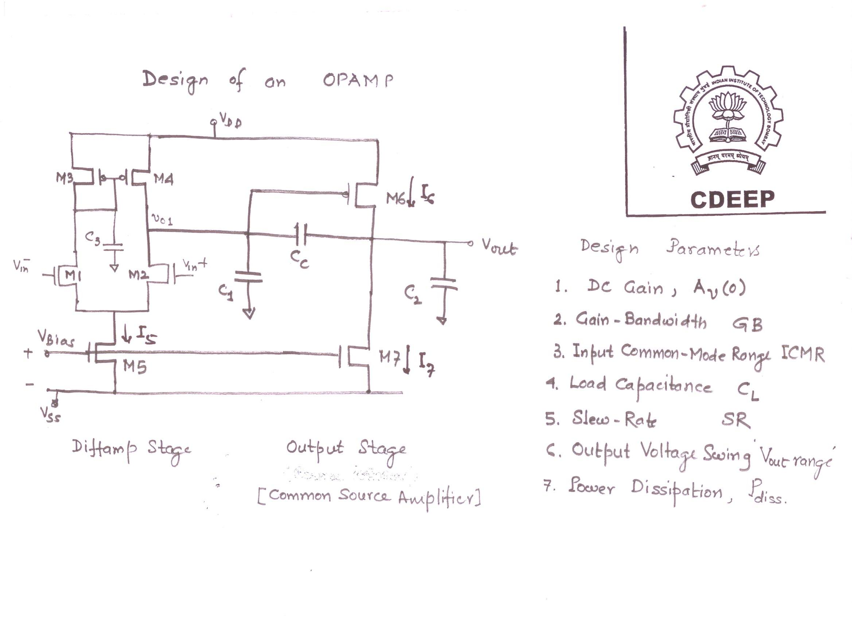

Slide 4
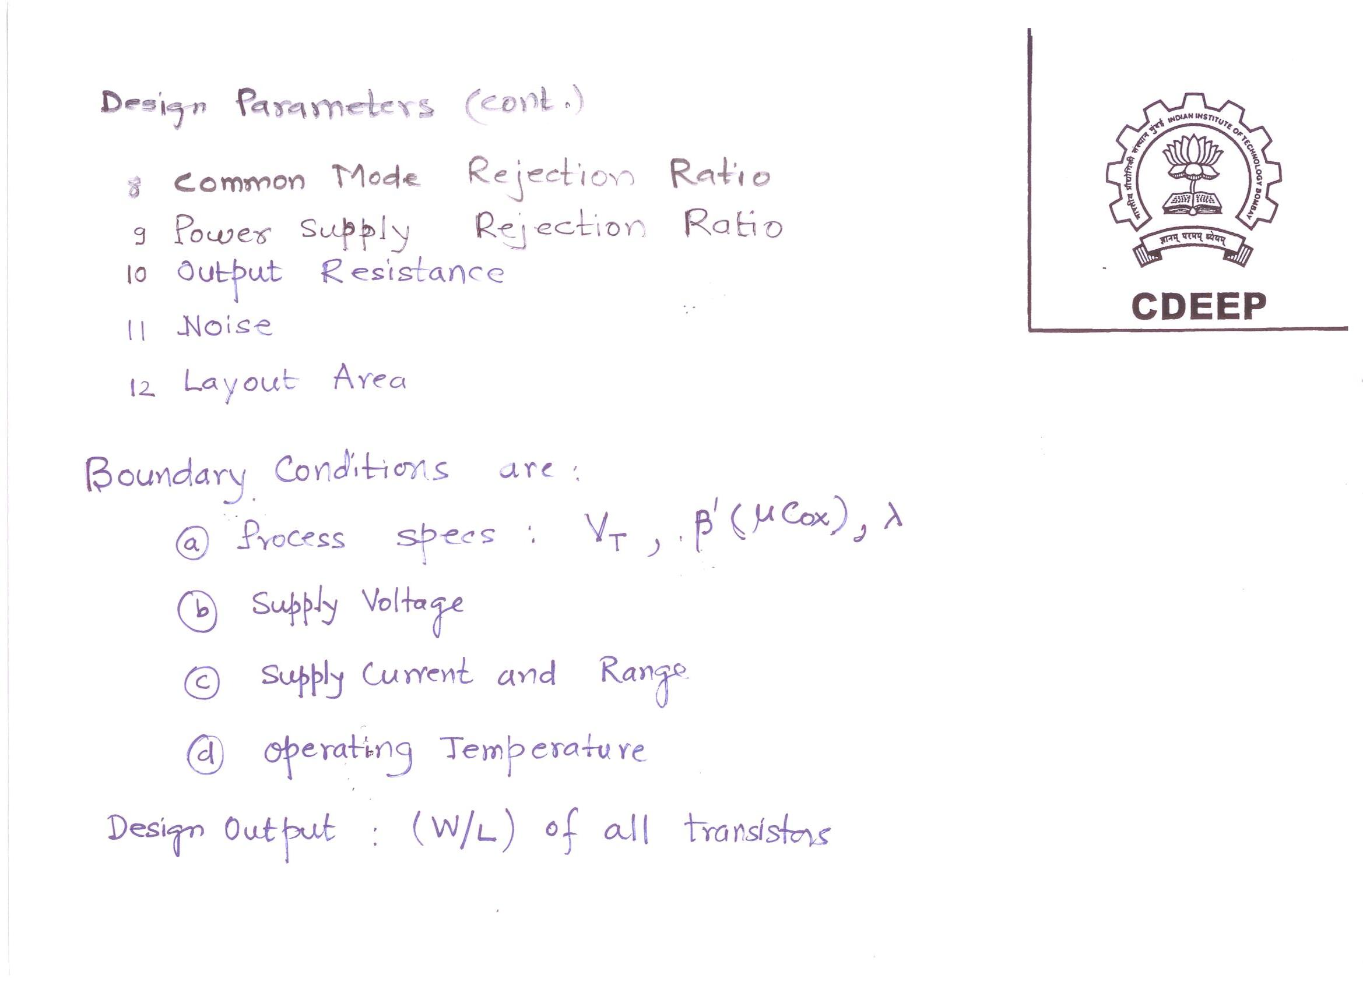

Slide 5
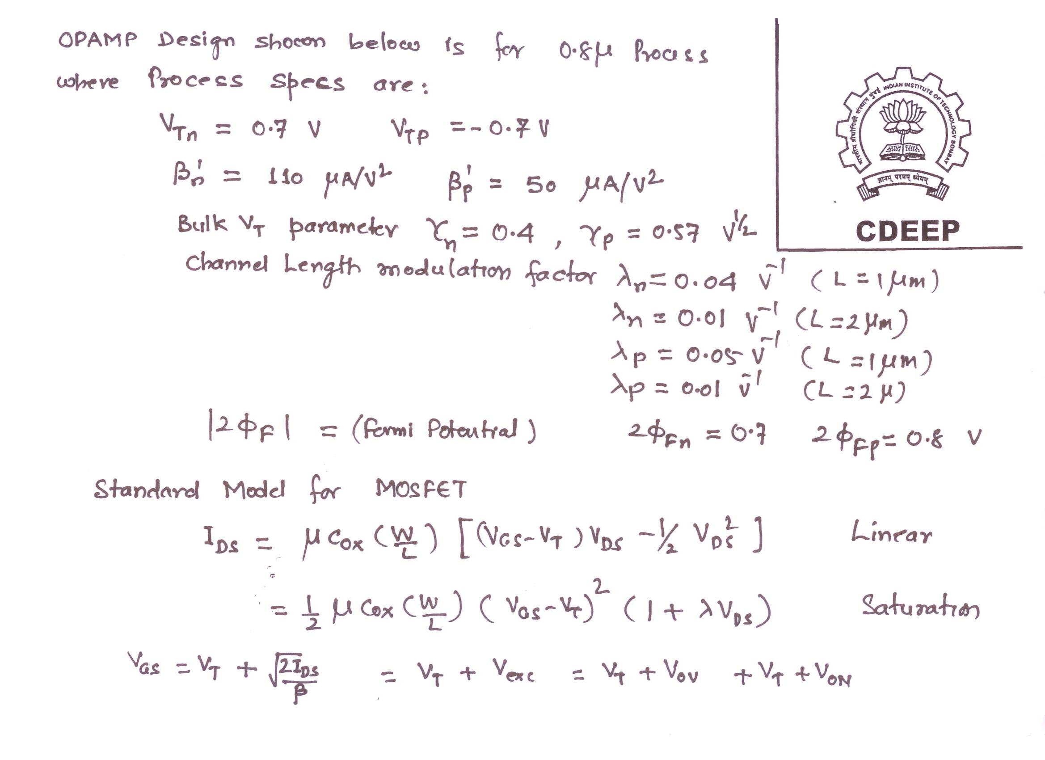

Slide 6
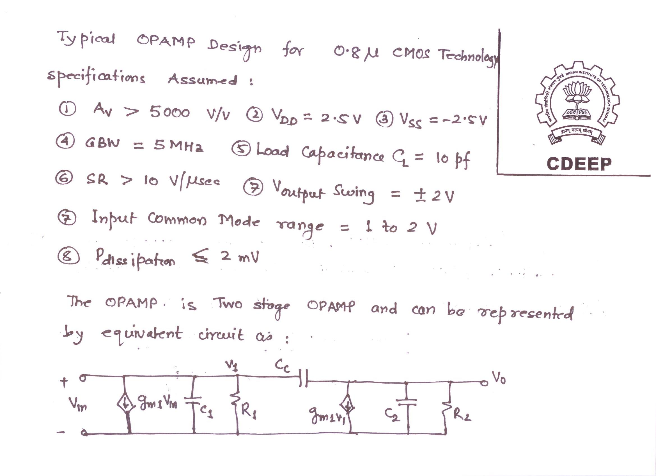

Slide 7
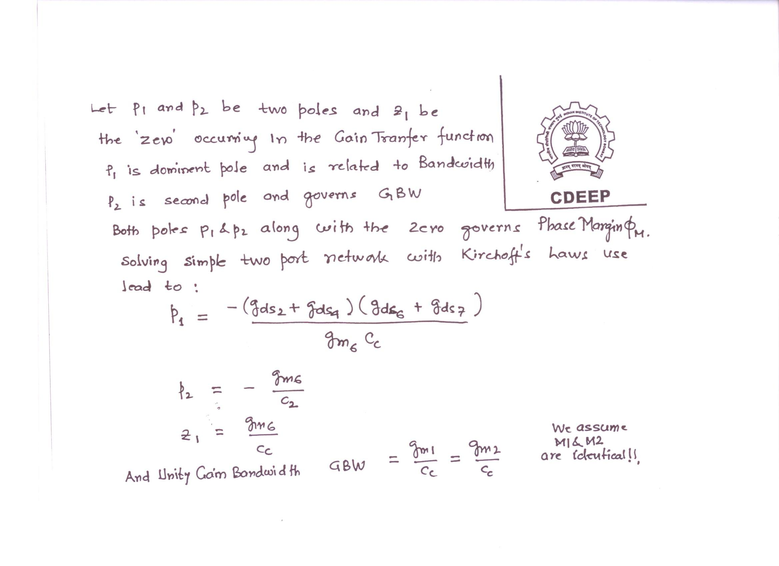

Slide 8
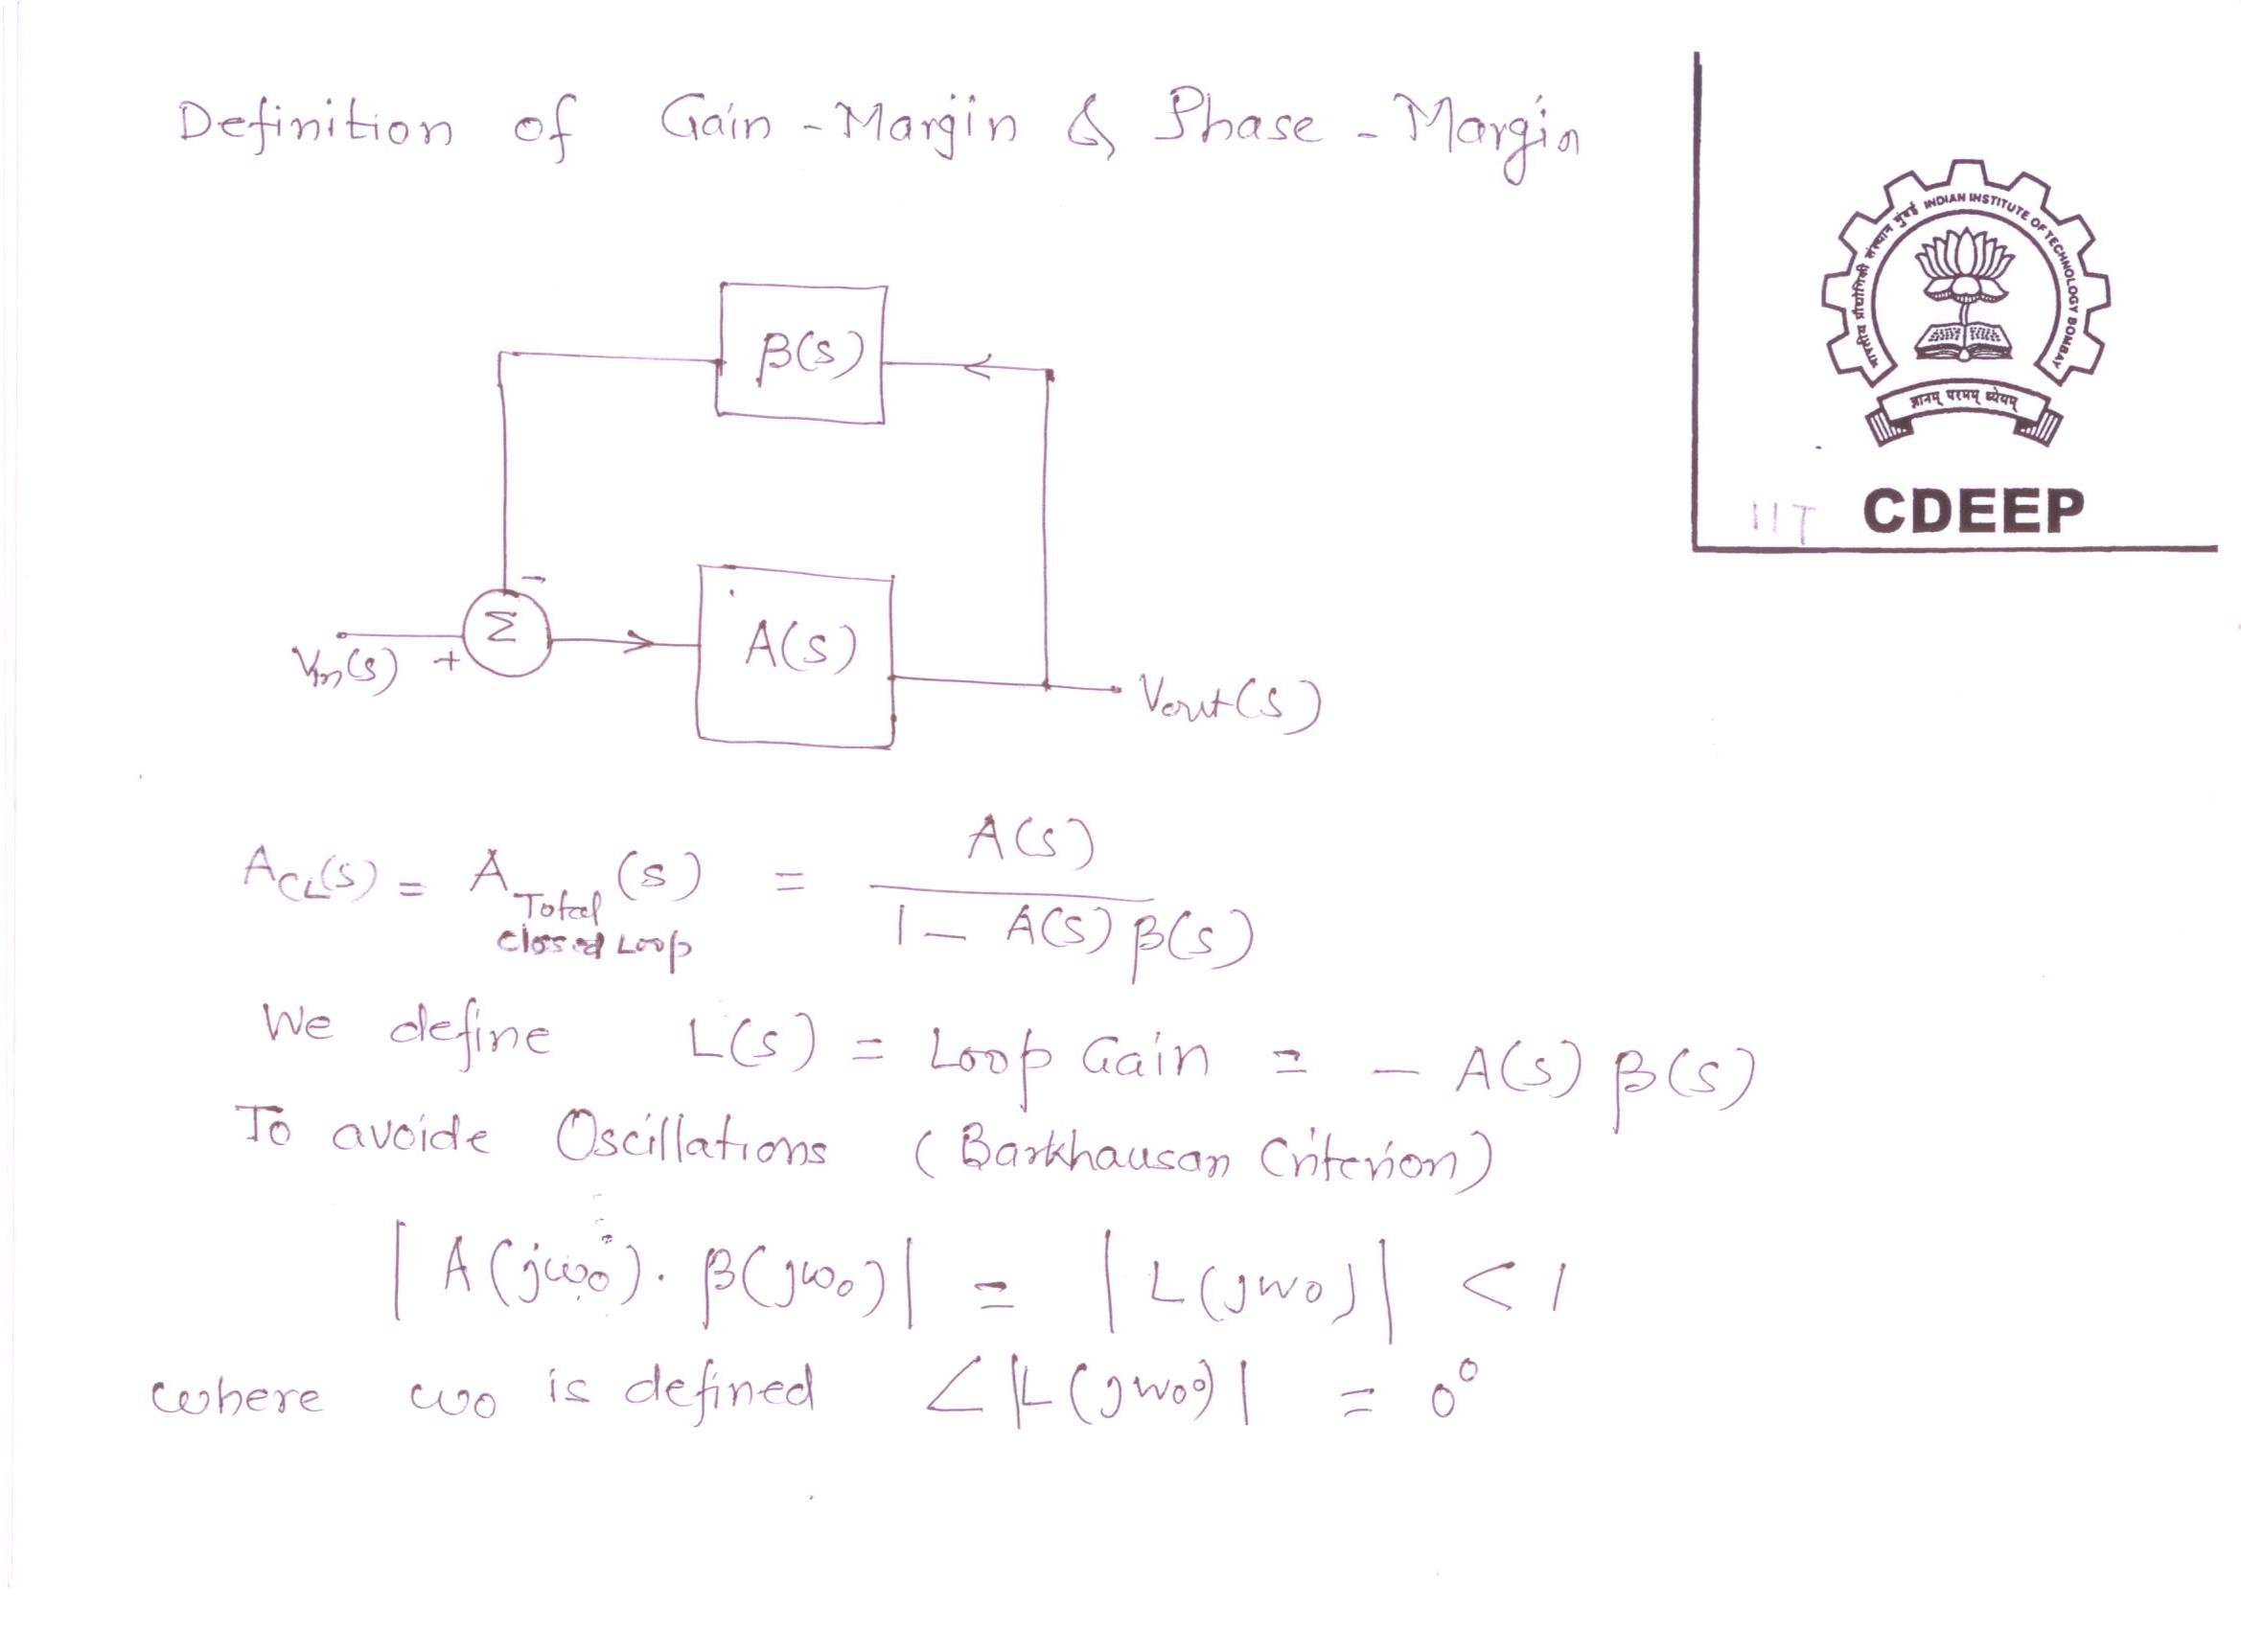

Slide 9
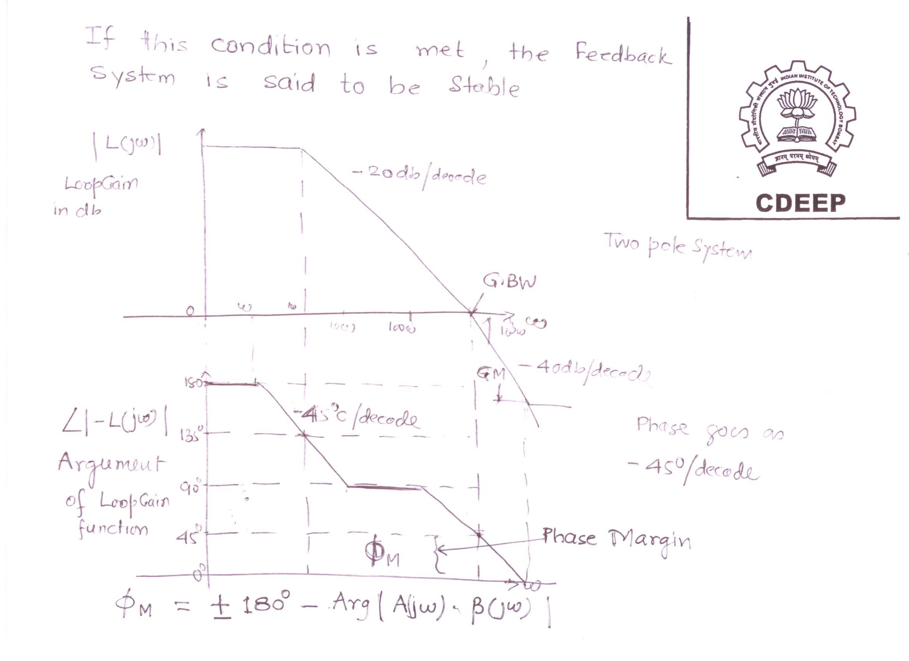

Slide 10
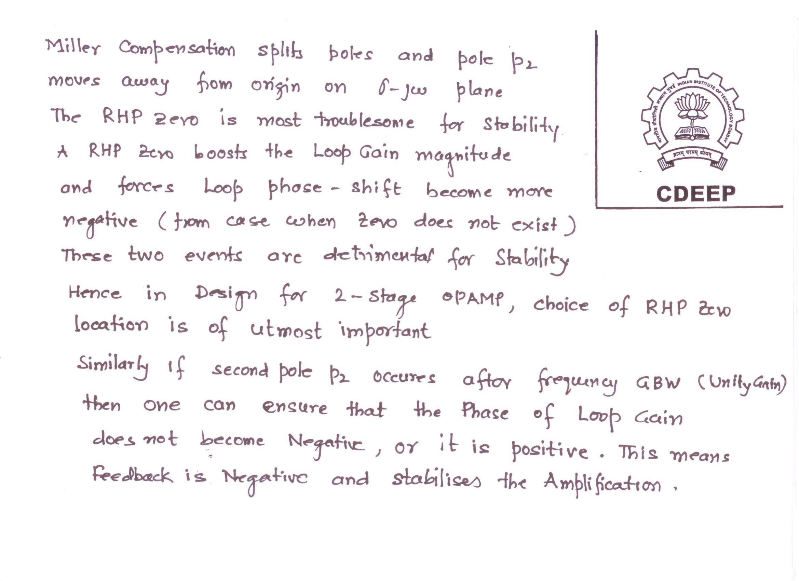

Slide 11
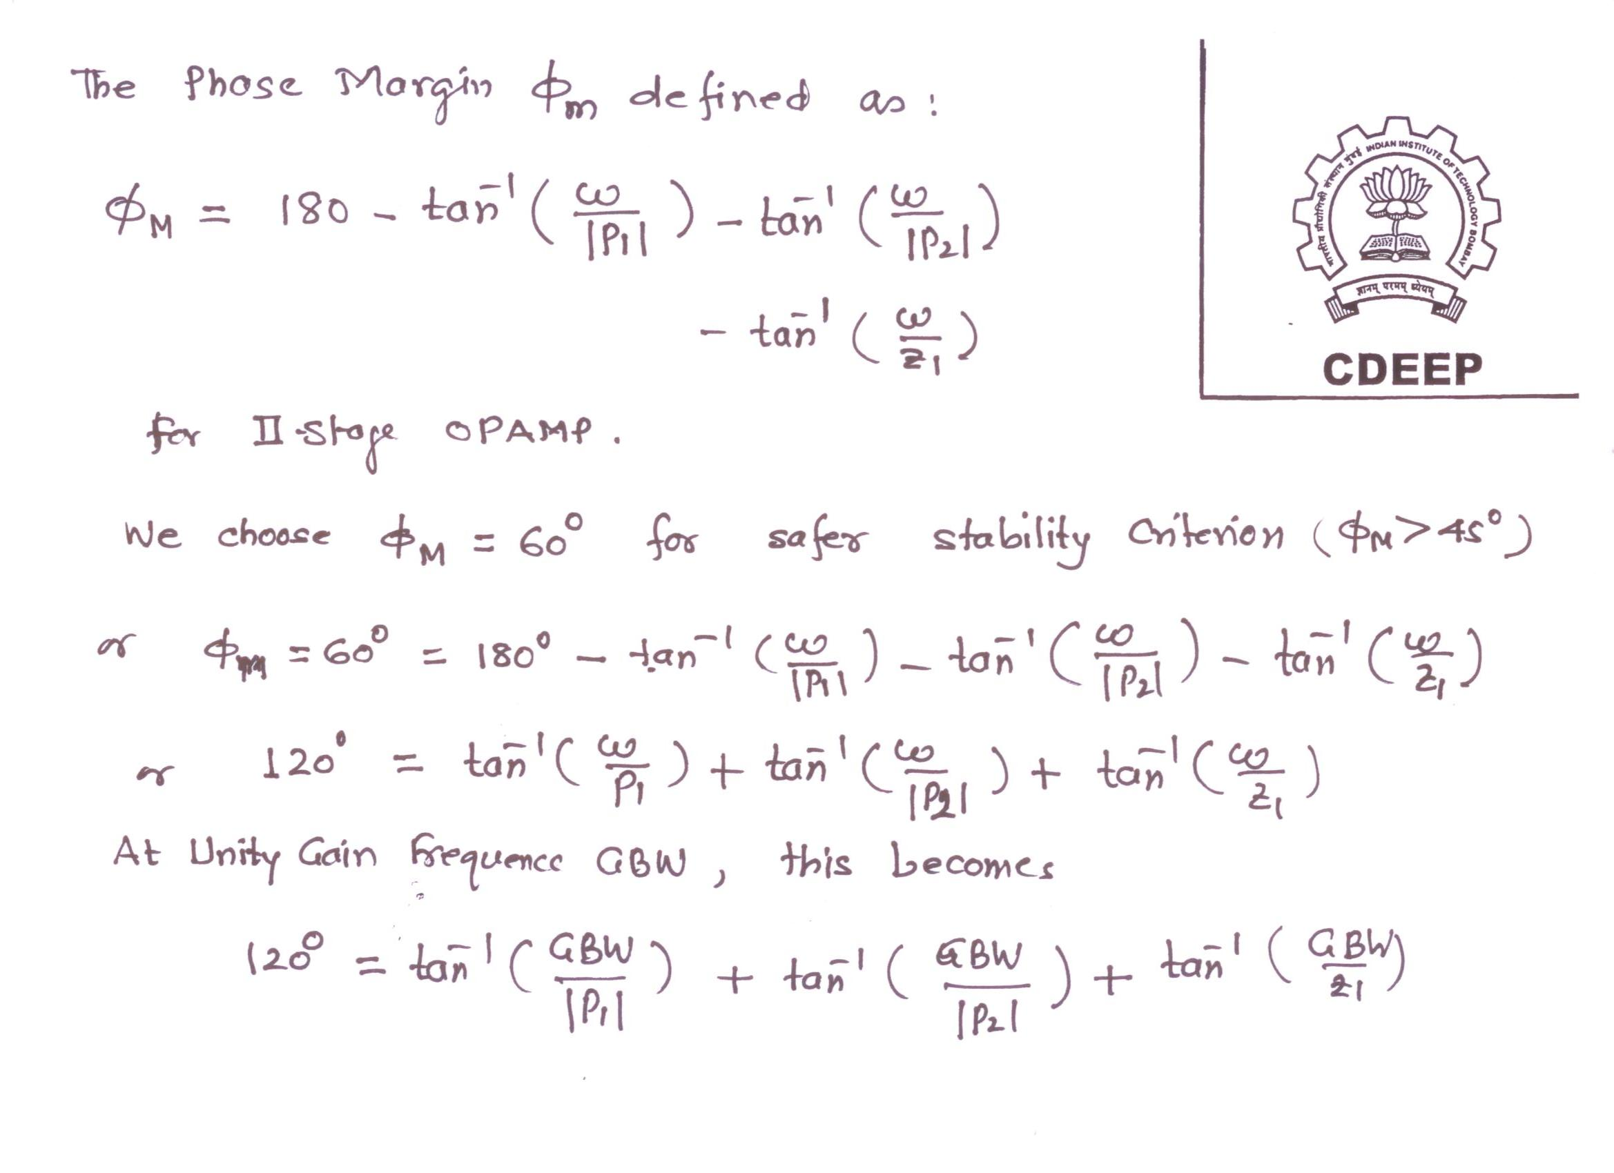

Slide 12
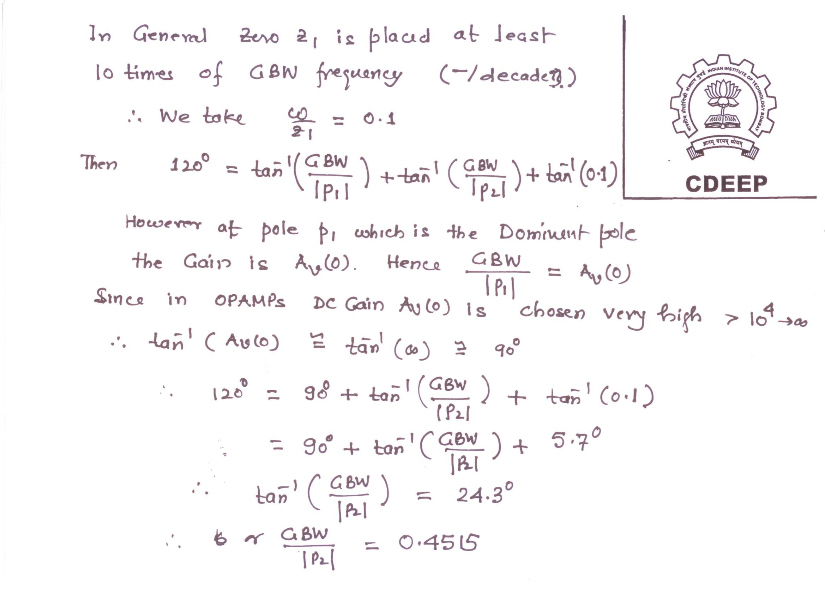

Slide 13
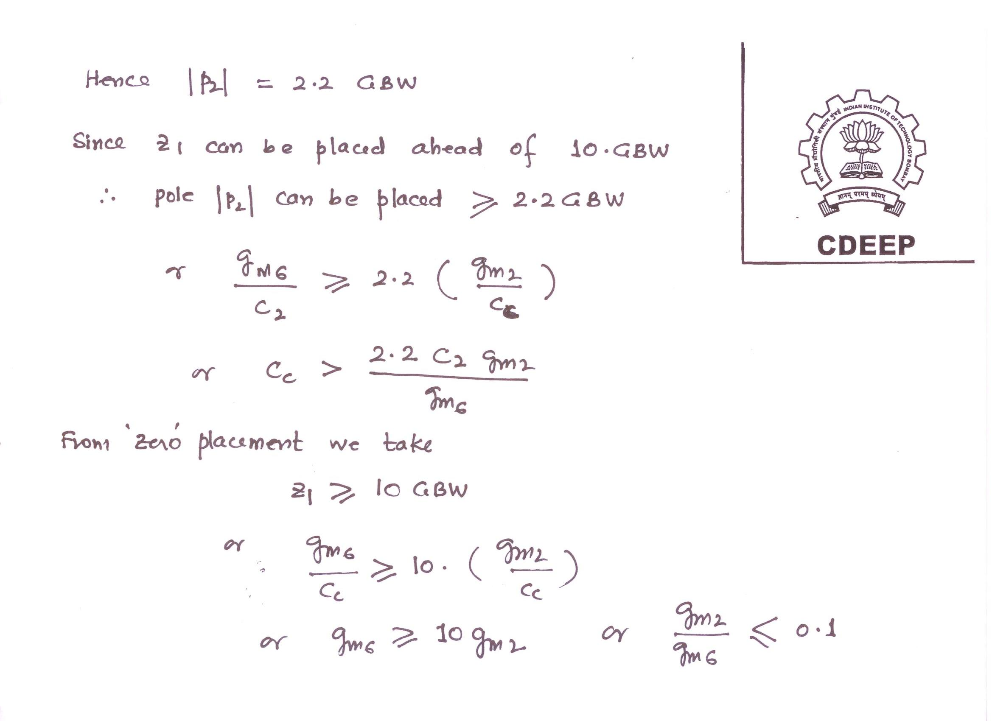

Slide 14
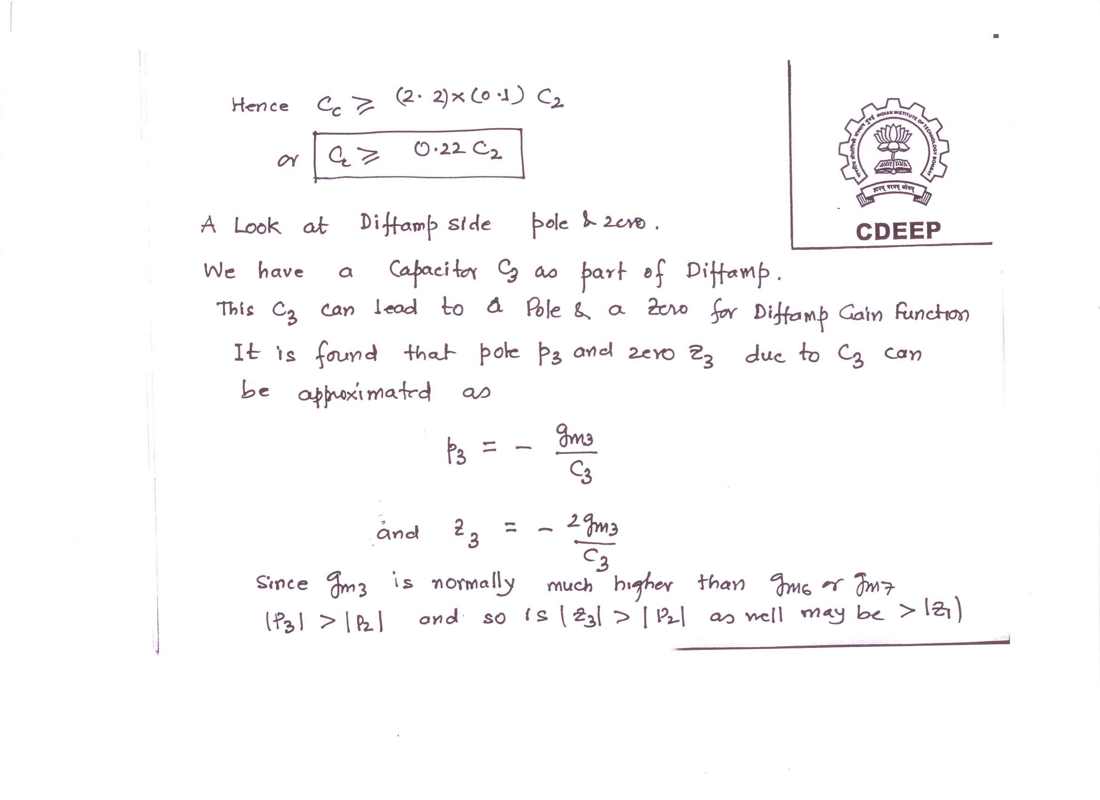

Slide 15
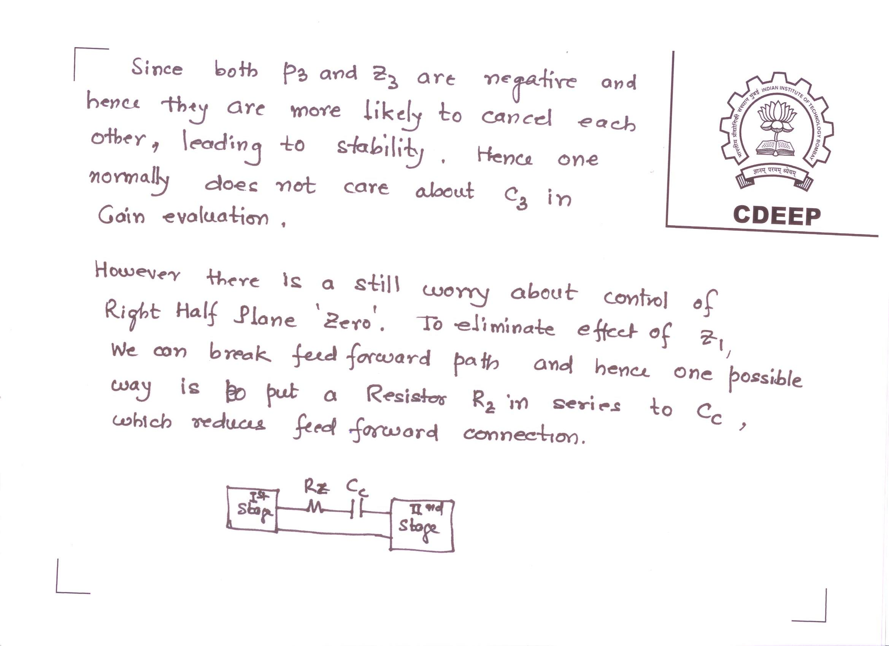

Slide 16
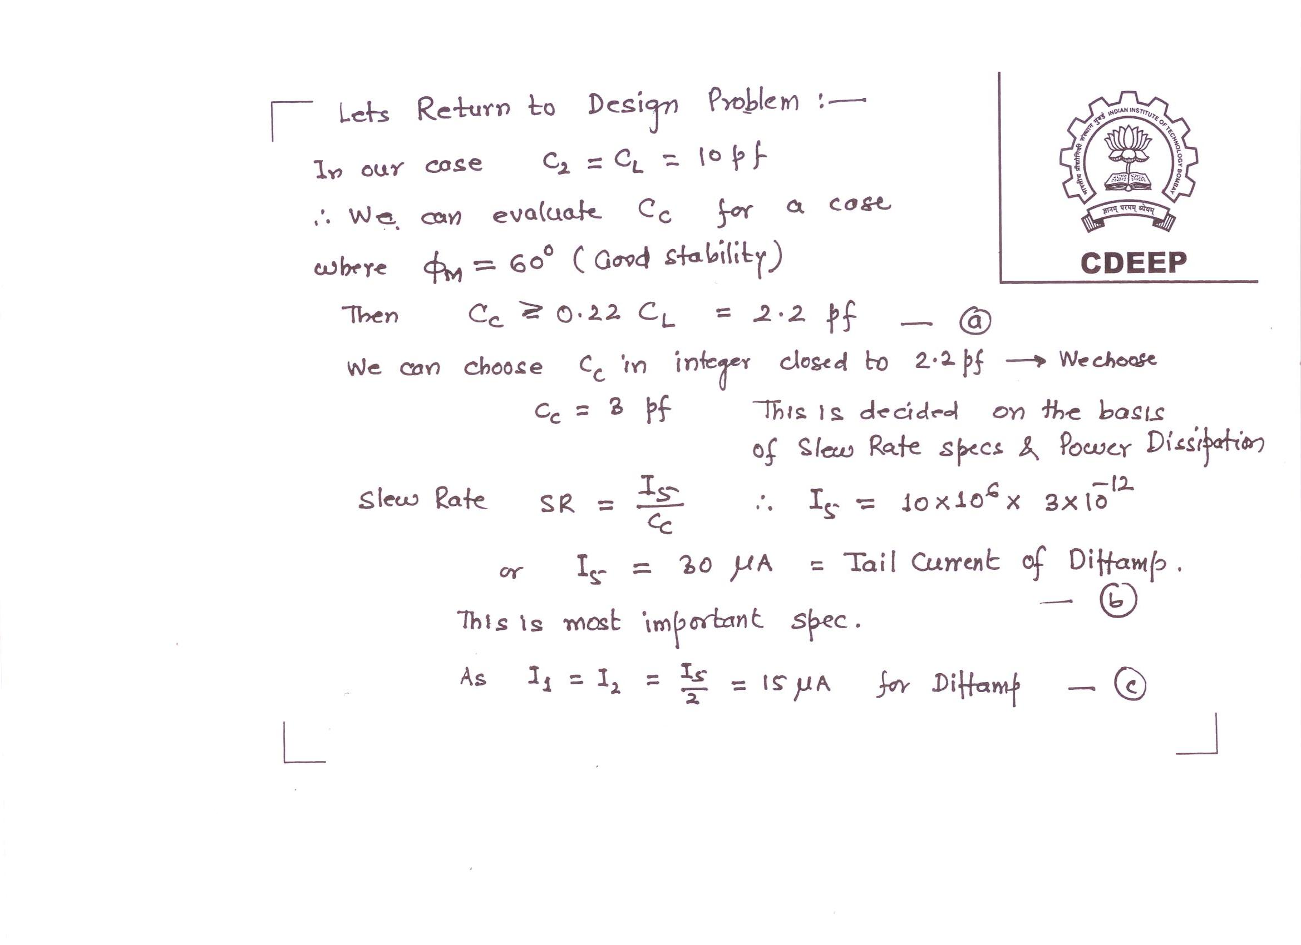

Slide 17
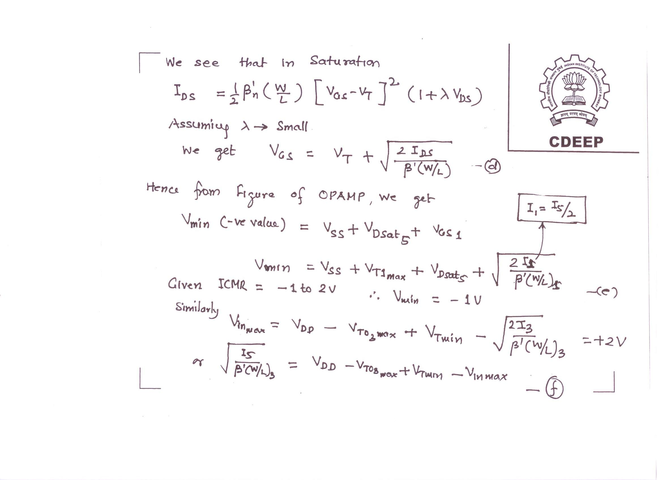

Slide 18
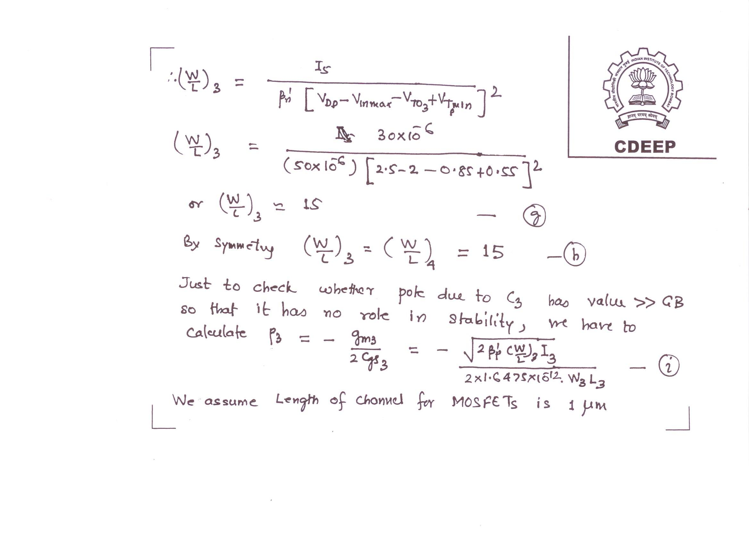

Slide 19
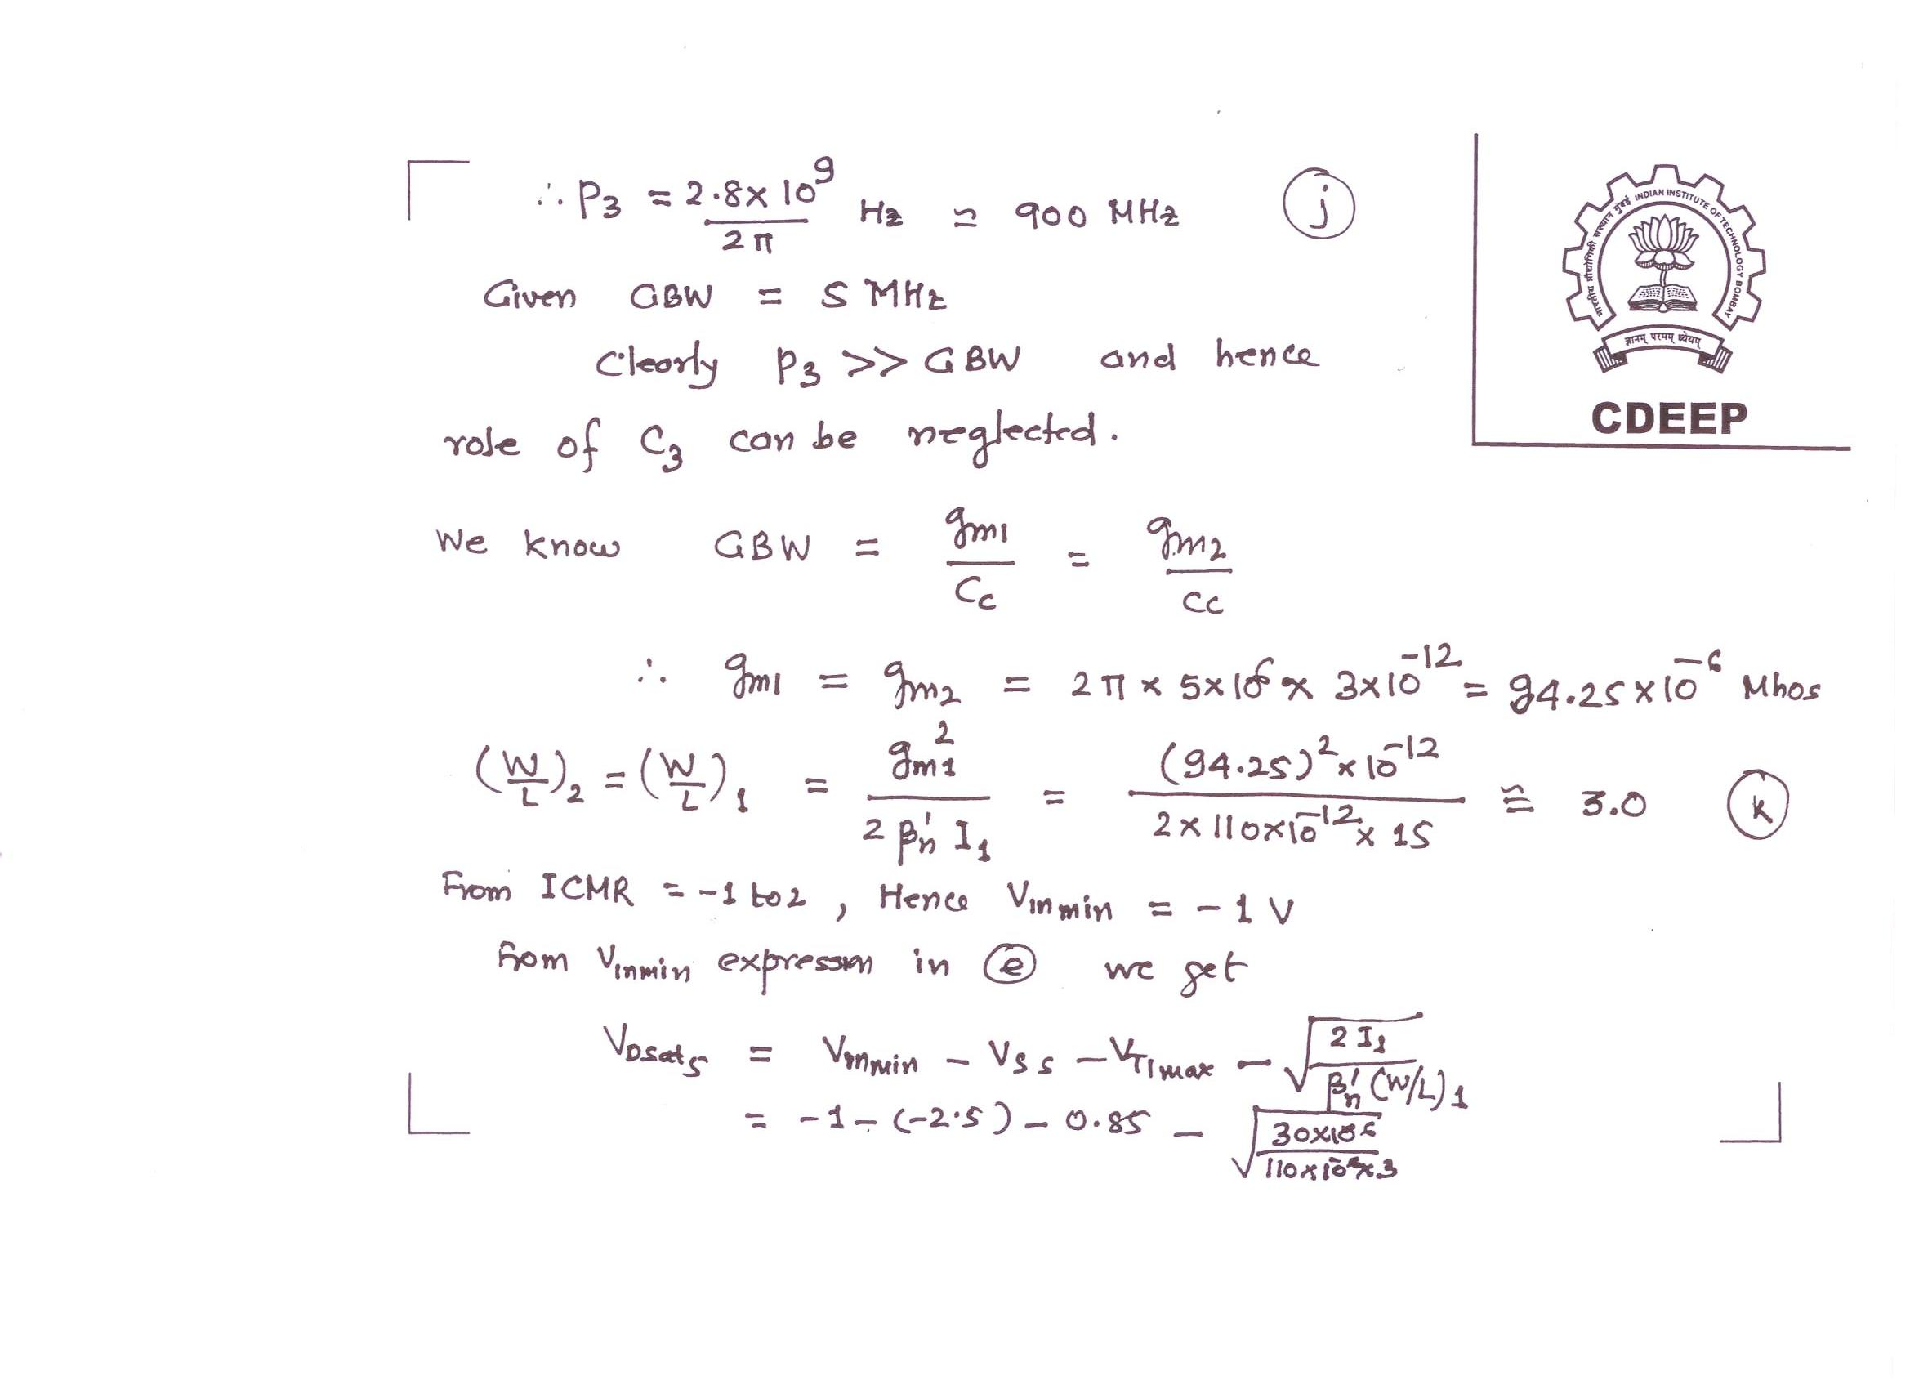

Slide 20
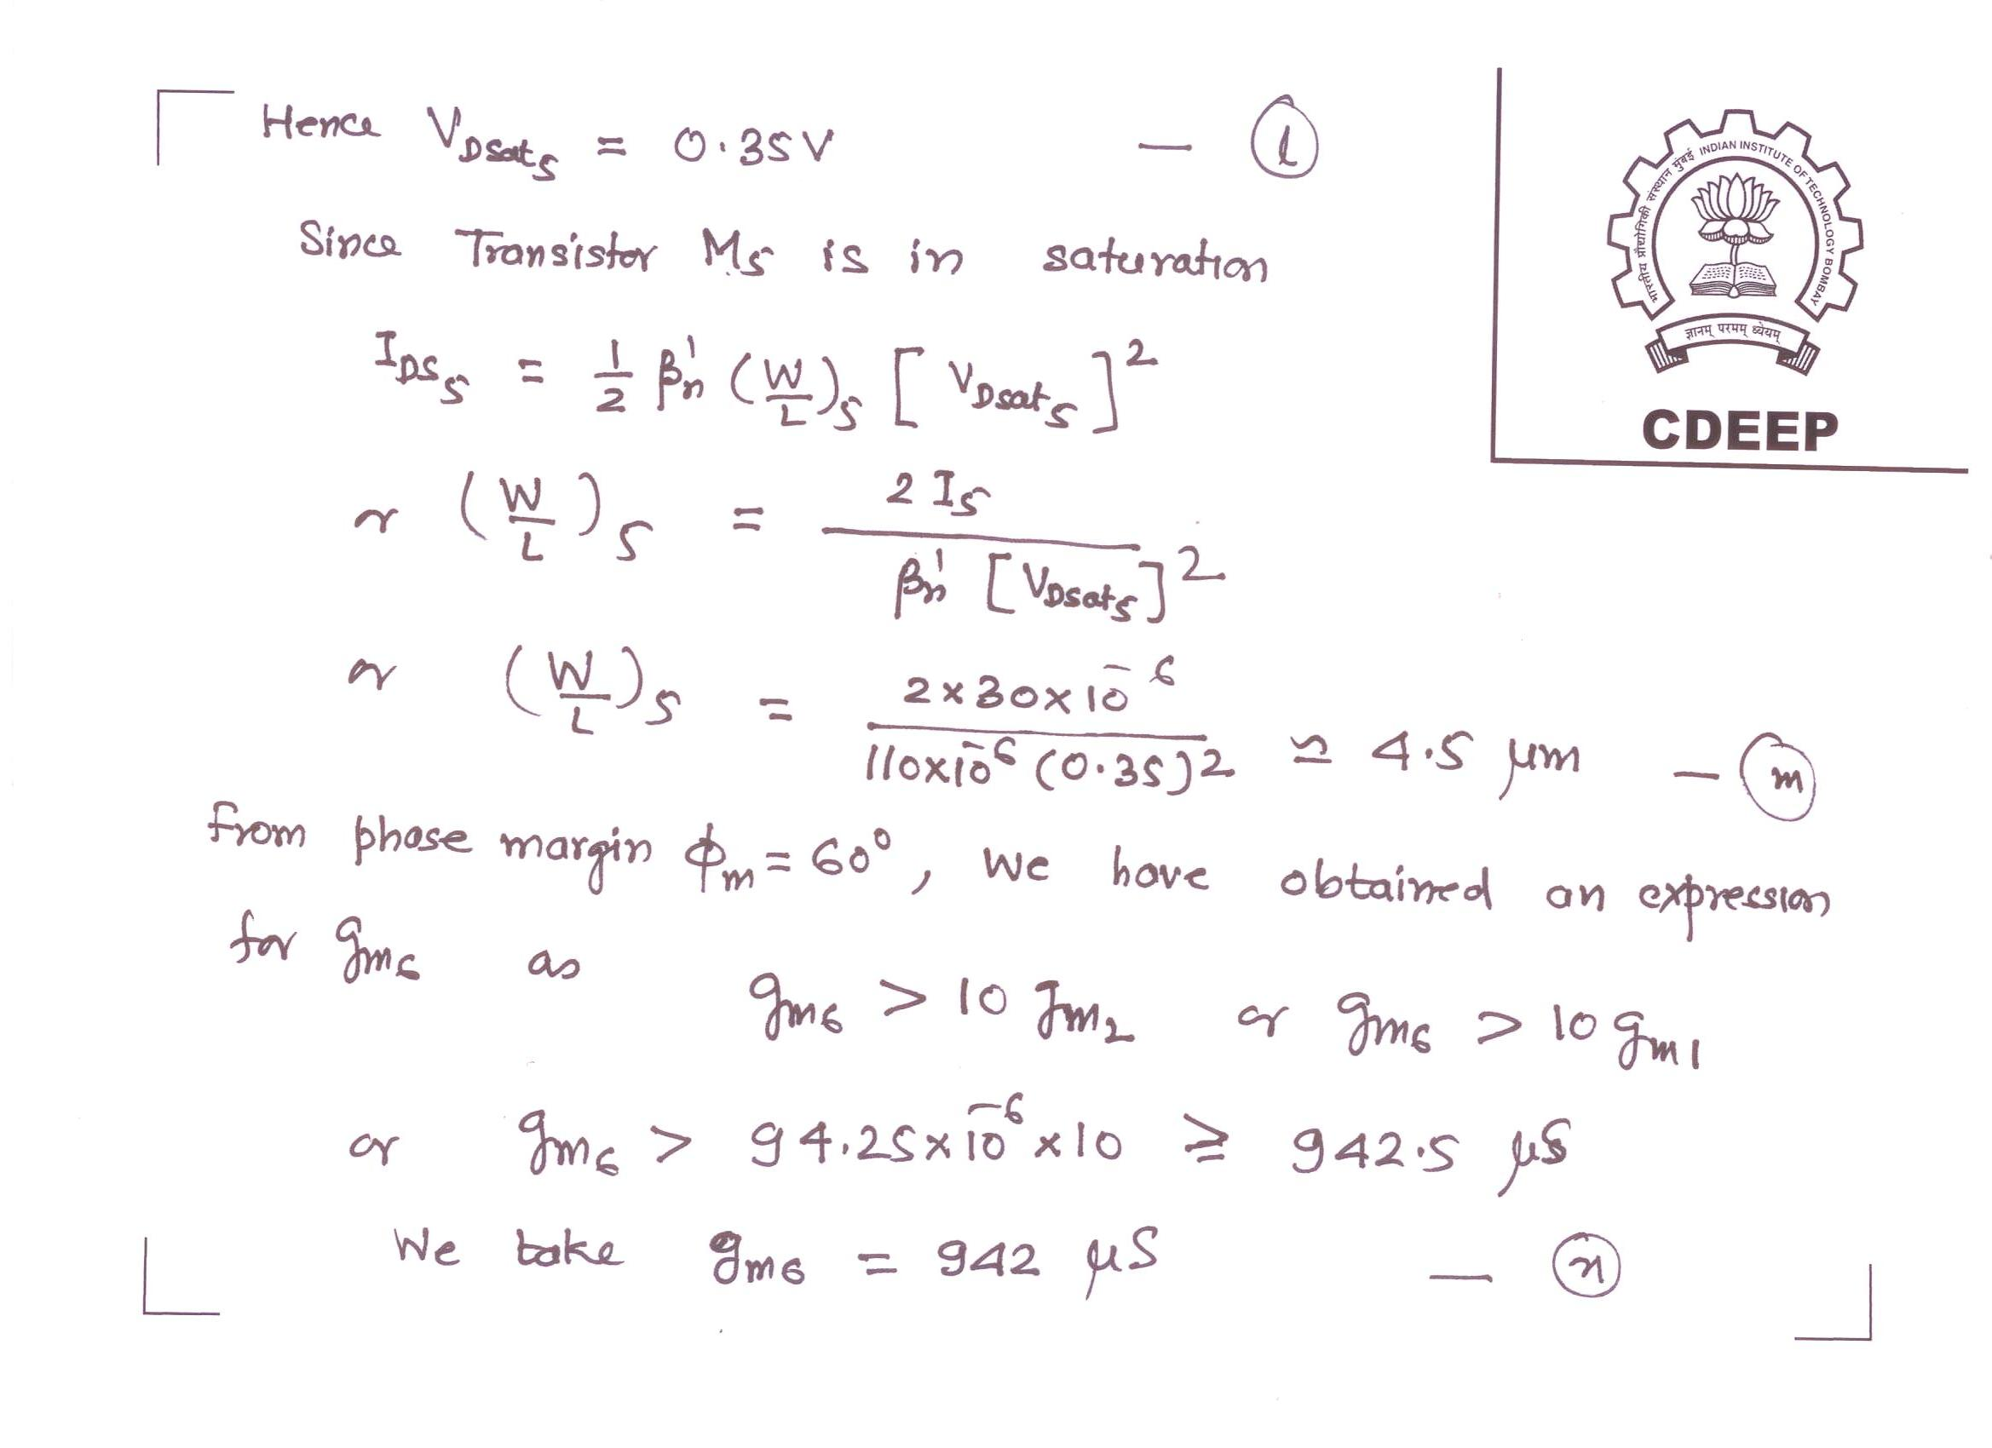

Slide 21
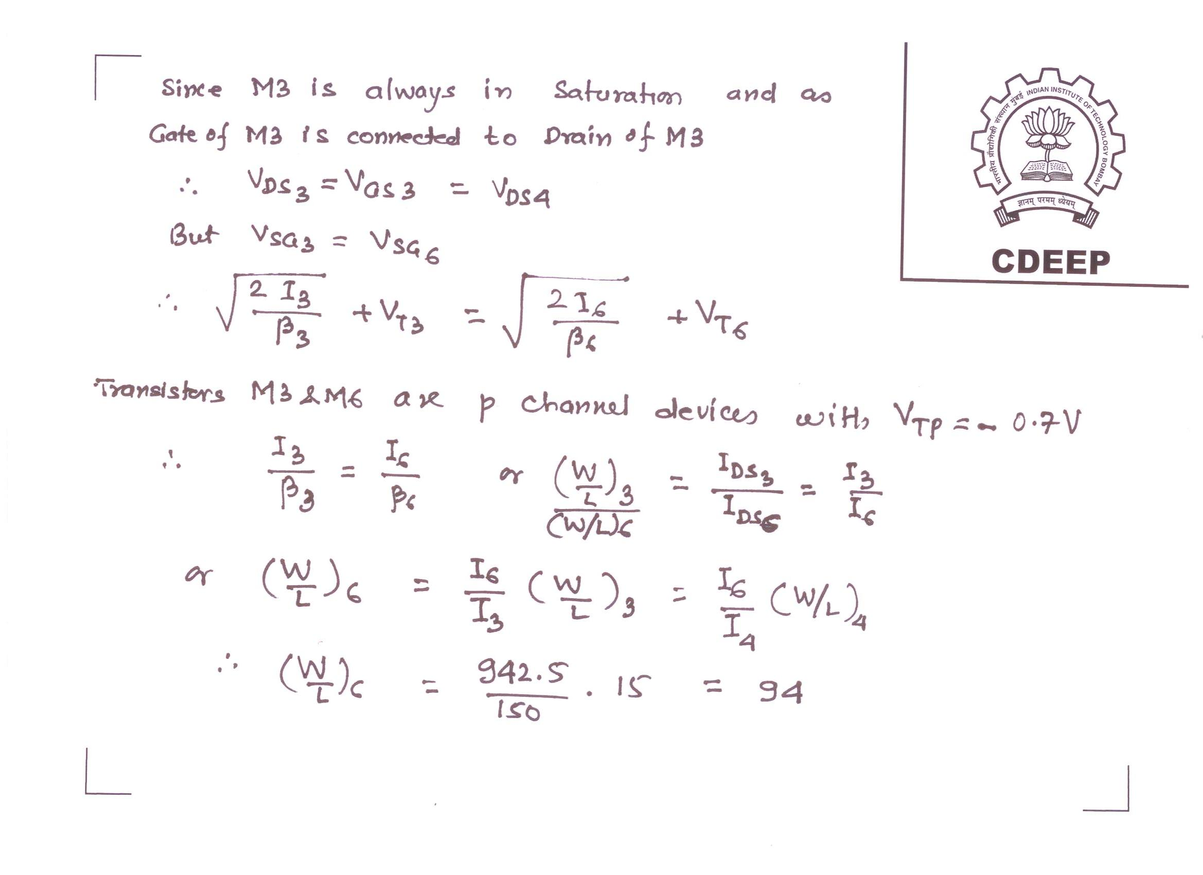

Slide 22
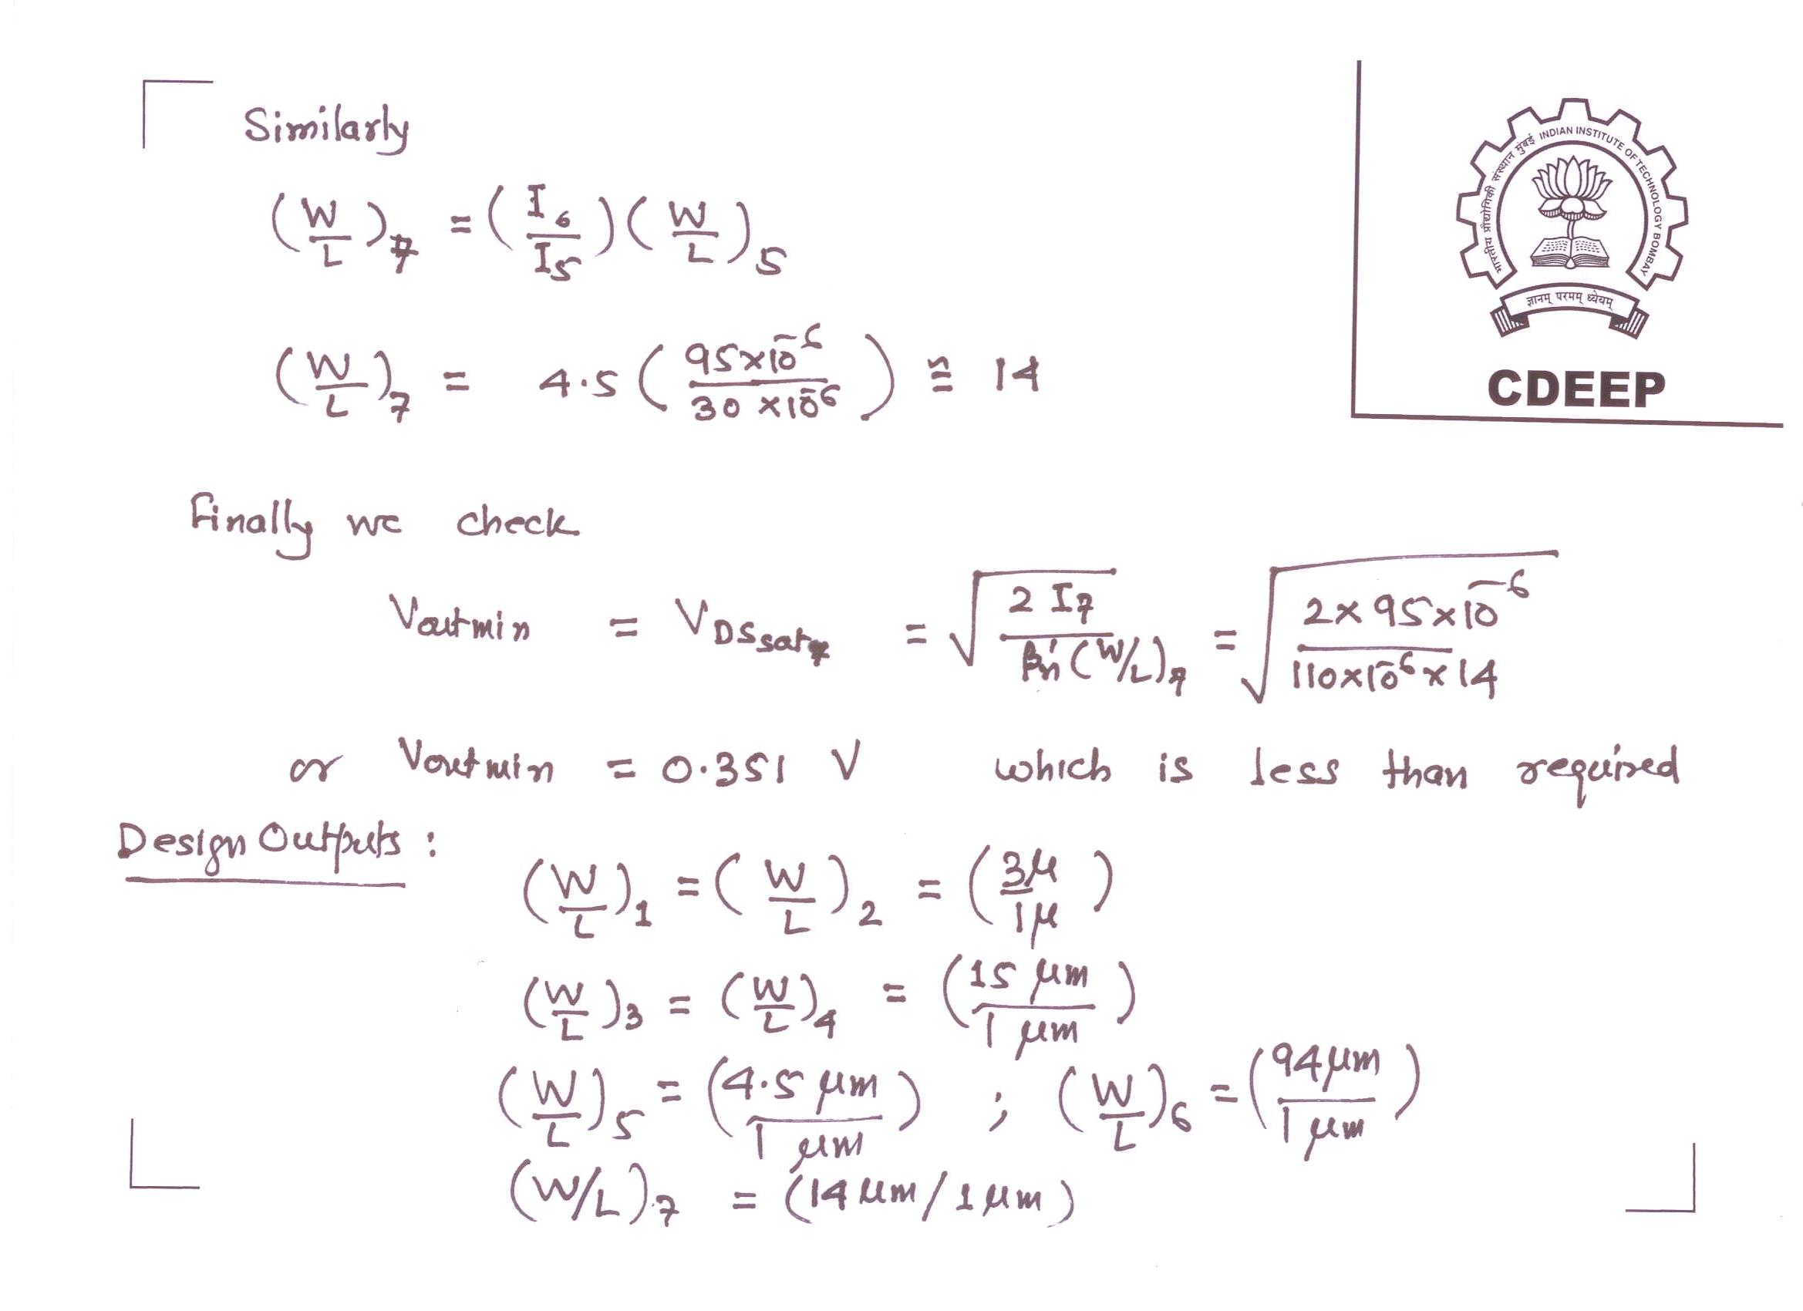

Slide 23
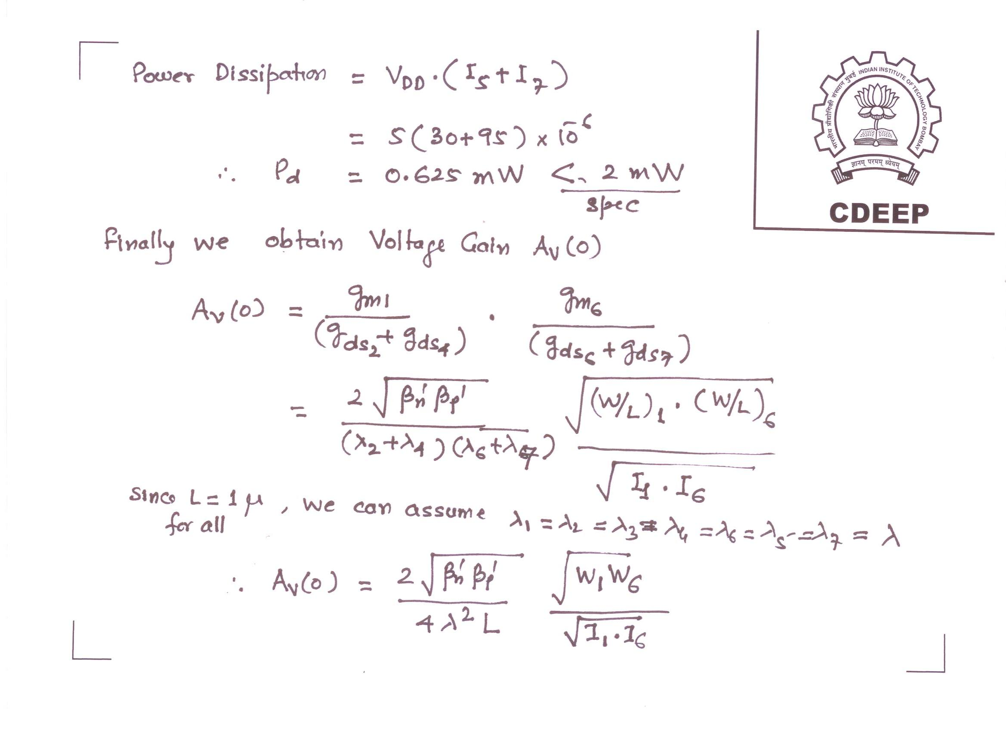

Slide 24
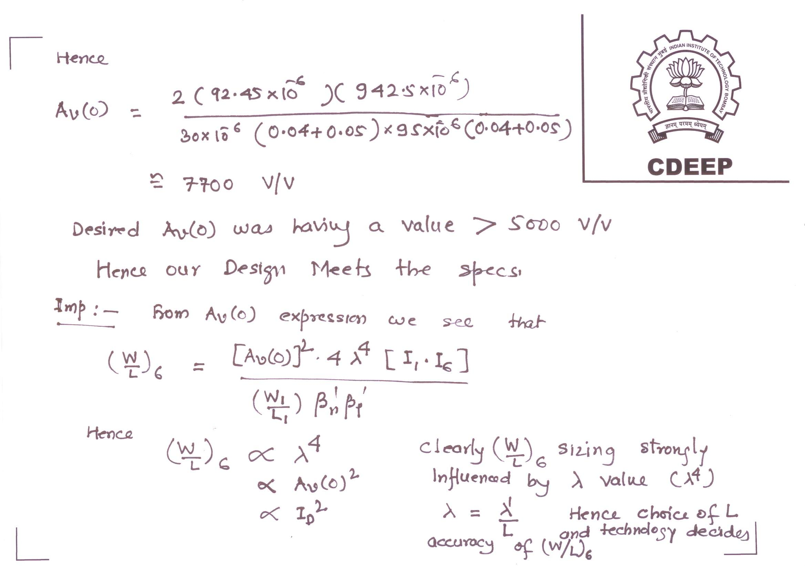

Slide 25
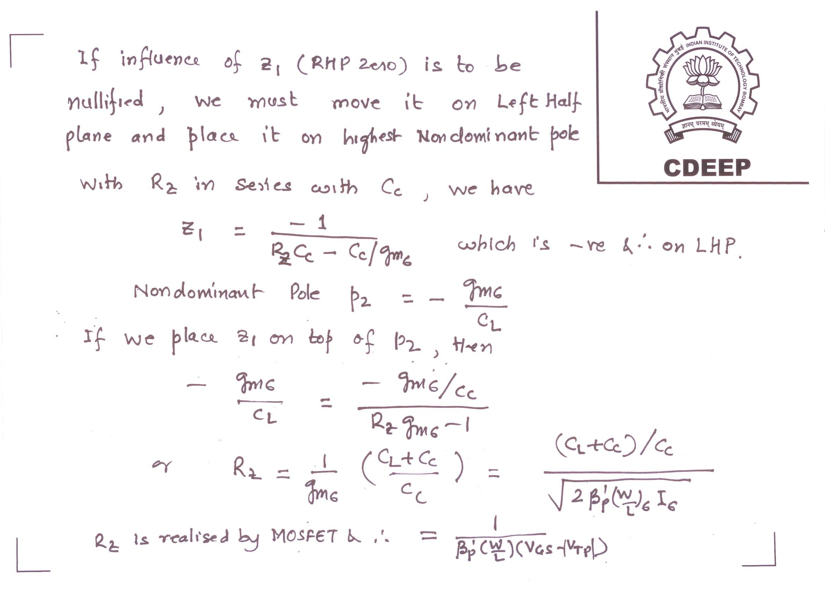

Slide 26
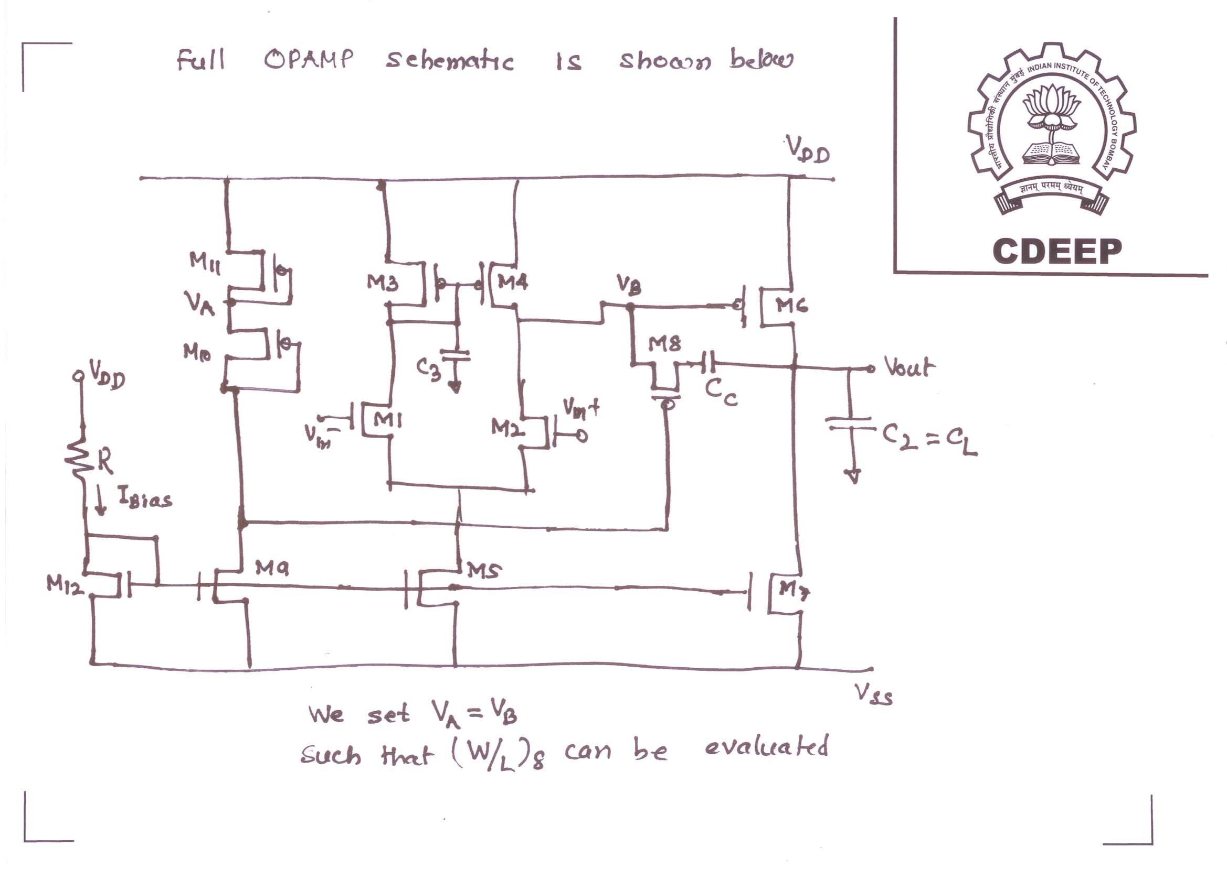

Slide 27
Acknowledgements
TO
My Graduate students of last 10 Years,
Who did their Projects
With me in Analog, Digital and RF Designs
&
Also those who participated in my courses in
“Digital VLSI Design”, “Analog VLSI Design”
VLSI technology, RF VLSI and System Design.
Thanks to authors who put their work on
Many Websites and they are as referred in the PPTs

Slide 28
Thank-you

