Slide 1
EE204: Analog Circuits
Lecture-1
Sandip Mondal
Assistant Professor IIT Bombay

Slide 2
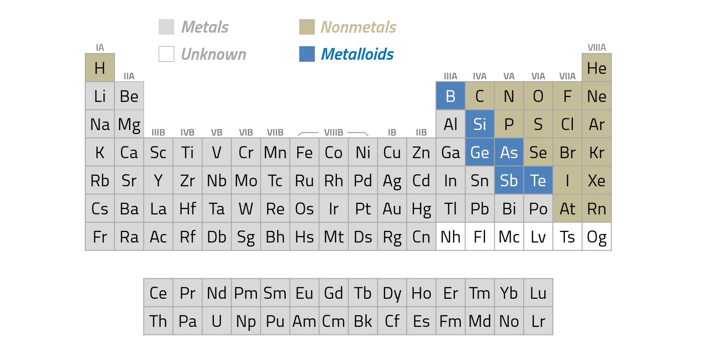
Extrinsic Semiconductors
n-Type (group IV)→ Al, B, Ga
p-Type (group III)→ P
2

Slide 3
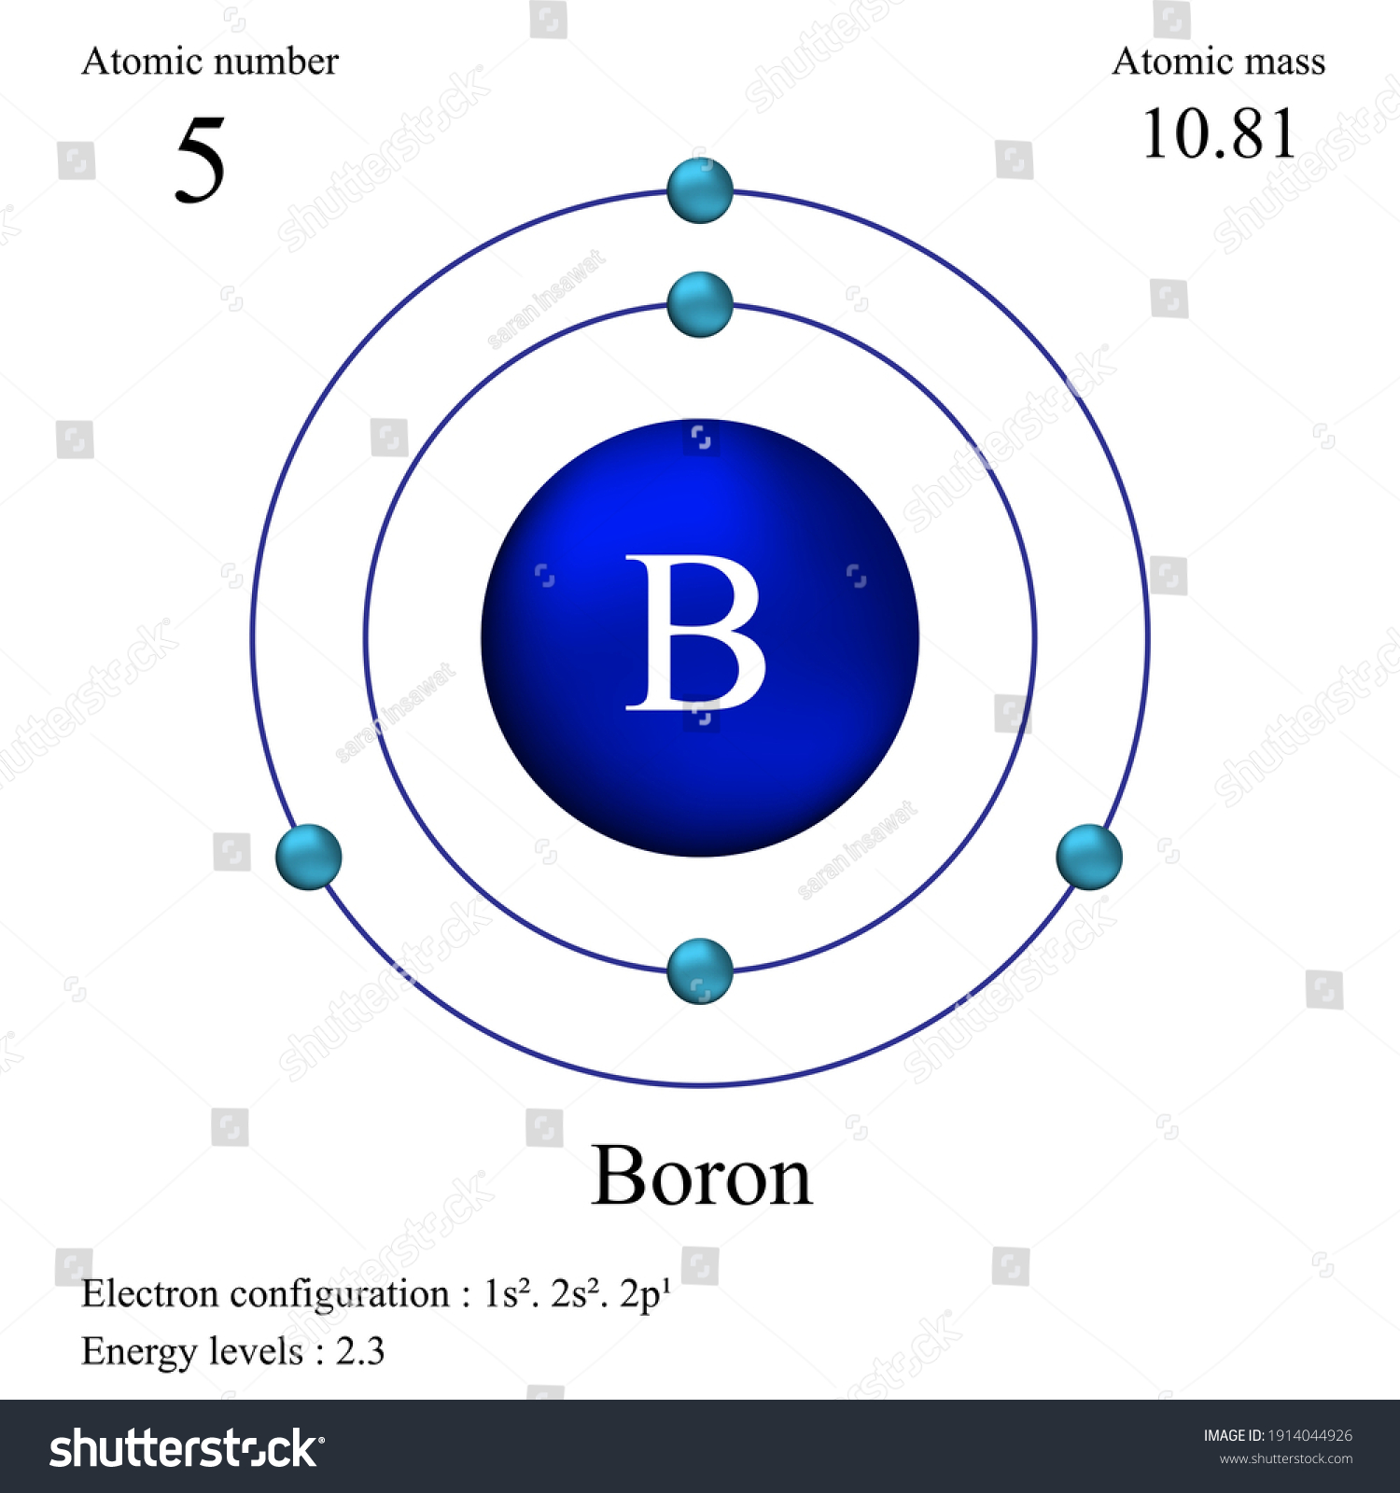
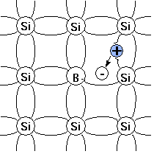
p-type Silicon Semiconductor
Atomic details of Boron
Doping in Silicon
3

Slide 4
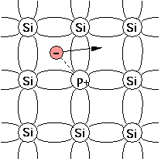
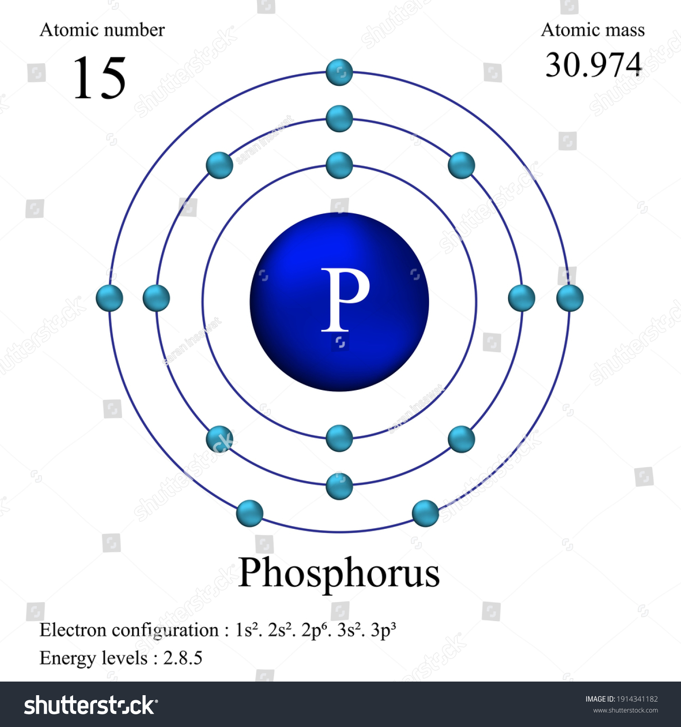
n-type Silicon Semiconductor
Atomic details of Phosphorus
Doping in Silicon
4

Slide 5
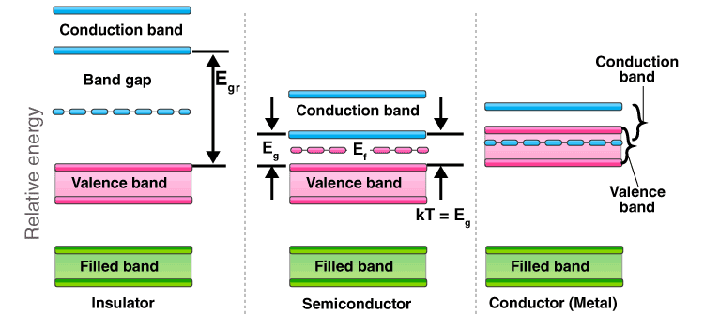
Energy Band Diagram
Metals: Resitivity~10⁻⁶ Ω cm
Semiconductors: resitivity~10⁻³ to 10⁹ Ω cm
Insulators: resitivity~10²² Ω cm
5

Slide 6
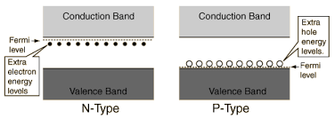
P and n-Type Semiconductors
http://hyperphysics.phy-astr.gsu.edu/hbase/Solids/dope.html
6

Slide 7
Diode
7

Slide 8
p-n Semiconductor (Diode)
p-Silicon
n-Silicon
8

Slide 9
p-n Semiconductor (Diode)
p-Silicon
n-Silicon
9

Slide 10
p-n Semiconductor (Diode)
Acceptor ion
p-Silicon
Junction
n-Silicon
Donner ion
+
-
+
-
+
-
+
-
+
-
+
-
Hole
+
+
Electron
-
-
+
-
+
-
+
-
+
-
+
-
+
-
+
-
-
+
-
+
-
+
+
+
+
-
-
-
-
-
-
+
+
+
+
-
+
-
+
-
-
+
-
+
-
+
10

Slide 11
p-n Semiconductor (Diode)
p-Silicon
Junction
n-Silicon
+
-
+
-
+
-
+
-
+
-
+
-
+
+
+
-
-
-
-
-
-
+
+
+
Concentration of Acceptor
Concentration of Donner
Concentration of hole
Concentration of electron
11

Slide 12
p-n Semiconductor (Diode)
p-Silicon
Junction
n-Silicon
+
-
+
-
+
-
+
-
+
-
+
-
+
+
+
-
-
-
-
-
-
+
+
+
Negative space charge
Positive space charge
+
-
$$V_{n}$$
$$V_{n}$$
$${−x}_{p}$$
$$x_{n}$$
$$V_{p}$$
$${−V}_{p}$$
Potential change across the junction
12

Slide 13
p-n Semiconductor (Diode)
p-Silicon
Junction
n-Silicon
+
-
+
-
+
-
+
-
+
-
+
-
+
+
+
-
-
-
-
-
-
+
+
+
P-type
}
$$E_{cp}$$
$$eV_{B}$$
n-type
$$E_{p}$$
$$E_{cn}$$
$$E_{vp}$$
$$E_{p}$$
$$E_{cp}−E_{cn}=E_{vp}=E_{B}=eV_{B}$$
$$E_{vn}$$
13

Slide 14
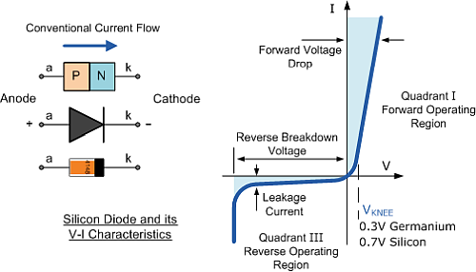
p-n Semiconductor (Diode)
14

Slide 15
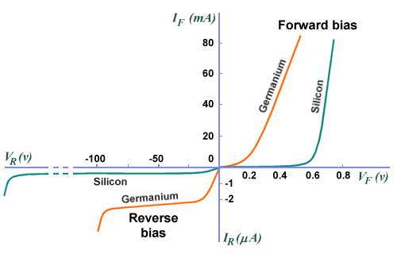
Ge and Si: p-n Diode
15

Slide 16
Concept Questions-1
The conductivity of Ge is 0.7/Ohm-meter and 0°C and 2/Ohm-meter 20°C. What is the bandgap of Ge? 4
Suppose a specimen of pure Ge is doped with one doner impurity atom in every ${10}^{8}$Ge atom. Find the conductivity and resistivity of doped Ge at 300K. (Standard atomic weight, density and electron mobility have to be considered at 300K) 3
Forbidden energy gap in a direct gap semiconductor is 1.43eV. Determine the wavelength of radiation emitted when a conduction band electron makes direct recombination with a valence band hole. 3
16

Slide 17
Induced Voltage: Transformer
$$V_{1}$$
$$\frac{V_{P}}{V_{S}} =\frac{N_{P}}{N_{S}}$$
$$Pri$$
$$Sec$$
$$N_{P}$$
$$N_{S}$$
Reference book: The Art of Electronics by Paul Horowitz and Windfield Hill
17

Slide 18
Application: p-n Diode
Rectifier
Half-wave Rectifier
$$V_{1}$$
$$R$$
$$Pri$$
$$Sec$$
$$Load$$
$$N_{P}$$
$$N_{S}$$
18

Slide 19
Application: p-n Diode: Rectifier
Dynamic characteristics
$$i_{a}$$
V
0
$$\frac{π}{ω}$$
$$\frac{2π}{ω}$$
$$\frac{3π}{ω}$$
t
0
$$\frac{π}{ω}$$
Half-wave Rectifier
$$\frac{2π}{ω}$$
$$\frac{3π}{ω}$$
t
19

Slide 20
Application: p-n Diode
Full-wave Rectifier
Outputs
D1
0
$$T$$
$$+$$
$$+$$
$$R$$
$$i_{a1}$$
$$i_{a1}$$
$$v$$
$$i_{L}$$
$$0$$
0
$$−$$
$AC$Mains
$$+$$
$$i_{a2}$$
$$v$$
$$i_{a2}$$
0
$$−$$
$$−$$
$$i_{L}$$
0
$$\frac{π}{ω}$$
$$\frac{2π}{ω}$$
$$\frac{3π}{ω}$$
$$\frac{4π}{ω}$$
t
D2
20

Slide 21
Application: p-n Diode: Bridge Rectifier
B
$$T$$
$$+$$
$$+$$
D1
D2
A
C
E
$AC$Mains
$$−$$
$$−$$
$$R_{L}$$
D3
D4
S
D
F
During +Ve half cycle: D2 and D3 are forward bias and D4 and D1 are reversed bias
Current through: BCEFADSB
During -Ve half cycle: D1 and D4 are forward bias and D3 and D2 are reversed bias
Current through: DCEFABSD
21

Slide 22
Application: p-n Diode: Bridge Rectifier
D1
D2
$$+$$
Different Design
$$+$$
$$−$$
$$T$$
$$R$$
$$−$$
$AC$Mains
What is the advantage of a bridge rectifier?
D3
D4
What is the disadvantage of a bridge rectifier?
22

