Slide 1
EE204: Analog Circuits
Lecture-2
Sandip Mondal
Assistant Professor IIT Bombay

Slide 2
Analysis: Half Wave Rectifier
$$v=v_{a}+v_{L}$$
$r_{a}=$Diode resistance
$$v={i_{a}r}_{a}+{i_{a}R}_{L}$$
$R_{L}=$Load resistance
$$i_{a}$$
$$R_{L}$$
AC
$$v$$
$$v={i_{a}(r}_{a}+R_{L})$$
$$v=v_{m}\sin{ωt}+v_{a}$$
$v_{m}=$Peak inverse voltage if input
$$i_{a}=v{/(r}_{a}+R_{L})$$
$I_{m}=$Peak inverse value of diode
For half cycle $0≤t≤\frac{T}{2}$
For next half cycle $\frac{T}{2}≤t≤T$
$i_{a}=\frac{v_{m}}{{(r}_{a}+R_{L})}\sin{ωt}=I_{m}$ $\sin{ωt}$
Diode is reverse bias
$$i_{a}=0$$
2

Slide 3
Half Wave Rectifier: DC component of current
$$I_{dc}=\frac{\int_{0}^{T}{i_{a}dt}}{\int_{0}^{T}{dt}}=\frac{1}{T}\int_{0}^{T}{i_{a}dt}$$
$$v_{L}$$
$$i_{a}$$
$$R_{L}$$
AC
$$v$$
$$=\frac{1}{T}\left[\int_{0}^{\frac{T}{2}}{i_{a}dt}+\int_{\frac{T}{2}}^{T}{i_{a}dt}\right]$$
$$=\frac{1}{T}\left[\int_{0}^{\frac{T}{2}}{I_{m} \sin{ωt}dt}\right]$$
$i_{a}=I_{m}$ $\sin{ωt}$
3

Slide 4
Half Wave Rectifier: DC component of current
$$I_{dc}=\frac{1}{T}\left[\int_{0}^{\frac{T}{2}}{I_{m} \sin{ωt}dt}\right]$$
$$i_{a}$$
$$R_{L}$$
AC
$$v$$
$$=\frac{I_{m}}{ωT}{\left[\cos{ωt}\right]}_{0}^{\frac{T}{2}}$$
$$=\frac{I_{m}}{2π}\left[−\cos{π}−cos0\right]$$
$$=\frac{I_{m}}{2π}\left[−\left(−1\right)+1\right]$$
$$=\frac{I_{m}}{π}$$
$$T=\frac{2π}{ω}$$
4

Slide 5
Half Wave Rectifier: DC component of current
$$I_{rms}=\frac{1}{2π}\left[\int_{0}^{π}{I_{m}^{2}\sin^{2}ωt d(ωt)}\right]$$
$$i_{a}$$
$$R_{L}$$
AC
$$v$$
$$=\frac{I_{m}^{2}}{4}$$
5

Slide 6
Half Wave Rectifier: Power dissipated in load
$$P_{dc}=I_{dc}^{2}R_{L}$$
$$i_{a}$$
$$R_{L}$$
AC
$$R_{L}$$
$$=\frac{I_{m}^{2}}{π^{2}}R_{L}$$
$$v$$
$$P_{dc}=\frac{v_{m}^{2}}{π^{2}{(r_{a}+R_{L})}^{2}}R_{L}$$
6

Slide 7
Half Wave Rectifier: Input AC power from Source
$$P_{ac}=\frac{\int_{0}^{T}{vi_{a}dt}}{\int_{0}^{T}{dt}}=\frac{1}{T}\int_{0}^{T}{{vi}_{a}dt}$$
$$i_{a}$$
$$R_{L}$$
AC
$$v$$
$$=\frac{1}{T}\left[\int_{0}^{\frac{T}{2}}{{vi}_{a}dt}+\int_{\frac{T}{2}}^{T}{vi_{a}dt}\right]$$
$$=\frac{1}{T}\left[\int_{0}^{\frac{T}{2}}{v_{m}\sin{ωt}I_{m}\sin{ωt}dt}\right]$$
7

Slide 8
Half Wave Rectifier: Input AC power from Source
$$P_{ac}=\frac{1}{T}\left[\int_{0}^{T/2}{v_{m}\sin{ωt}I_{m}\sin{ωt}dt}\right]$$
$$i_{a}$$
$$R_{L}$$
AC
$$v$$
$$=\frac{v_{m}I_{m}}{T}\int_{0}^{T/2}{\sin^{2}ωt dt}$$
$$=\frac{v_{m}I_{m}}{2T}\int_{0}^{T/2}{(1−{cosωt) dt}}$$
$$P_{ac}=\frac{v_{m}I_{m}}{4}=\frac{v_{m}}{4}\frac{v_{m}}{{(r}_{a}+R_{L})}$$
8

Slide 9
Half Wave Rectifier: Efficiency
$$η_{hwr}=\frac{P_{output dc}}{P_{input ac}}100\%$$
$$i_{a}$$
$$R_{L}$$
AC
$$v$$
$$\frac{r_{a}}{R_{L}}→0$$
Maximum for
$$η_{hwr} =\frac{40.53}{\left(1+\frac{r_{a}}{R_{L}}\right)}\%$$
$$\frac{r_{a}}{R_{L}}→1$$
Minimum for
9

Slide 10
Half Wave Rectifier: Ripple Factor
$$i_{L}=I_{dc}+i^{′}$$
$$i_{L}$$
$$Ripple Factor=\frac{rms value of hermonic component of output current}{Stedy dc value of output current }$$
AC
$$R_{L}$$
$$v$$
$$Ripple Factor=\frac{I_{rms}^{′}}{I_{dc}}$$
Instantaneous ac component of the load current is: $i_{L}{−I}_{dc}=i^{′}$
The rms value of alternating component of load current (or ripple current)
$$I_{rms}^{′}={\left[\frac{1}{2π}\int_{0}^{2π}{{\left(i_{L}{−I}_{dc}\right)}^{2}d(ωt)}\right]}^{2}$$
10

Slide 11
Half Wave Rectifier: Ripple Factor
$$I_{rms}^{′}={\left[\frac{1}{2π}\int_{0}^{2π}{{\left(i_{L}{−I}_{dc}\right)}^{2}d(ωt)}\right]}^{2}$$
$$i_{L}$$
$$R_{L}$$
AC
$$I_{rms}^{′}={\left[\frac{1}{2π}\int_{0}^{2π}{\left({i_{L}}^{2}−2i_{L}I_{dc}+{I_{dc}}^{2}\right)d\left(ωt\right)}\right]}^{2}..(a)$$
$$v$$
If $I_{rms}$ is the rms or the effective value of the total load current, we have
$$I_{rms}=\frac{1}{2π}\int_{0}^{2π}{{i_{L}}^{2}d(ωt)}$$
The first term of integral gives ${I_{rms}}^{2}$ and the second term (a) yields -2${I_{dc}}^{2}$
$$I_{rms}^{′}={({I_{rms}}^{2}−2{I_{dc}}^{2}+{I_{dc}}^{2})}^{1/2}={({I_{rms}}^{2}−{I_{dc}}^{2})}^{1/2}$$
11

Slide 12
Half Wave Rectifier: AC component of current
$$I_{rms}^{2}=\frac{1}{2π}\left[\int_{0}^{π}{I_{m}^{2}\sin^{2}ωt d(ωt)}\right]$$
$$i_{a}$$
$$R_{L}$$
AC
$$v$$
$I_{rms}=\frac{I_{m}}{2}$ for Half wave rectifier
$=\frac{I_{m}}{4}$ for Full wave rectifier
$$\frac{I_{rms}}{I_{dc}}=\frac{\frac{I_{m}}{2}}{\frac{I_{m}}{π}}=\frac{π}{2}=1.57$$
12

Slide 13
Half Wave Rectifier: Ripple Factor
$$Ripple Factor(γ)=\frac{{({I_{rms}}^{2}−{I_{dc}}^{2})}^{\frac{1}{2}}}{I_{dc}}$$
$$i_{L}$$
$$R_{L}$$
AC
$$v$$
$$={\left[{\left(\frac{I_{rms}}{I_{dc}}\right)}^{2}−1\right]}^{1/2}$$
$$=1.21$$
13

Slide 14
Analysis: Full Wave Rectifier
Full-wave Rectifier
Outputs
D1
0
$$T$$
$$+$$
$$+$$
$$R_{L}$$
$$i_{a1}$$
$$i_{a1}$$
$$v$$
$$i_{L}$$
$$0$$
0
$$−$$
$AC$Mains
$$+$$
$$i_{a2}$$
$$v$$
$$i_{a2}$$
0
$$−$$
$$−$$
$$i_{L}$$
0
$$\frac{π}{ω}$$
$$\frac{2π}{ω}$$
$$\frac{3π}{ω}$$
$$\frac{4π}{ω}$$
t
D2
14

Slide 15
Analysis: Full Wave Rectifier
$i_{a}=\frac{v_{m}}{{(r}_{a}+R_{L})}\sin{ωt}=I_{m}$ $\sin{ωt}$
For half cycle $0≤t≤\frac{T}{2}$
$i_{a}=\frac{v_{m}}{{(r}_{a}+R_{L})}\sin{ωt}=−I_{m}$ $\sin{ωt}$
For half cycle $\frac{T}{2}≤t≤T$
For half cycle $0≤t≤\frac{T}{2}$
$v=v_{m}$ $\sin{ωt}$
For half cycle $\frac{T}{2}≤t≤$T
$v=−v_{m}$ $\sin{ωt}$
15

Slide 16
Full Wave Rectifier: DC component of current
$$I_{dc}=\frac{\int_{0}^{T}{i_{a}dt}}{\int_{0}^{T}{dt}}=\frac{1}{T}\int_{0}^{T}{i_{a}dt}$$
$$=\frac{1}{T}\left[\int_{0}^{\frac{T}{2}}{i_{a}dt}+\int_{\frac{T}{2}}^{T}{i_{a}dt}\right]$$
$$=\frac{1}{T}\left[\int_{0}^{\frac{T}{2}}{I_{m} \sin{ωt}dt}+\int_{\frac{T}{2}}^{T}{−I_{m} \sin{ωt}dt}\right]=\frac{{2I}_{m}}{π}$$
16

Slide 17
Full Wave Rectifier: Input AC power from Source
$$P_{ac}=\frac{\int_{0}^{T}{vi_{a}dt}}{\int_{0}^{T}{dt}}=\frac{1}{T}\int_{0}^{T}{{vi}_{a}dt}$$
$$=\frac{1}{T}\left[\int_{0}^{\frac{T}{2}}{{vi}_{a}dt}+\int_{\frac{T}{2}}^{T}{vi_{a}dt}\right]$$
$$=\frac{v_{m}I_{m}}{2T}\left[\int_{0}^{\frac{T}{2}}{2\sin^{2}ωtdt+\int_{\frac{T}{2}}^{T}{2\sin^{2}ωtdt}}\right]$$
$$P_{ac}=\frac{1}{2}\frac{v_{m}^{2}}{{(r}_{a}+R_{L})}$$
17

Slide 18
Full Wave Rectifier: Efficiency
$$η_{fwr}=\frac{P_{output dc}}{P_{input ac}}100\%$$
$$=\frac{4}{π^{2}}\frac{v_{m}^{2}R_{L}}{{{(r}_{a}+R_{L})}^{2}}\frac{(r_{a}+R_{L})}{v_{m}^{2}}100\%$$
$$η_{fwr} =\frac{81.06}{\left(1+\frac{r_{a}}{R_{L}}\right)}\%$$
18

Slide 19
Full Wave Rectifier: Ripple Factor
$$Ripple Factor(γ)=\frac{{({I_{rms}}^{2}−{I_{dc}}^{2})}^{\frac{1}{2}}}{I_{dc}}$$
$$={\left[{\left(\frac{I_{rms}}{I_{dc}}\right)}^{2}−1\right]}^{1/2}$$
$$=0.48$$
What is the difference between bridge, full wave and half wave rectifiers ?
19

Slide 20
Regulation of Rectifier
Steady DC current
$$I_{dc}=\frac{I_{m}}{π}=\frac{1}{π}.\frac{V_{m}}{\left(r_{a}+R_{L}\right)}=k\frac{V_{m}}{\left(r_{a}+R_{L}\right)}$$
→ Half wave rectifier
$$k=1/π$$
$$=\frac{2}{π}.\frac{V_{m}}{\left(r_{a}+R_{L}\right)}=k\frac{V_{m}}{\left(r_{a}+R_{L}\right)}$$
→ Full wave rectifier
$$k=2/π$$
$$V_{dc}$$
$$I_{dc}\left(r_{a}+R_{L}\right)=kV_{m}$$
$$V_{NL}$$
When, $I_{dc}=0$
$$V_{RL}$$
$$V_{dc}=kV_{m}=V_{NL}$$
$$I_{dc}R_{L}=kV_{m}−I_{dc}r_{a}$$
$$No load voltage$$
$$V_{dc}=kV_{m}−I_{dc}r_{a}$$
$$I_{dc}$$
$$V_{dc}=V_{NL}−I_{dc}r_{a}$$
$$I_{RL}$$
20

Slide 21
Filters
Steady DC current
$$L$$
$$To$$
$$rectifier$$
$$To$$
$$rectifier$$
$$C$$
$$R_{L}$$
$$R_{L}$$
Capacitor filter
Inductor filter
21

Slide 22
Filters
Steady DC current
$$L$$
$$L$$
$$To$$
$$rectifier$$
$$To$$
$$rectifier$$
$$C$$
$$R_{L}$$
$$C$$
$$C$$
$$R_{L}$$
L-type LC filter
$π$-type LC filter

Slide 23
Analysis: Full Wave Rectifier with $π$-Filter
Full-wave Rectifier with filter
Inputs
D1
$$L$$
$$i_{a1}$$
0
$$T$$
$$i_{L}$$
$$+$$
D1
$AC$Mains
$$+$$
$$i_{a1}$$
$$R_{L}$$
$$v$$
$$−$$
0
$$0$$
D2
$$+$$
$$−$$
$$v$$
$$i_{a2}$$
0
$$−$$
$$i_{a2}$$
$$i_{L}$$
Output from rectifier
0
$$\frac{π}{ω}$$
$$\frac{2π}{ω}$$
$$\frac{3π}{ω}$$
$$\frac{4π}{ω}$$
t
D2
Output from filter
23

Slide 24
Percentage of Regulation of Rectifier
Steady DC current
$$\frac{V_{NL}−V_{RL}}{V_{RL}}×100=\frac{V_{m}−I_{dc}R_{dc}}{I_{dc}R_{dc}}×100$$
$$=\frac{I_{dc}R_{0}}{I_{dc}R_{L}}×100=\frac{100}{4fCR_{L}} percent of regulation$$
24

Slide 25
Full Wave Rectifier: Ripple Factor C-type ckt
$$Ripple Factor(γ)=\frac{V_{rms}}{V_{dc}}$$
$$=\frac{1}{{4\sqrt{3}fCR}_{L}}$$
25

Slide 26
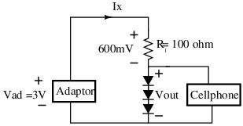
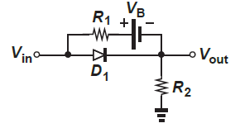
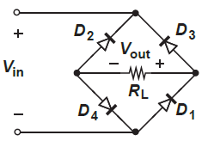
Concept Questions-3
Q.1 Having lost his 2.4-V cellphone charger, an electrical engineering student
tries several stores but does not find adaptors with outputs less than 3 V.
He then decides to put his knowledge of electronics to work and constructs the
circuit shown in Fig. a, where three identical diodes in forward bias produce
a total voltage of Vout = 3VD ≈ 2.4 V and resistor R sustains the remaining 600 mV.
Neglect the current drawn by the cellphone.
Determine the reverse saturation current (Is) of diode so that Vout = 2.4 V.
(b) Compute Vout if the adaptor voltage is in fact 3.1 V.
(a)
Q.2 Plot the currents trough R1 and D1 as a function of Vin for the circuit shown in Fig. b .
Assume a constant voltage diode model and VB =2V.
(b)
Q.3 While constructing a full- wave rectifier. A student mistakenly
has swapped the terminals of D3 as depicted in Fig. c.
Explain what happens by showing the output waveform.
(c)
26

Slide 27
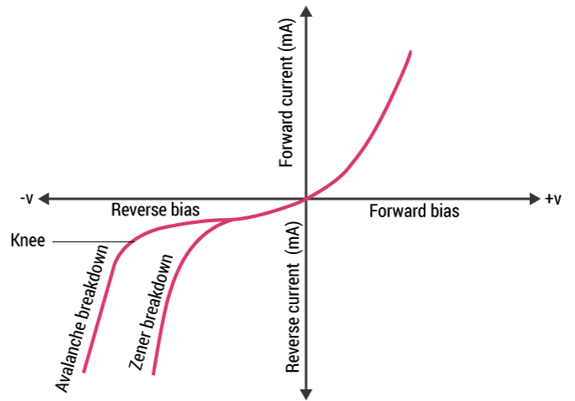
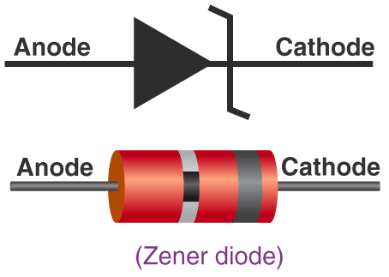
Other type of diodes
27

Slide 28
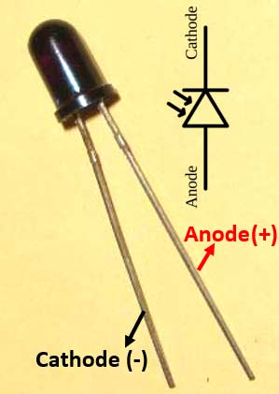
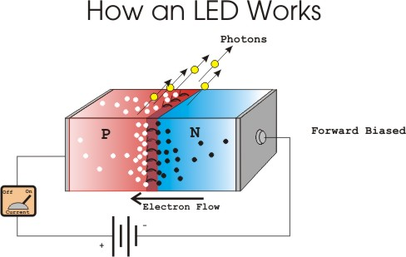
Other type of diodes
Photo diode
Solar cell diode
28

Slide 29
Other type of diodes
29

