Slide 1
EE204: Analog Circuits
Lecture-6
Sandip Mondal
Assistant Professor IIT Bombay

Slide 2
Transistor Biasing→ FIXED BIAS (FB)
Using the Kirchhoff law
$$I_{C}$$
$$R_{L}$$
$$I_{B}=\frac{V_{CC}−V_{BE}}{R_{B}}$$
$$R_{B}$$
$$V_{o}$$
The collector current
$$C_{1}$$
$$I_{B}$$
$$V_{CC}$$
$$+$$
$${ I}_{C}=β{ I}_{B}+(β+1{) I}_{CO}$$
Input
Signal
$$V_{BE}$$
$$−$$
$${ I}_{C}=β\frac{V_{CC}−V_{BE}}{R_{B}}+(β+1{) I}_{CO}$$
2

Slide 3
Transistor Biasing→ Stability Factors
FIXED BIAS (FB)
Lower the stability factor, the better stability of Q-point
$$S=\frac{δI_{c}}{δI_{CO}}=β+1$$
$$S^{′}=\frac{δI_{c}}{δV_{BE}}=−\frac{β}{R_{B}}$$
$$S^{′′}=\frac{δI_{c}}{δβ}=\frac{V_{CC}−V_{BE}}{R_{B}}+{ I}_{CO}$$
3

Slide 4
Transistor Biasing→ C to B bias (CB)
Collector to Base Bias
Using the Kirchhoff law
$$I_{C}+I_{B}$$
$$V_{CE}={ I}_{B}R_{B}+V_{BE}$$
$$R_{B}$$
$$R_{L}$$
$$V_{CC}={(I_{C}+I}_{B})R_{L}+V_{CE}$$
$$V_{o}$$
Using the above equations
$$V_{CC}={(I_{C}+I}_{B})R_{L}+{ I}_{B}R_{B}+V_{BE}$$
$$C_{1}$$
$$V_{CC}$$
$$I_{B}$$
$${ I}_{B}=\frac{V_{CC}−V_{BE}−{ I}_{C}R_{L}}{R_{B}+R_{L}}$$
$$+$$
Input
Signal
$$V_{BE}$$
$$−$$
$${ I}_{C}=β{ I}_{B}+(β+1{) I}_{CO}$$
Substituting for ${ I}_{B}$ and rearranging
$${ I}_{C}\left(1+\frac{βR_{L}}{R_{B}+R_{L}}\right)=β{\frac{(V_{CC}−V_{BE})}{R_{B}+R_{L}}}_{}+(β+1{) I}_{CO}$$
4

Slide 5
Transistor Biasing→ Stability Factors
Collector to Base Bias
Lower the stability factor, the better stability of Q-point
$$S=\frac{δI_{c}}{δI_{CO}}=\frac{β+1}{1+βR_{L}/(R_{L}+R_{B})}$$
$$S^{′}=\frac{δI_{c}}{δV_{BE}}=−\frac{β}{R_{B}+R_{L}(β+1)}$$
$$S^{′′}=\frac{δI_{c}}{δβ}=\frac{V_{CC}−V_{BE}−{ I}_{C}R_{L}+(R_{B}+R_{L}){ I}_{CO}}{R_{B}+R_{L}(β+1)}$$
$V_{BE}$<< $V_{CC}$
$$S^{′′}=\frac{δI_{c}}{δβ}=\frac{V_{CC}−{ I}_{C}R_{L}+(R_{B}+R_{L}){ I}_{CO}}{R_{B}+R_{L}(β+1)}$$
5

Slide 6
Self-Bias or Emitter Bias
Emitter Bias
Thevenin source
$$I_{C}$$
$$R_{L}$$
$${ V}_{T}=\frac{{ R}_{2}V_{CC}}{R_{1}+R_{2}}$$
$$C_{2}$$
$$R_{1}$$
$$V_{o}$$
$$V_{CC}$$
$$C_{1}$$
$$I_{B}$$
Thevenin resistance
$$+$$
$$V_{BE}$$
$${ R}_{T}=\frac{{ R}_{1}R_{2}}{R_{1}+R_{2}}$$
Input
Signal
$$−$$
$$R_{2}$$
$$C_{e}$$
$$R_{e}$$
6

Slide 7
Self-Bias or Emitter Bias
Emitter Bias
Thevenin source
$$I_{C}$$
$$R_{L}$$
$${ V}_{T}=\frac{{ R}_{2}V_{CC}}{R_{1}+R_{2}}$$
$$R_{T}$$
$$+$$
$$V_{CC}$$
$$V_{CE}$$
Thevenin resistance
$$+$$
$$−$$
$$I_{B}$$
$${ R}_{T}=\frac{{ R}_{1}R_{2}}{R_{1}+R_{2}}$$
$$V_{BE}$$
$$−$$
$$V_{T}$$
$$R_{e}$$
$${(I}_{c}+I_{B})$$
7

Slide 8
Self-Bias or Emitter Bias
Emitter Bias
Using the Kirchhoff law around base
$$I_{B}R_{T}+V_{BE}+(I_{B}+I_{C})R_{e}=V_{T}$$
$$I_{C}$$
$$R_{L}$$
$${ I}_{B}=\frac{V_{T}−V_{BE}−{ I}_{C}R_{e}}{R_{T}+R_{e}}$$
$$R_{T}$$
$$+$$
$$V_{CC}$$
$$V_{CE}$$
Using the Kirchhoff law around Collector
$$+$$
$$−$$
$$R_{e}(I_{c}+I_{B})+I_{C}R_{L}+V_{CE}=V_{CC}$$
$$I_{B}$$
$$V_{BE}$$
$As I_{C}$>> $I_{B}$, $I_{B}R_{e} is neglected compare to I_{C}R_{e }$
$$−$$
$$V_{T}$$
$$R_{e}$$
$${(I}_{c}+I_{B})$$
$$V_{CE}={−I}_{C}(R_{L}+R_{e})+V_{CC}$$
8

Slide 9
Self-Bias or Emitter Bias- Q point
Emitter Bias
LOADLINE
$I_{B}=0.$2V
$$V_{CE}={−I}_{C}(R_{L}+R_{e})+V_{CC}$$
Load line slope: $−(R_{L}+R_{e})$
$$8$$
$0.15 m$A
BIAS CURVE
$$6$$
$$Load line$$
$$I_{B}R_{T}+V_{BE}+(I_{B}+I_{C})R_{e}=V_{T}$$
$$Bias curve$$
$I_{C}$(mA)
$$4$$
$0.1m$A
A relation between $V_{CE}$and $I_{B}$ to be achieved. For each vale of $I_{B}$ marked on the collector curves, $V_{CE}$calculated from the relationship. The interaction of the dc loadline and the bias curve gives the quiescent point Q.
$$Q$$
$$1$$
$0.05m$A
$$0mA$$
$$0$$
$$0$$
$$2$$
$$5$$
$$6$$
$$8$$
$V_{CE}$(V)
9

Slide 10
Self-Bias or Emitter Bias- Stability factors
Emitter Bias
The collector current can be represented as
$${ I}_{C}=β{ I}_{B}+(β+1{) I}_{CO}$$
$${ I}_{B}=\frac{V_{T}−V_{BE}−{ I}_{C}R_{e}}{R_{T}+R_{e}}$$
The base current can be represented as
$${ I}_{C}\left(1+\frac{βR_{e}}{R_{T}+R_{e}}\right)=\frac{βV_{T}}{R_{T}+R_{e}}−\frac{βV_{BE}}{R_{T}+R_{e}}+(β+1{) I}_{CO}$$
Using above 2 eqn:
$$S=\frac{δI_{c}}{δI_{CO}}=\frac{β+1}{1+βR_{e}/(R_{T}+R_{e})}=(β+1)\frac{1+R_{T}/R_{e}}{1+β+R_{T}/R_{e})}$$
$$S^{′}=\frac{δI_{c}}{δV_{BE}}=−\frac{β}{R_{T}+R_{e}(β+1)}$$
$$S^{′′}=\frac{δI_{c}}{δβ}=\frac{1}{β(β+1)}\left[{ I}_{C}\frac{(R_{T}+R_{e})(β+1{)−βSI}_{CO}}{R_{T}+R_{e}}−{SI}_{CO}\right]$$
10

Slide 11
Comparison of biasing
Which is the best biasing condition?
Fixed bias, Collector to Base bias and Emitter bias
Advantages?
Disadvantages?
11

Slide 12
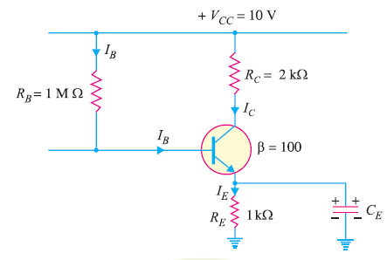
Calculate the values of three currents in the circuit shown in Figure below.(Take base-emitter voltage V_{BE} = 0.)
Concept Question-4
12

Slide 13
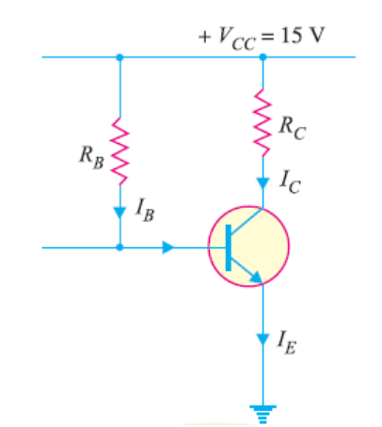
Concept Questions - 5
2. For a given CE amplifier, operating point is V_{CE} = 8V and I_{C} = 2 mA. You are supplied with a fixed 15V d.c. supply and a silicon transistor with β = 100. Take base-emitter voltage V_{BE} = 0.6V. Calculate the value of load resistances that would be employed.
13

Slide 14
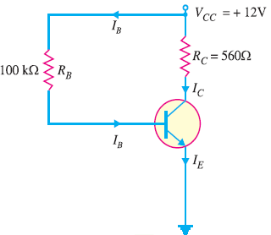
Concept Questions - 6
3. For the given base bias circuit, determine V_{CE} and IC.(Take base-emitter voltage V_{BE} = 0.7V.)
14

