Slide 1
EE204: Analog Circuits
Tutorial-1
TAs
Date: 17/01/2025

Slide 2
Source: Adel S. Sedra, Kenneth Carless Smith, “Microelectronic Circuits 7th Edition, International Edition”, Oxford University Press, 2015

Slide 3
Source: Adel S. Sedra, Kenneth Carless Smith, “Microelectronic Circuits 7th Edition, International Edition”, Oxford University Press, 2015

Slide 4
Source: Adel S. Sedra, Kenneth Carless Smith, “Microelectronic Circuits 7th Edition, International Edition”, Oxford University Press, 2015

Slide 5
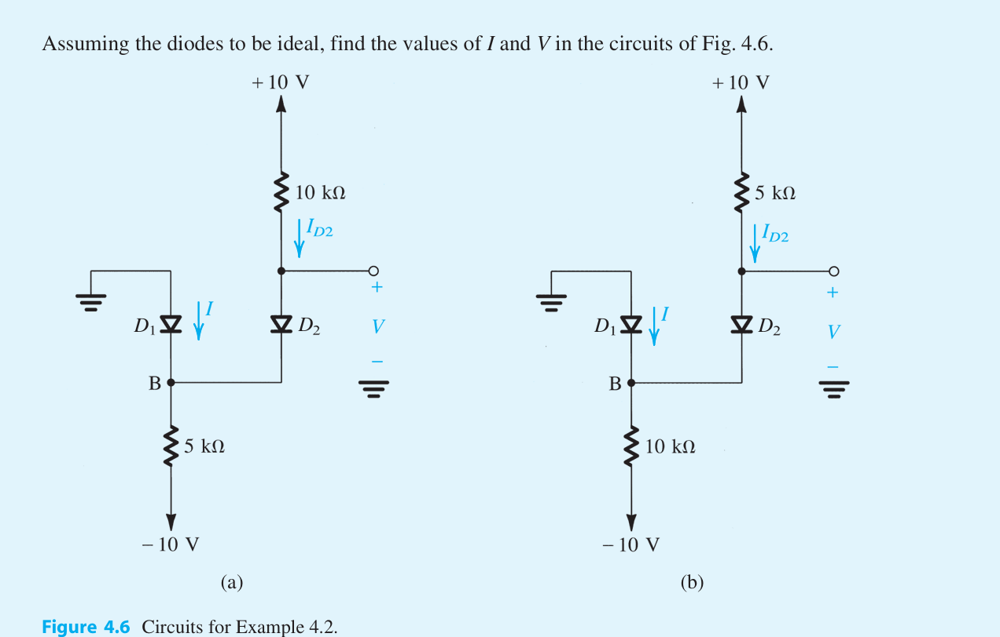
Source: Adel S. Sedra, Kenneth Carless Smith, “Microelectronic Circuits 7th Edition, International Edition”, Oxford University Press, 2015

Slide 6
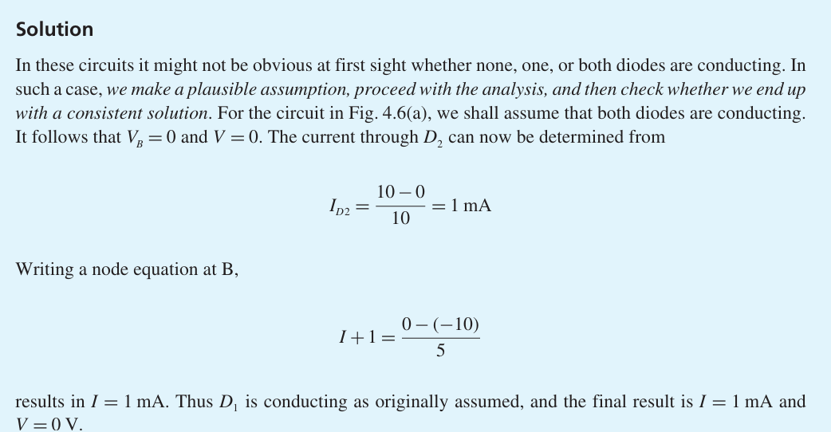
Source: Adel S. Sedra, Kenneth Carless Smith, “Microelectronic Circuits 7th Edition, International Edition”, Oxford University Press, 2015

Slide 7
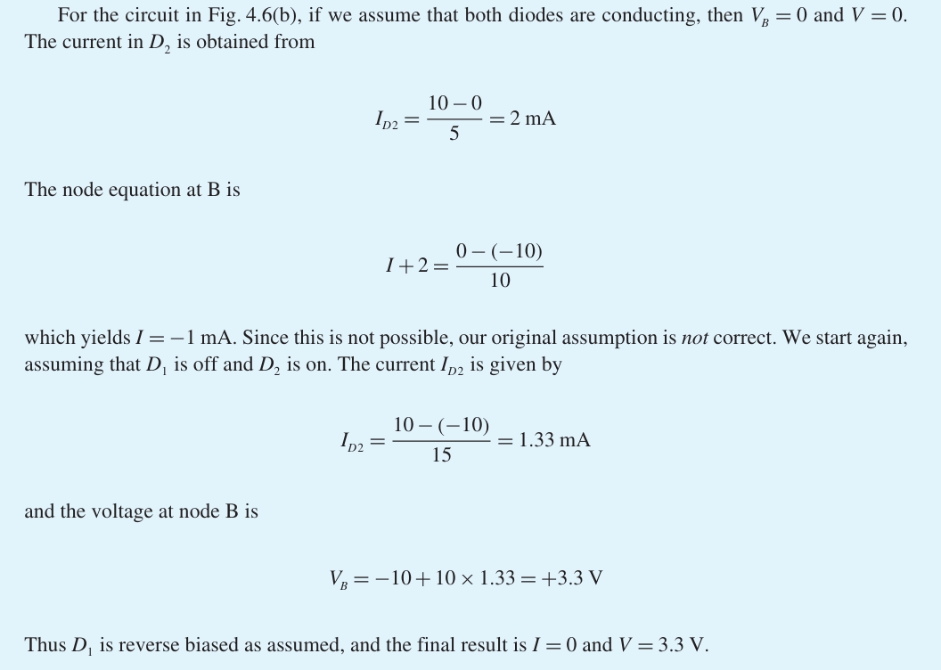

Slide 8
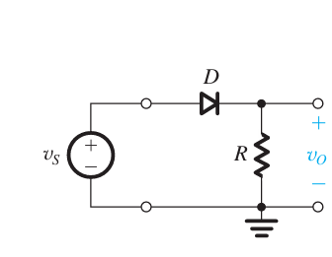
Source: Adel S. Sedra, Kenneth Carless Smith, “Microelectronic Circuits 7th Edition, International Edition”, Oxford University Press, 2015

Slide 9
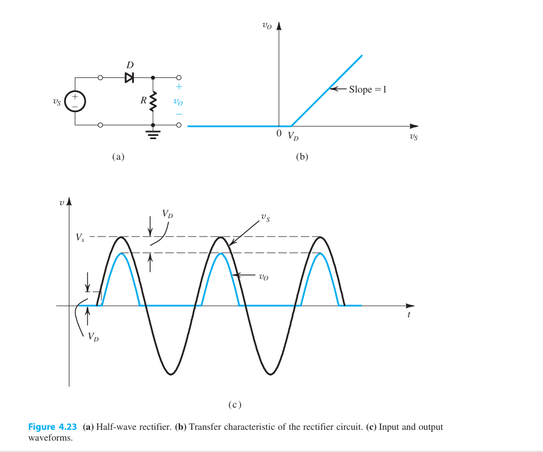
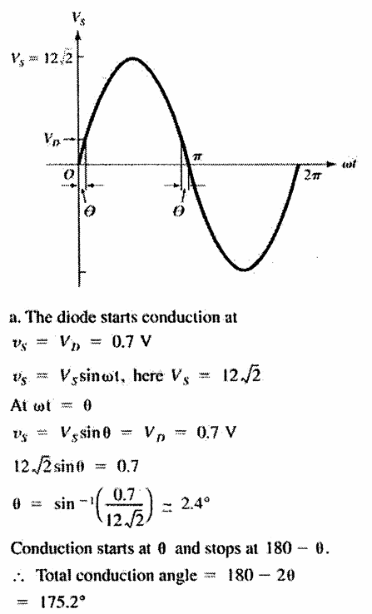
Source: Adel S. Sedra, Kenneth Carless Smith, “Microelectronic Circuits 7th Edition, International Edition”, Oxford University Press, 2015

Slide 10
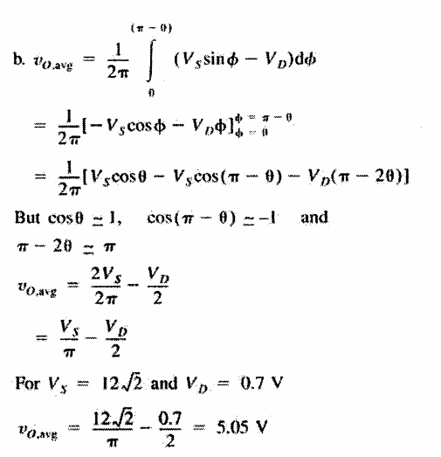
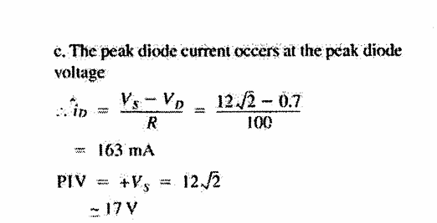
Source: Adel S. Sedra, Kenneth Carless Smith, “Microelectronic Circuits 7th Edition, International Edition”, Oxford University Press, 2015

Slide 11
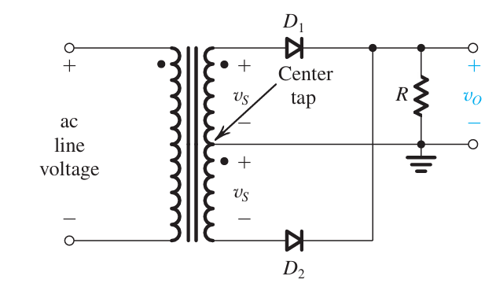
Source: Adel S. Sedra, Kenneth Carless Smith, “Microelectronic Circuits 7th Edition, International Edition”, Oxford University Press, 2015

Slide 12
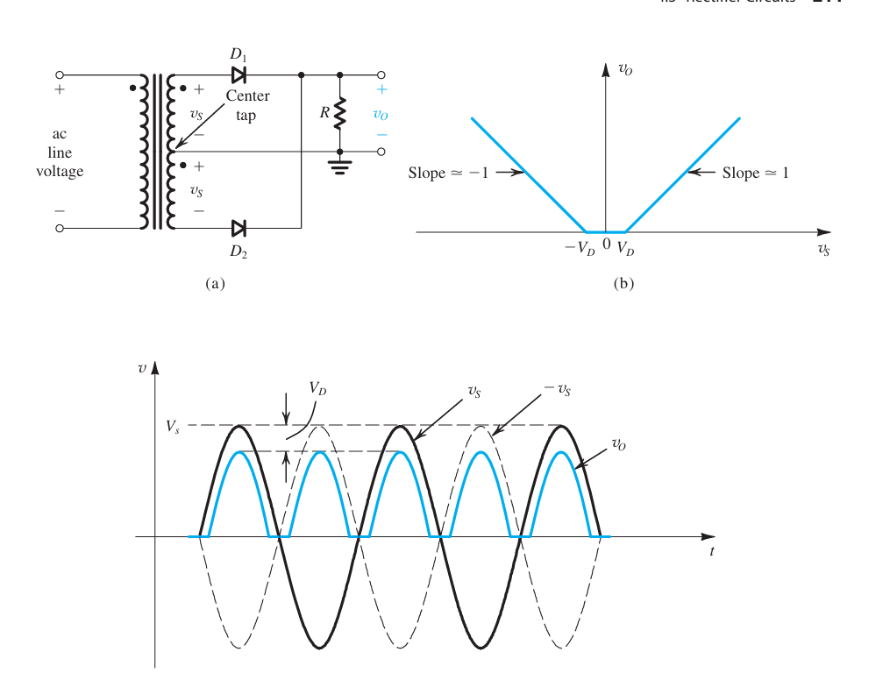
Source: Adel S. Sedra, Kenneth Carless Smith, “Microelectronic Circuits 7th Edition, International Edition”, Oxford University Press, 2015

Slide 13
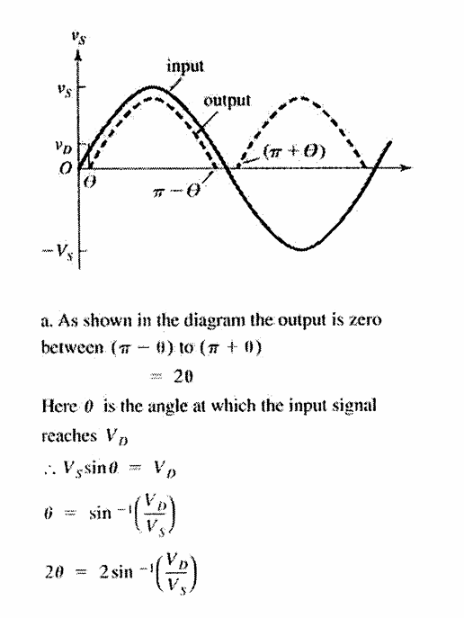
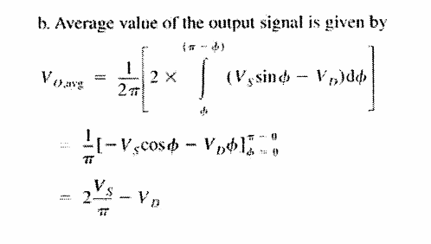
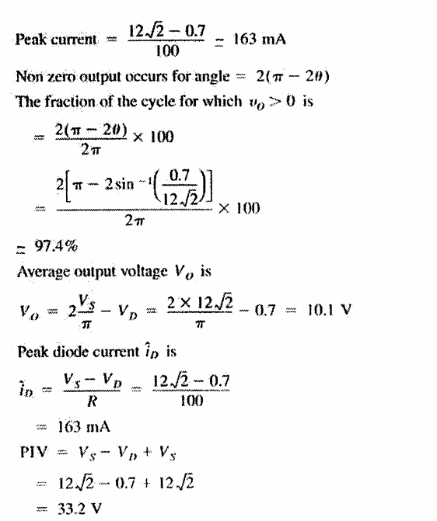
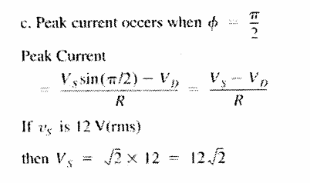
Source: Adel S. Sedra, Kenneth Carless Smith, “Microelectronic Circuits 7th Edition, International Edition”, Oxford University Press, 2015

Slide 14
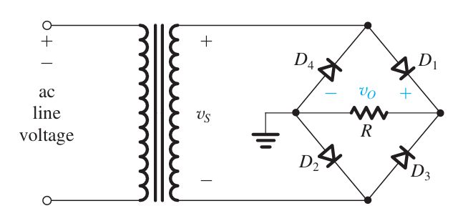
Source: Adel S. Sedra, Kenneth Carless Smith, “Microelectronic Circuits 7th Edition, International Edition”, Oxford University Press, 2015

Slide 15
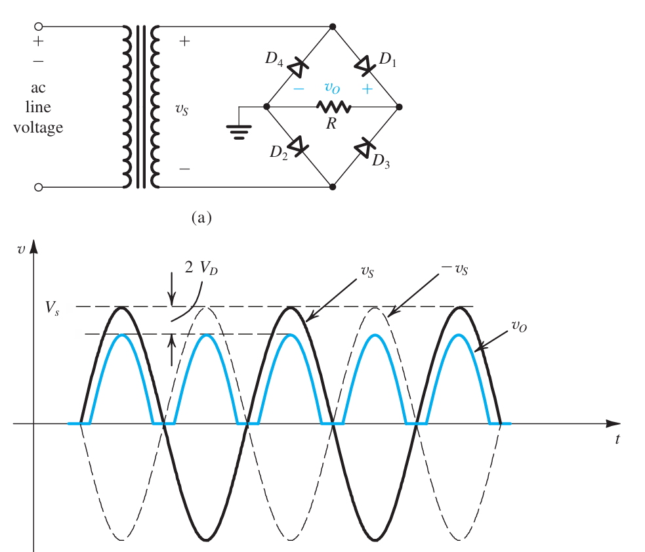
Source: Adel S. Sedra, Kenneth Carless Smith, “Microelectronic Circuits 7th Edition, International Edition”, Oxford University Press, 2015

Slide 16
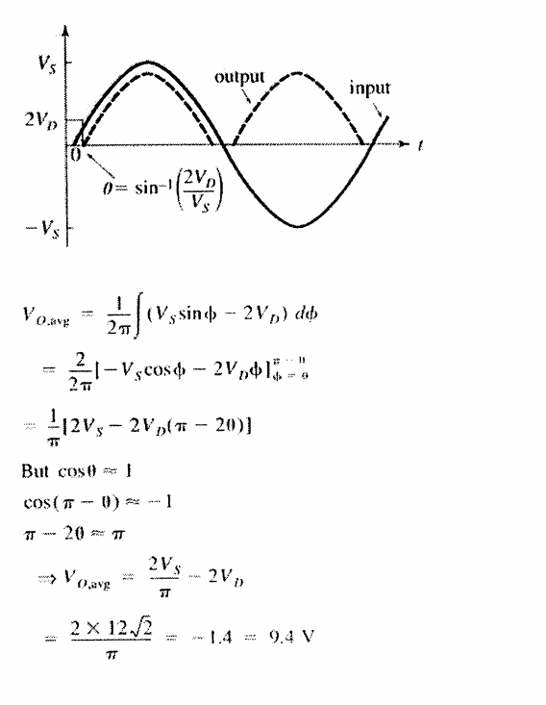
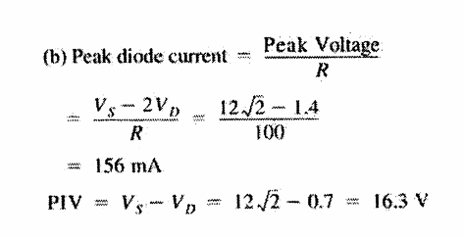
Source: Adel S. Sedra, Kenneth Carless Smith, “Microelectronic Circuits 7th Edition, International Edition”, Oxford University Press, 2015

