Slide 1
EE204: Analog Circuits
Tutorial-2
TAs
Date: 31/01/2025

Slide 2
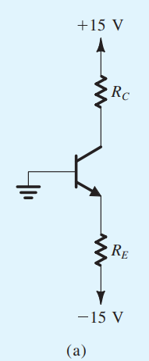
Q1
Source: Adel S. Sedra, Kenneth Carless Smith, “Microelectronic Circuits 7th Edition, International Edition”, Oxford University Press, 2015

Slide 3
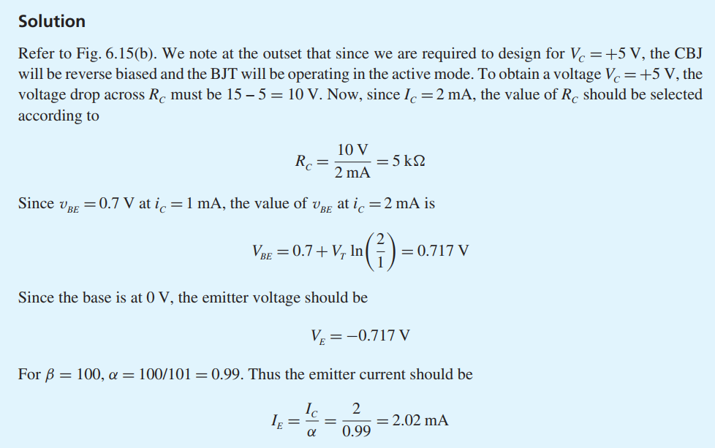
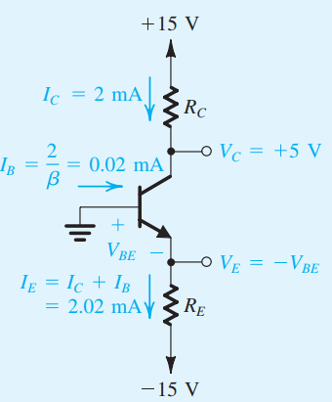
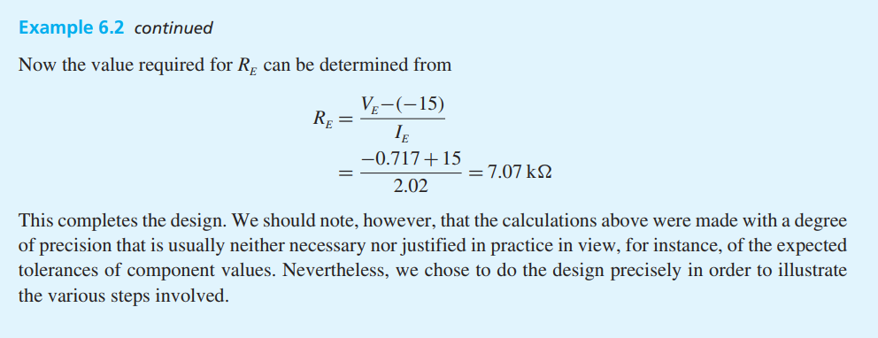
Solution:

Slide 4
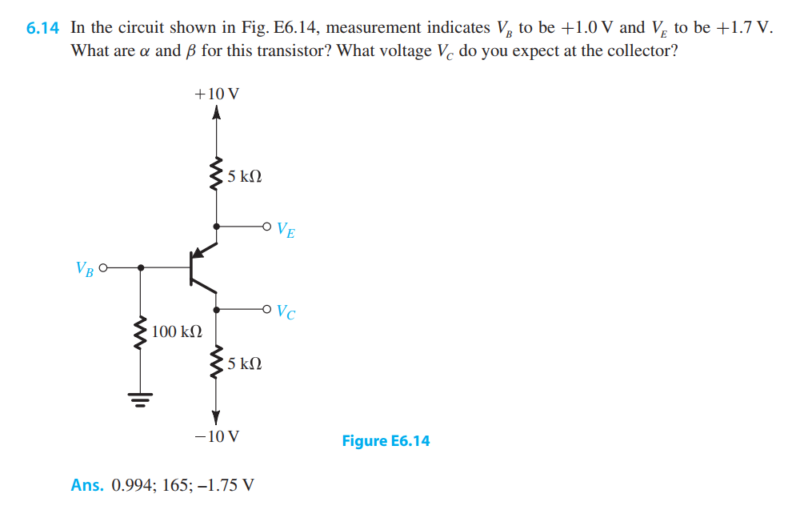
Q2
Source: Adel S. Sedra, Kenneth Carless Smith, “Microelectronic Circuits 7th Edition, International Edition”, Oxford University Press, 2015

Slide 5
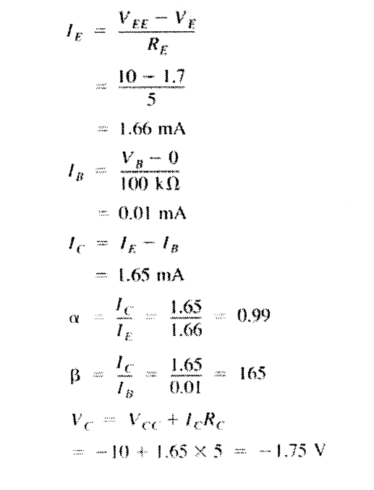
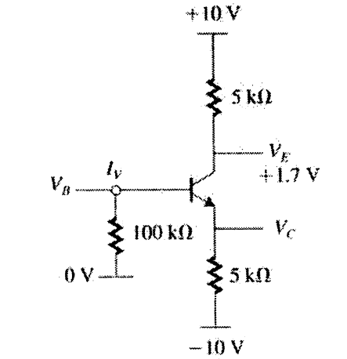
Source: Adel S. Sedra, Kenneth Carless Smith, “Microelectronic Circuits 7th Edition, International Edition”, Oxford University Press, 2015

Slide 6
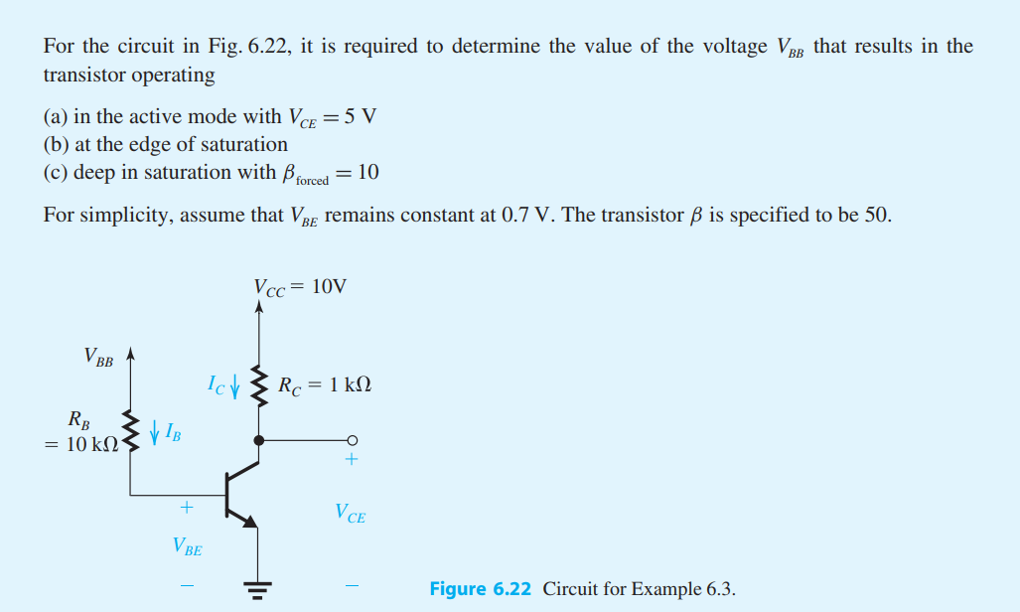
Q3
Source: Adel S. Sedra, Kenneth Carless Smith, “Microelectronic Circuits 7th Edition, International Edition”, Oxford University Press, 2015

Slide 7
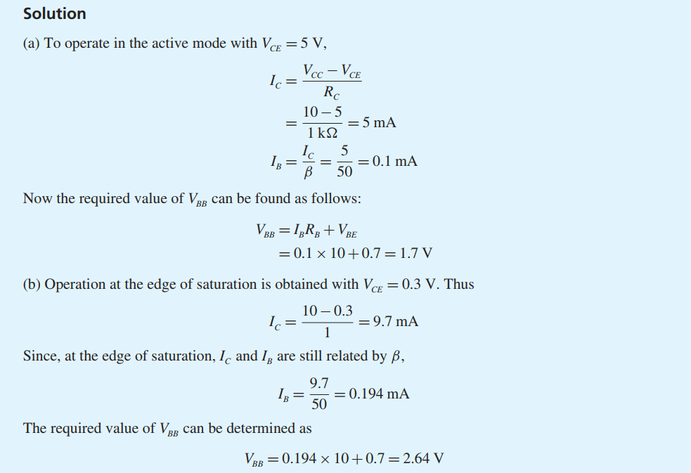
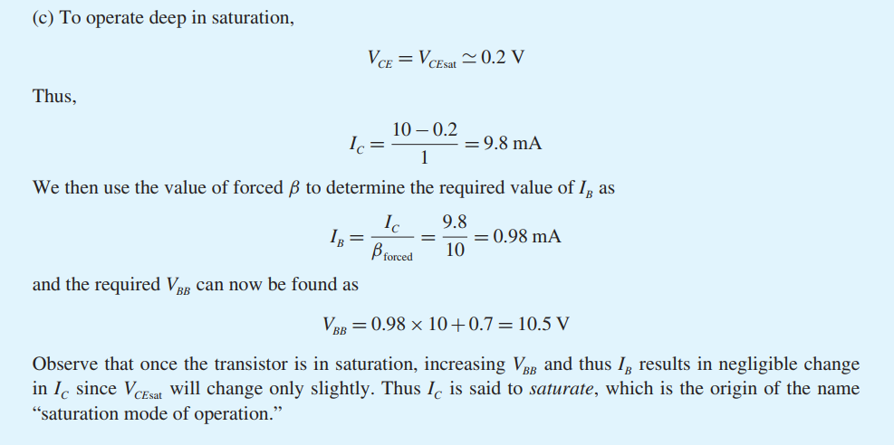
Source: Adel S. Sedra, Kenneth Carless Smith, “Microelectronic Circuits 7th Edition, International Edition”, Oxford University Press, 2015

Slide 8
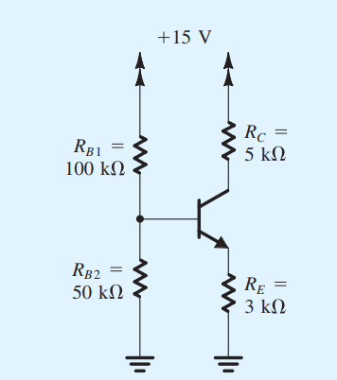
Q4
Source: Adel S. Sedra, Kenneth Carless Smith, “Microelectronic Circuits 7th Edition, International Edition”, Oxford University Press, 2015

Slide 9
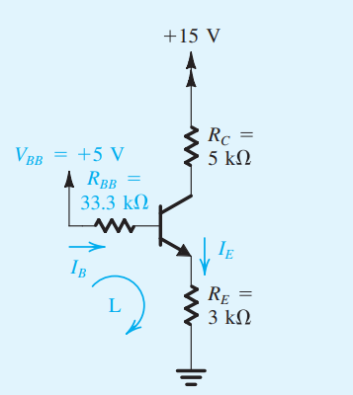
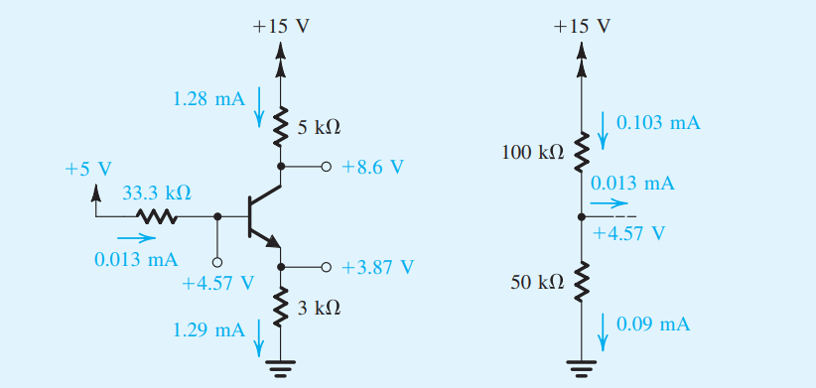
Source: Adel S. Sedra, Kenneth Carless Smith, “Microelectronic Circuits 7th Edition, International Edition”, Oxford University Press, 2015

Slide 10
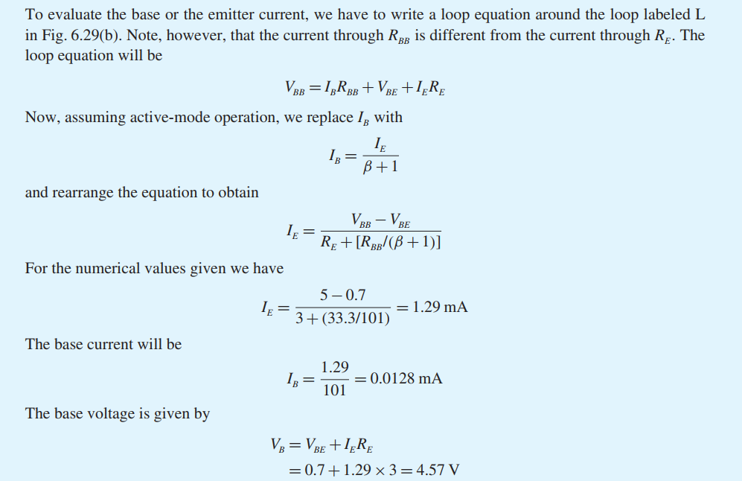
Source: Adel S. Sedra, Kenneth Carless Smith, “Microelectronic Circuits 7th Edition, International Edition”, Oxford University Press, 2015

Slide 11
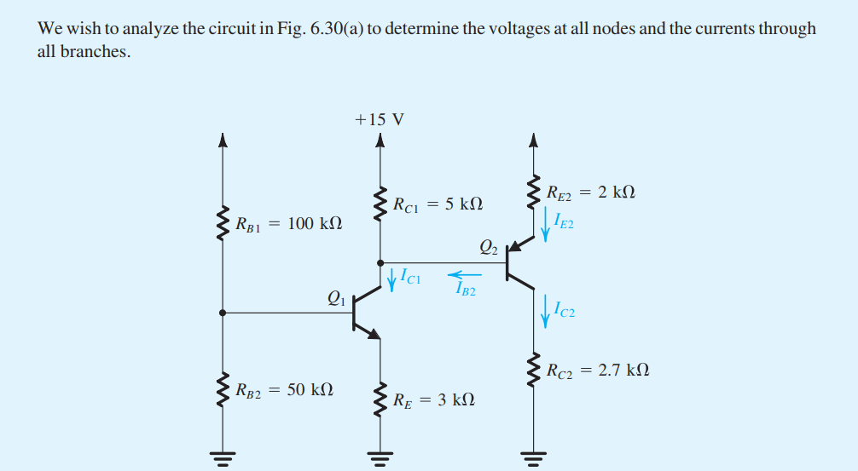
Q5
Source: Adel S. Sedra, Kenneth Carless Smith, “Microelectronic Circuits 7th Edition, International Edition”, Oxford University Press, 2015

Slide 12
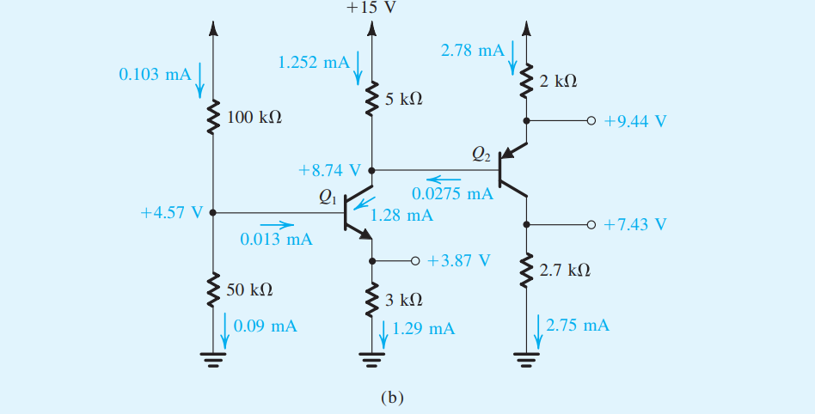
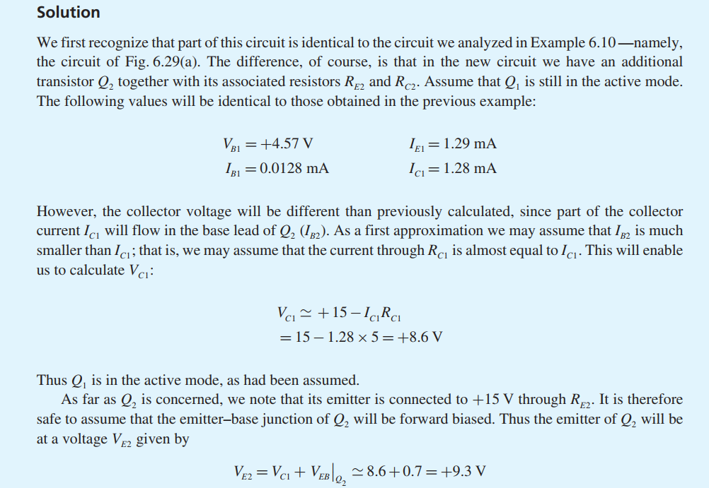
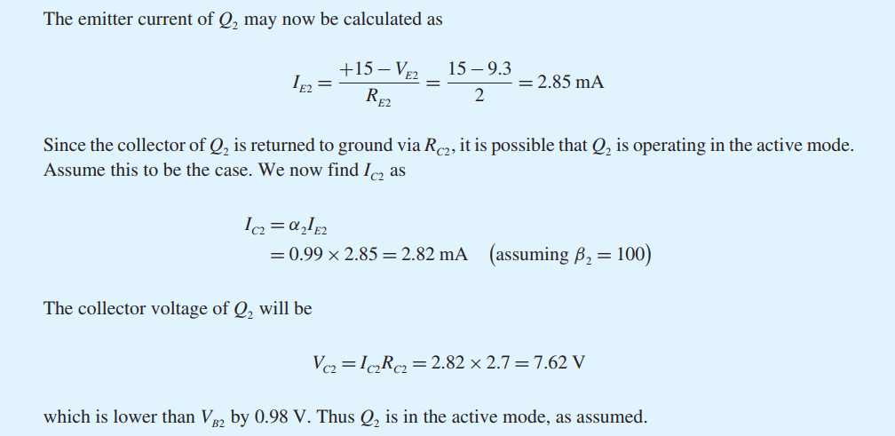
Source: Adel S. Sedra, Kenneth Carless Smith, “Microelectronic Circuits 7th Edition, International Edition”, Oxford University Press, 2015

Slide 13
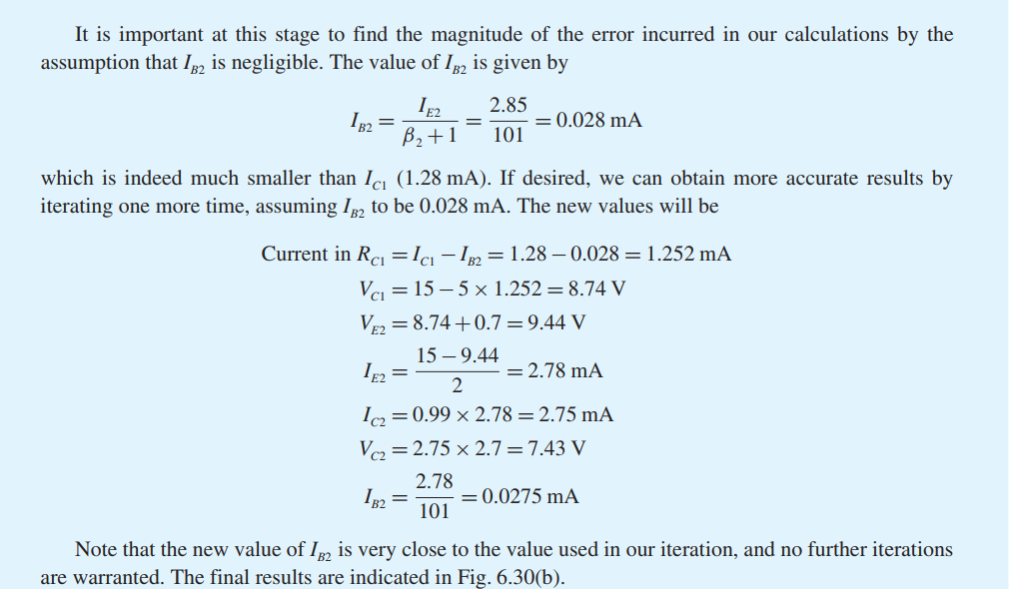
Source: Adel S. Sedra, Kenneth Carless Smith, “Microelectronic Circuits 7th Edition, International Edition”, Oxford University Press, 2015

Slide 14
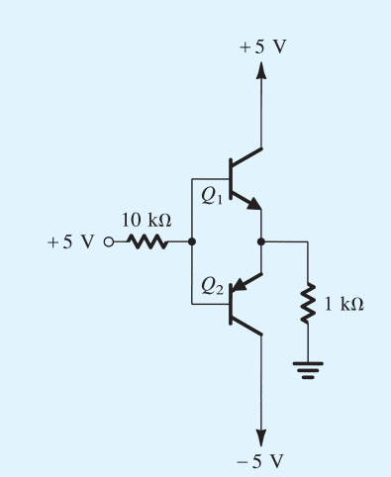
Q6
Source: Adel S. Sedra, Kenneth Carless Smith, “Microelectronic Circuits 7th Edition, International Edition”, Oxford University Press, 2015

Slide 15
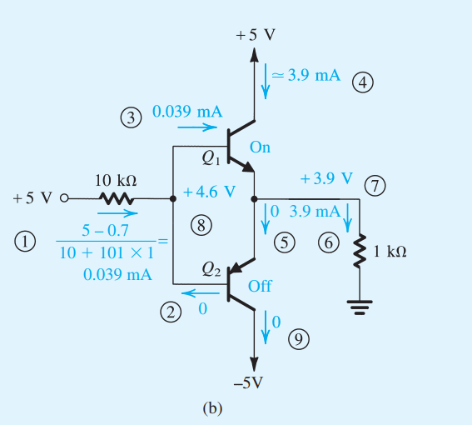
Source: Adel S. Sedra, Kenneth Carless Smith, “Microelectronic Circuits 7th Edition, International Edition”, Oxford University Press, 2015

Slide 16
Source: Adel S. Sedra, Kenneth Carless Smith, “Microelectronic Circuits 7th Edition, International Edition”, Oxford University Press, 2015

