Slide 1

EE204: Analog Circuits
Lecture-0
Sandip Mondal
Assistant Professor IIT Bombay
30/7/2025

Slide 2

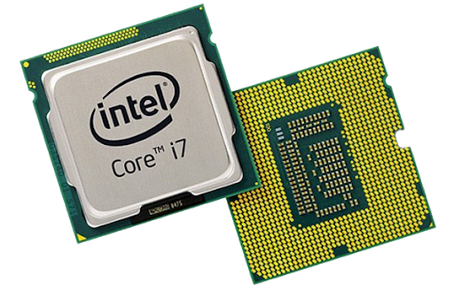


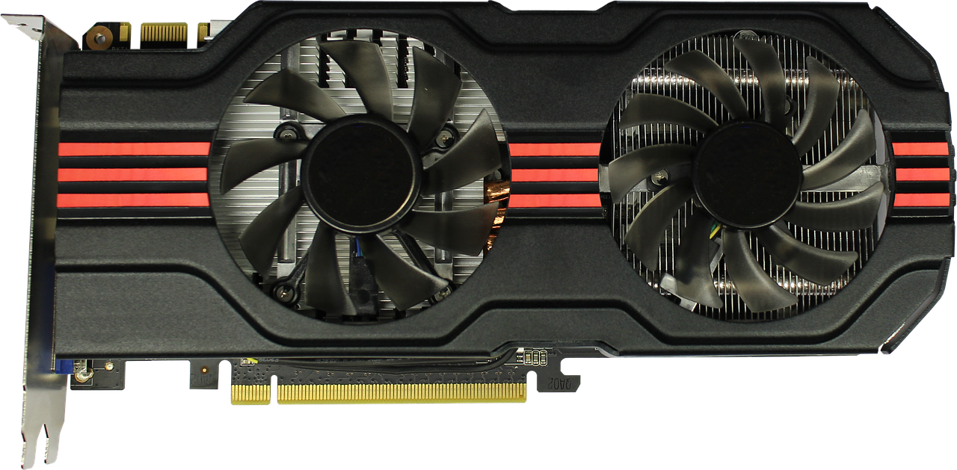
Electronic System/Circuit
Compute
Store
Transmit
Major functions
CPU and GPU (i5, i7, i9, M1, RTX 40 etc.)
HDD, Flash etc.
5G devices etc.
2

Slide 3
History of the Transistor
The first transistor patent is a Field Effect device by Lilienfeld in 1925
Shockley (Bell Labs) failed to get FET working, due to excessive surface states between the semiconductor and oxide; the issue was later identified by Bardeen (Bell Labs)
Bardeen and Brattain (Bell Labs) learned from Shockley’s shortcomings and invented a Point Contact Transistor in 1947, which later gave rise to the Bipolar Junction Transistor (BJT)
First demonstration of Metal Oxide Semiconductor (MOS) FET by Atalla and Kahng (Bell Labs) in 1960
MOSFETs are >99% of all “transistors” made as of today
3

Slide 4
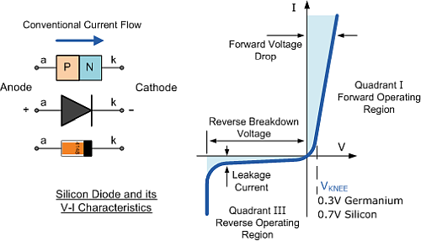
p-n Semiconductor (Diode)
4

Slide 5
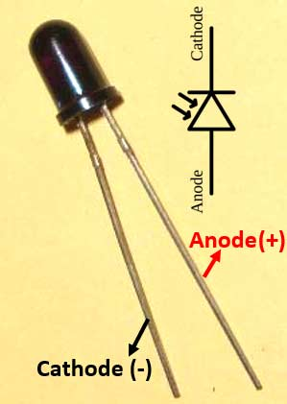
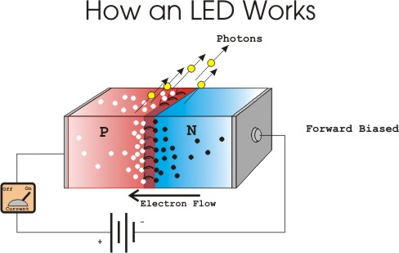
Other type of diodes
Photo diode
Solar cell diode
5

Slide 6
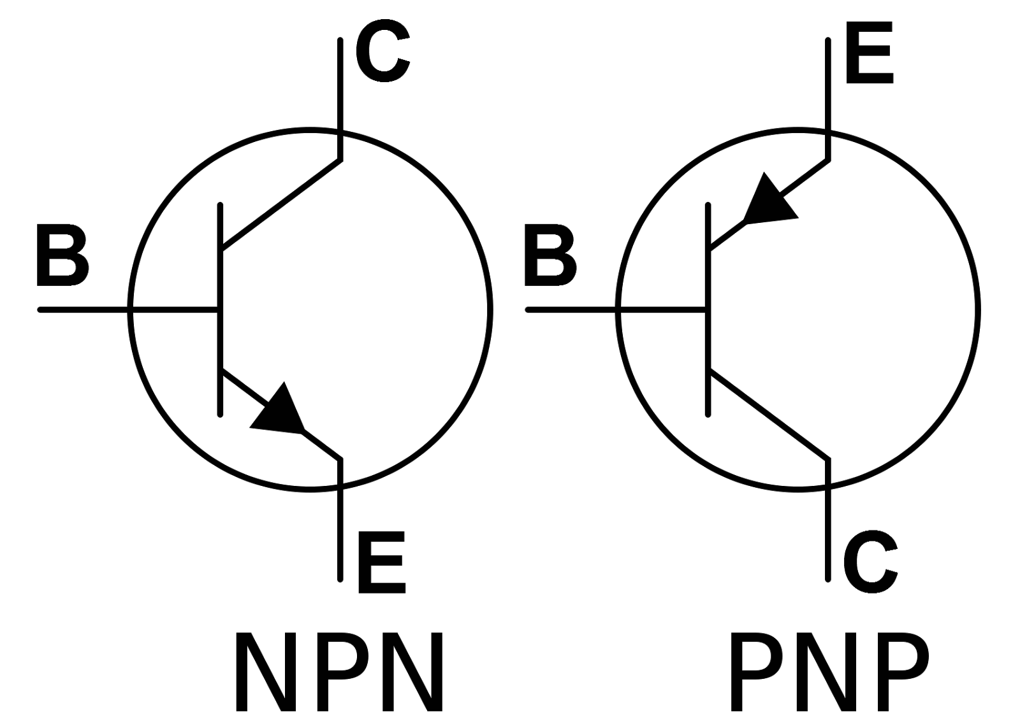
Semiconductor (Transistor)
6

Slide 7

















Transistor characteristics PNP
$$A_{2}$$
$$+$$
$$−$$
$$T$$
$$A_{1}$$
$$−$$
$$B_{1}$$
$$−$$
$$+$$
$$V_{2}$$
$$B_{2}$$
$$−$$
$$R_{2}$$
$$+$$
$$R_{1}$$
$$V_{1}$$
$$+$$
A circuit arrangement to study transistor characteristics for CE configuration
7

Slide 8





Summing Transistor Amplifier
1941: H SWARTZAL patent
$$15 V$$
$$R_{1}$$
C1
C2
C3
B1
B2
B3
E1
E2
E3
DC
$$R_{2}$$
$$R_{2}$$
$$R_{2}$$
8

Slide 9





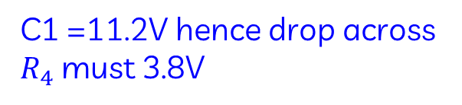

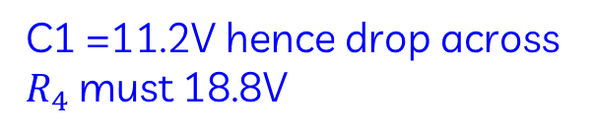


Voltage regulator
Change in supply voltage
P=20V
C2
E2
If the supply voltage become high hence P=30V
$$V_{o}$$
T2
$$V_{o}$$
$$R_{Load}$$
C1 =11.2V hence drop across $R_{4}$ must 18.8V
$R_{4}=4.7$k
B2
$$R_{1}$$
S
C1
$$R_{3}$$
If the supply voltage become low hence P=15V
5.6V
Q
T1
Input 20V DC (15V←20V→28V)
B1
This is biasing the Zener
C1 =11.2V hence drop across $R_{4}$ must 3.8V
E1
5V
$$R_{2}$$
5V
More current =More $V_{BE}$(T1)
Less current =Less $V_{BE}$(T1)
Then the output voltage will change
9

Slide 10












OPAMP-Inverting
Gain 10 → inverting amplifier
$$R_{2}$$
$$+15V$$
E3
$$R_{C1}$$
$$R_{1}$$
P
B3
$$−$$
C1
T3
C2
N
$$+$$
P
B1
T1
B2
T2
C3
$$V_{o}$$
$R_{2}$=9k
E1
E2
$$R_{C2}$$
$R_{1}$=1k
$$R_{E}$$
$$−15V$$
10

Slide 11
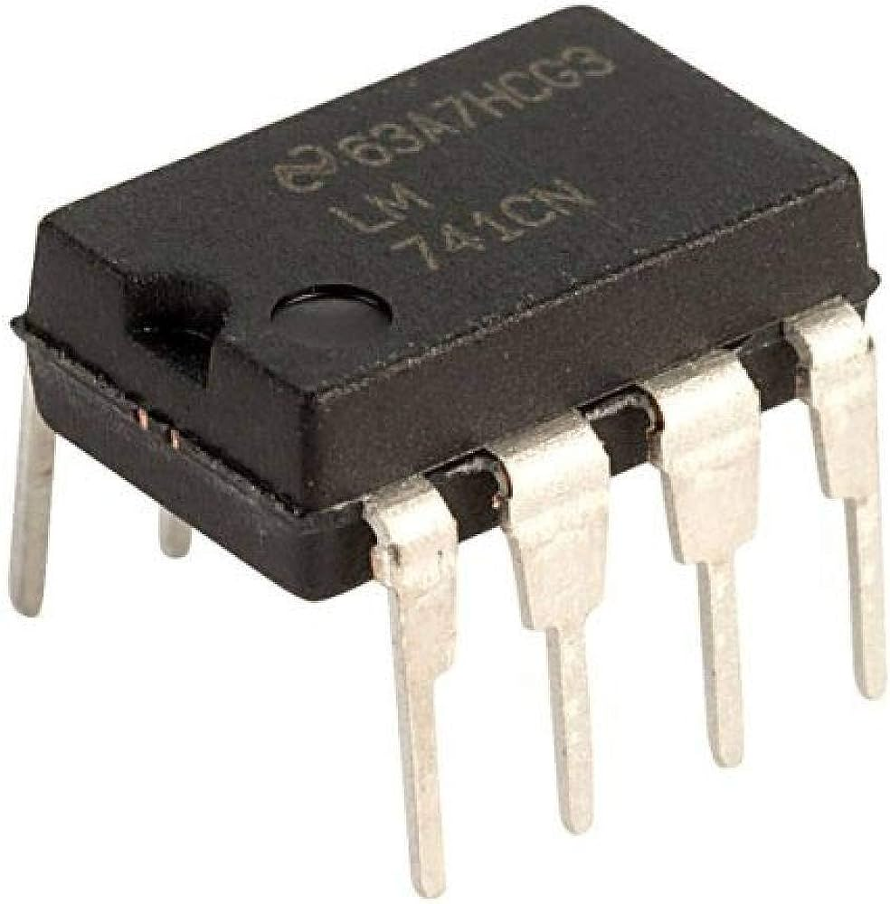
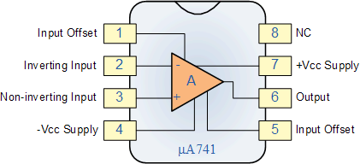
Ideal OPAMP
Adder, Subtractor, Differentiator, Amplifier, Integrator
11

Slide 12
MOS-Cap to MOSFET
G
S
D
Four terminal device – Gate,
Source, Drain and Body (Substrate)
All voltages and currents are (conventionally) with reference to the Source terminal
Field Effect – voltage applied to the Gate (V_{GS}) induces charges in the substrate: fixed (depletion layer) and mobile (inversion layer)
Transport – voltage applied to the Drain (V_{DS}) results in a flow of mobile substrate charges, resulting in drain current (I_{DS})
B
12

Slide 13







Disadvantage MOSFET Switch
+12V
Designing of MOSFET switch is easy but limited with high voltage operation.
BS-170 operates with 5V only.
If any circuit needs to be operated at low voltage (say +/- 2V) then the MOSFET circuit will not work for such operation.
Where the transistor require only 0.6V base-emitter voltage to operate in the transistor.
$D_{2}$
-14.2V
0V
+15V
$D_{1}$
$$−$$
$V_{out}$
MOSFET
BS-170
$$+$$
-15V
$R_{}$
$$C_{MOS}$$
13

Slide 14







How to perform the calibration
+15V
$R_{f}$=82k
Pot=P2=22k
R=5.6K
$$R_{i}\text{=100}\text{k}$$
$$V1$$
-2.73V
$$−$$
$$V_{Out}$$
-15V
Pot=P1
DISPLAY
LM335
$$R_{1}\text{=100}\text{k}$$
00V to 1.00 V
$$+$$
Put LM335 in ice and adjust P1 and adjust output to 0 V
Put LM335 at 100C and adjust P2 output to 1V
Repeat above steps for several times
-2.5V
LM336
14

Slide 15

















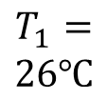














Output voltage corresponding to temp.
Single junction thermocouple
$$24 kΩ$$
$$1 kΩ$$
+15V
$$−$$
$$100 kΩ$$
$$2$$
Ambient
$$+$$
$$−50mV$$
$$40μV/℃$$
$$100 kΩ$$
R
-15V
$$−$$
R
$$3$$
LM335
R
$$1$$
$$100 MΩ$$
+15V
741
+15V
$$T_{1}=$$
$$26℃$$
$$25℃$$
$$R_{f}$$
$$−$$
$$+$$
$$−$$
$$0.25V$$
R
$$R_{1}$$
$$+$$
$$+$$
+15V
-15V
$$−2.73V$$
$$−$$
-15V
+15V
$$−15V$$
$$+$$
$$10mV/℃$$
$$R_{2}$$
$$+5V$$
-15V
$$100mV$$
$$50mV$$
$${(T_{s}−T}_{am})$$
2.5V
$$2.73V$$
15

Slide 16
Lecture Schedule and Course Materials
Lectures: Wednesday 11:05 - 12:30
Friday 11:05 - 12:30
Tutorial: To be decided
https://www.ee.iitb.ac.in/sandip/teaching.html
16

Slide 17
Grading
*Four Quizzes: 10 % (Surprises)
*Every class Quizzes: 20 % (SAFE)
*Mid-sem: 25 %
*End-sem: 45 %
Project work: 10-100 % (Project dependent)
17

Slide 18

Term and Condition (TC)
No Electronics are allowed in class
ONLY PEN-PAPER
(except during Quizzes)
18

Slide 19
References
Foundations of Electrical Engineering by L. S. Bobrow
Electrical Engineering Fundamentals by Vincent Del Toro
Alternate reading for much of the material covered in this course can be found in numerous texts. Some recent ones are:
• Foundations of Analog and Digital Electronic Circuits by A. Agarwal and J.Lang
• Principles and Applications of Electrical Engineering by G. Rizzoni
• Solid State Electronic Devices, by B. G. Streetman
• Semiconductor device Fundamentals by R. Pierret
• Digital Microelectronics, by H. Haznedar
19

Slide 20
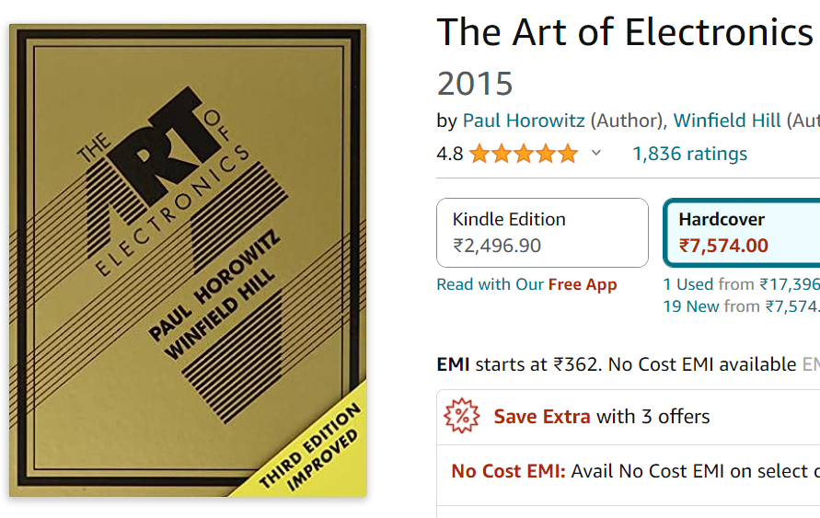
References
20

Slide 21
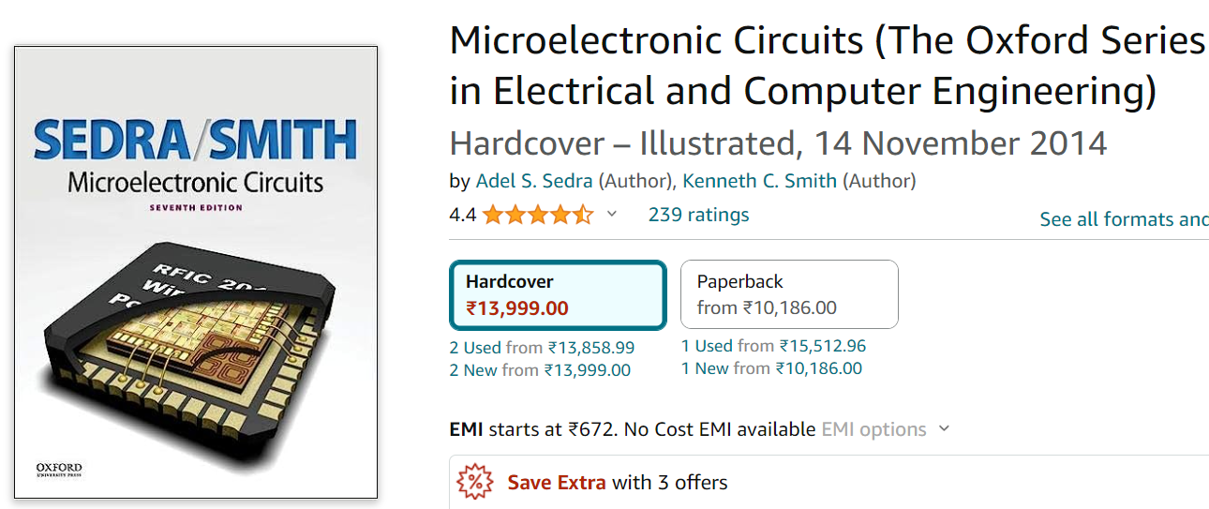
References
21

Slide 22
EE204: Project Proposal (100%)
Threshold measurement of NAND memory transistor
Max vacancy: 2 groups (2 person/group)

Slide 23
Project Registration Link
Project Registration
https://shorturl.at/FPJnl
No credit if you are unable to complete the project
Deadline – 08/08/2025

Slide 24
What you need to buy? (deadline-08/08/2025)
Breadboard
Digital Multimeter
Single Standard Wires (Multi-color)
Resistance box
Capacitor box
20 different color LEDs
Two 9-volt batteries
Few single standard wires
24

