Slide 1
Mathematica for Researchers
Presenter:
Anjan Kumar Pudi N S

Slide 2
Variables
a = 1
a[1] = 1
a[2, 3, 4] = 1
a[“name”] = 1
To clear variable ‘a’ – Clear[a]

Slide 3
Functions
Two types: Set (=) and Set Delayed (:=)
f[x_] = x²
R.h.s is simplified once and for all, then substitute all ‘x’ when a parameter is provided.
f[x_] := Expand[x²]
Substitute all x on the r.h.s, with the parameter provided, and then simplify.
f[x_, y_, z_] = x² + y² + z²
Multiple input function
Piecewise function

Slide 4
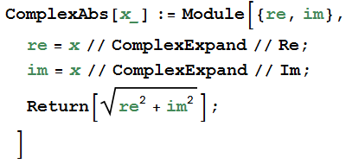
Functions (Cntd…)
Pipe Operator (//)
Flow of code - Readability
Ex:
Module

Slide 5
Functions (Cntd…)
Visually honest compared to MATLAB
Ex:
MATLAB
Mathematica

Slide 6
Functions (Cntd…)
Recursion
Memoization

Slide 7
Manipulating Expressions
Simplify, FullSimplify
Collect
Coefficient, CoefficientList
Ex:
Simplify[a² + b² + 2 a b] -> (a + b)²

Slide 8
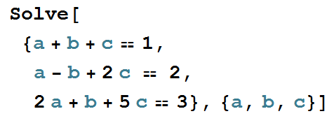
Solving Equations
Solve

Slide 9
Substitutions
Replace (/.)
2 x + 3 y + 7 /. {x−> 7, y−> a + b}
2 x /. {{x-> 1}, {x-> 2}}
Map (/@)
f[x_]=x²
f /@ {1,2,3}

Slide 10
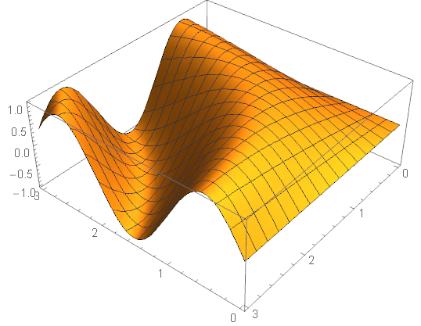
Graphics & Visualization
Plot, DiscretePlot, Plot3D
ListPlot, ListLinePlot
Fit, FindFit

Slide 11
Differentiation & Integration
D
f[x_]=x²;
D[f[x],x] or f’[x]
Integrate

Slide 12
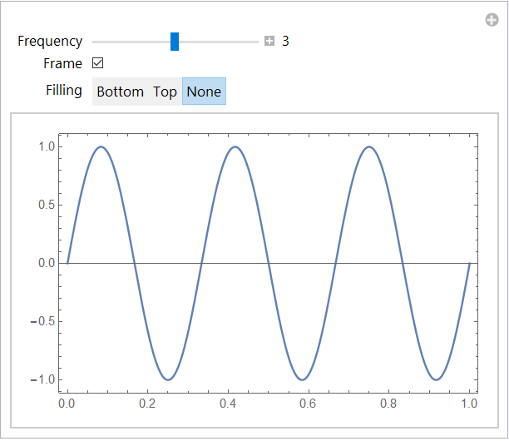
Interactive GUIs
Manipulate
Manipulate[x²,{x,1,10}]
Dynamic

Slide 13
Palettes & Formatting

Slide 14
Example
Consider a non-linear system y = x². For an input sinusoid signal of frequency f_{o} and amplitude A, what are the frequency components at the output?

