Slide 1
Object-Based Audio: A Signal Processing Overview
Sachin Ghanekar

Slide 2
Agenda
A brief Overview & History of Digital Audio
Basic Concepts of Object Audio & How it works
Signal Processing in Object Based Audio on Headphones.
Signal Processing in Object Based Audio on Immersive Speaker Layouts
Trends and Summary

Slide 3
Audio Signals – A snapshot view
Parameter | Values & Ranges | Comment
Bandwidth | 20 Hz to 20 kHz | Audible for Human Ear
Sound Pressure Level (Signal Energy) | 0 to 120 dB SPL (1e-12 to 1 W/m² ) OR (2e-5 to 20 Pa) | Range of sounds acceptable to Human ear. Note: 1 Pa = 1e-5 bar. Humans can hear sounds wave creating pressure changes less than a billionth of atmospheric pressure.
Loudness Resolution | 0.5 dB | Smallest volume Level change that is perceived by human ear.
Digital Audio
Sampling Rates | 32, 44.1, 48 kHz | Oversampled Signals up to 192kHz
Recording Levels. | 120 dB SPL Audio Input to ADC => 0 dB Full Scale digital output. | 120 dB SPL for Full-Range Audio 94 dB SPL for Normal-Range Audio
Sample Resolution | 16 to 24 bits per sample | 16 (Lo-Resolution internet audio) & 24 bits (Full-Resolution Audio)

Slide 4
A Brief History of Audio
[1979 – 1993] : Digital PCM Audio
Sampled PCM audio signals – LD (1979), CD (1982) , DAT (1987), Sony-MD (1992)
MIDI Audio (1983)
[1991 – 2003] : MPEG Stereo Audio
Digital Stereo Audio Compression Standards
ISO mpeg1,2 and mp3, (1991 to 1998).
mp4-aac (2003)
[1996 – 2007] : Digital Radio/TV Broad-Cast Audio
Digital Video & Stereo Audio Compression Standards
DTV/ATSC standards for TV broadcast
Video: 1998 (mp1), 2009 (H264/AVC)
Audio: mp2 and Dolby-AC3-multi channel
Digital Radio Broadcast DAB stereo (1995 (mp2), 2006 (aac) – till now)
[1997 – onwards] : Immersive Multi-Channel Audio (Cinema/Home) Dolby/DTS
Multi-Channel Immersive Audio for Home, Theater
VCD (1994 – mp2 audio), DVD (1997 – ac3/dts5.1 audio), BlueRay (2006 – dd+/dts-hd audio)
Dolby/DTS encoded sound tracks for Movies, Songs & Concerts.

Slide 5
A Brief History of Audio
[1987 – onwards] : Audio for Gaming Devices
MIDI and FM synthesis. (Synthetic Audio Sounds)
ATARI Gaming Consoles 1987+,
Game Boy, Nintendo Gaming Gadgets 1989-1996
CD-Audio Tracks (Natural + Synthetic Audio) [1994 – onwards]
SEGA Saturn, Sony PS 1994 onwards – PCM stereo Audio
Microsoft XBOX, Sony PS2 – Immersive Audio – Dolby/DTS 8 channels compressed audio.
Next: XBOX, PS2+ - 3D Audio experience.
Immersive, 3D-Audio Tracks (Immersive Audio & Sounds) [2014 – onwards]
XBOX One
Sony PS3 /
[2005 – onwards] : Audio for Internet Streaming & Mobile Devices
Most popular stereo standards (mp3, aac, wma, real)
Low Power DSPs, Low bit-rate stereo audio standards
Bitrates requirements are 40 to 256 kbps – high-resolution upto 640 kbps.

Slide 6
A Brief History of Audio
Digital PCM Audio
Theater, Cinema Multi-channel Audio
MPEG Stereo Audio
DTV & DAB
Broadcast
1979
1995
Object Based Audio
1991
2013
1997
PC & Gaming Audio
Internet Streaming & Mobile Audio
1987
2005

Slide 7
Basics of Object Based Audio
What is an Object Based Audio?
Audio which is generated by
a Stationary or moving object
OR
a class of objects that are clubbed together as a collective source of sound
Some Examples of Audio Objects are:
A Stage artiste
Chorus
Cheering Crowd at Cricket ground
Ocean waves, wind blowing
Birds chirping
An Airplane or A Helicopter
A moving Train
A bullet fired
A monologue or a dialogue

Slide 8
Examples of Object-Based Audio
Audio Scene or Sound Field generated by mixing (not just adding) audio signals from multiple Objects. Following are a few examples.
Watching a football match in a stadium with home crowd. (Sports TV Channel)
3 objects : Home Crowd as a ring object, Commentator as a point object, Players-Umpire conversations as another object.
Participating as a player in a field game. (Computer Games)
4+ objects : Home Crowd as a ring object around you, Commentator as a point object, Player’s own voice responses as a point object, Other Players-Umpire as multiple moving objects.
Being a part of Scuba-diver team searching an underwater treasure. (VR)
Listening to a conversation between different actors & backgrounds in a movie scene. (cinema)
Attending a music concert or a simple Hindustani classical music mehafil (concert)

Slide 9
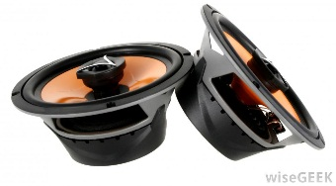
Basics of Object-Based Audio
A YouTube examples of Audio Scene with different Objects:
http://youtube search "UDK + SuperCollider for real-time sound effect synthesis - demo 6“
Observe the Video carefully & Identify --
Number of Audio Objects present in the scene.
Shape of the objects
Movement of those objects.
Appearance / Disappearance of objects
Properties of the audio signals generated by these objects.

Slide 10
Channel Based Audio vs Object Based Audio
Channel Based Immersive Audio | Object Based Audio
Content Creation
Each signal track is associated with a specific speaker feed & setup at listener end. Content is created for a specific Listener Environment or setup. (mobile, home, or theater) | Audio Object based signal tracks are independent of speaker-setup. => Content created is independent Listener Environment or setup. (mobile, home, or theater)
Playback at Listener End
At Listener end, the contents (channels) are mapped onto user speaker setup Need to use Predefined channel-mapping to headphones, stereo speaker, 2.1, 5.1, 11.1 etc. | At Listener end, the objects are mapped onto user speaker setup Objects based on positions and movements are mapped on the fly to the speaker-setup.

Slide 11
Channel Based Audio vs Object Based Audio
Channel Based Immersive Audio | Object Based Audio
Content Creation
With inputs as the recorded contents or tracks, each Channel track is carefully designed and created at the recording studios. OR at the gaming developer studios for creating good immersive effects. | Audio Objects can be simply identified encoded as separate tracks. Associated meta-data should be carefully designed to capture shape, movement, appearance/disappearance of the objects assuming the listener at the center.
Playback at Listener End
If the content-target speaker == user speaker setup, then simple-mapping and playback. Else use some good pre-defined maps and delays for rear speakers to create the content. | Objects are decoded to create audio signals. Frame-by-Frame, positions of “active objects” are mapped on to user speakers in form of gains and delays for these objects. Mix and playback.

Slide 12
Channel Based Audio vs Object Based Audio
Channel Based Immersive Audio | Object Based Audio
Content Creation
Creation is a complex careful process. Encoding steps and procedure is complex and hence is done by skilled well trained sound designers. | Creation and encoding object-audio is a relatively simpler process and can be done without much pre-thinking of user-setups & environment. Audio object meta-data needs to be carefully associated with it.
Playback at Listener End
Decoders are Renderers are fairly simple. | Decoders are simple (as simple as channel based Audio). However the Renderers are much more complex. Renderers need to map these objects with its positions to speakers on a frame-by-frame basis.

Slide 13
Pros & Cons of Object Based-Audio
PROS | CONS
Richer Immersive experience Better user control & available choices for different audio-settings & preferences Same content can supports a much larger variety of playback speaker setups from simple Headphones to 22.2 setup. Readily maps to Gaming & VR requirements where user context is NOT defined and varies based on user’s navigation. | Decoder+Renderer complexity is about 2x to 3x times higher. Hence the power consumption during playback of such stream is higher.

Slide 14
A summary – basic of Object-Based Audio
Typical Object-Audio Encoded Stream contains 8 to 16 encoded audio object-tracks.
And each audio-object track has two parts
Object Audio Track
Enc-Audio-Obj Frame 1
Enc-Audio-Obj Frame 2
Enc-Audio-Obj Frame N
MetaData-Obj Frame 1
MetaData-Obj Frame 2
MetaData-Obj Frame N
Meta-Data:
Stream-level:
Max Number of Audio Objects present in the scene.
Frame-level:
Shape of the object, Data related to position, speed of the object, Appearance / Disappearance of object
Compressed PCM Audio-Data:
Standard DD or AAC encoded audio signals associated with a specific object.

Slide 15
Revisit – basic of Object-Based Audio
A YouTube examples of Audio Scene with different Objects:
http://youtube search "UDK + SuperCollider for real-time sound effect synthesis - demo 6“
Observe the Video carefully & Identify --
4-5 object of different shapes appear, move and disappear w.r.t. to the listener.
Footsteps, lava-pond, whirling wind, flowing stream, dripping water

Slide 16
Object-Based Audio Stream Decoding & Rendering
Decoding: The basic audio from object is encoded using standard legacy encoders. Therefore, decoding uses standard mp3, aac, dolby-digital decoding to provide basic audio PCM for the object.
Renderers: Challenges are in Rendering the decoded object-based audio PCM contents & use object’s shape/motion meta-data to create –
An immersive audio experience on headphones. (VR, Gaming, smartphones, and tablets)
An immersive audio experience on our multi-speaker layouts at homes or theaters

Slide 17
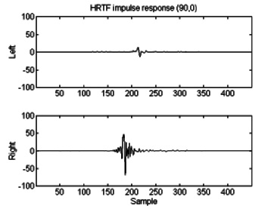
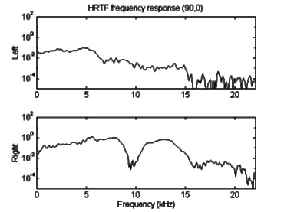
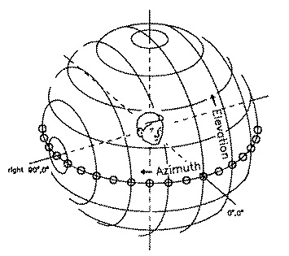
Object-Based Audio Renderer on Headphones
HRTF Model
(Head Related Transfer Function)
Ear impulse & frequency response for orientation shown in picture on left (90º azimuth, 0º- elevation) from WK SDO set. [2,3]
(Note: 5 to 9 msec duration impulse response width @ 16kHz sample rate)
Diagram of spherical coordinate system (Wightman and Kistler, Univ Winsconsin) – 1989 [1]

Slide 18
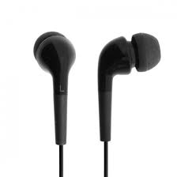
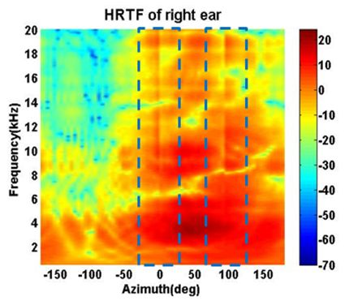
Object-Based Audio Rendering on Headphones
Gain / delay Module
FIR Filter Pair
HRTF_Left
HRTF_Right
MIXER
Decoded audio object PCM data
Interpolate & Compute
HRTF_Left & HRTF_Right from filter-pool
Distance -> Gain delay mapping
Decoded audio object Meta data
(dist, azi, ele)
R
φ & θ
HRTF_L/R – Filter pool for diff values of
φ_{i} & θ_{i}

Slide 19
Object-Based Audio Rendering on Headphones
Gain delay Module
FIR Filter Pair
HRTF_Left
HRTF_Right
MIXER
Decoded audio object PCM data
Distance -> Gain, delay mapping
Compute HRTF_Left & HRTF_Right
Decoded audio object Meta data
(dist, azi, ele)
R
φ & θ
Preset FIR Filter pool
The parameters R, φ & θ change every frame (20-30 msec)
filter coeffs, gain change every frame
This may cause glitches, distortions in the outputs.
Need for techniques to adaptively & smoothly change those coefficients
Signal Processing Challenges
There are multiple objects & some appear and disappear after a few frames.
Need for on the fly object pcm + associated meta-data memory
allocation, update and destruction
Need for fade-in / fade-out / mute of output PCM samples
Need for a well-designed multi-port PCM mixing module
Some Objects move very rapidly
“R” changes w.r.t. time => the speed of the object is substantial causing Doppler effect on audio signal (e.g. a fast-train passing by)
Need for pitch shifting (variable-delay) module to be introduced on top of gain application Module. Oversampling & Interpolation would be required.
VR / Computer Games related: Head / Joystick movements changes “R, φ & θ”
An additional Head-Tracking or Joystick movements module which feeds user orientation parameters “Ru, φu & θu”
Additional module to Perform 3-D geometry computations to derive final object position parameters from the above 2 sets “R, φ & θ”

Slide 20
Object-Based Audio Rendering on Headphones
FIR Filter Pair
Gain / delay Module
HRTF_Left
HRTF_Right
MIXER
Decoded audio object PCM data
Distance -> Gain & delay mapping
Compute HRTF_Left & HRTF_Right
Decoded audio object Meta data
(dist, azi, ele)
R
φ & θ
Preset FIR Filter pool
A Quick Example on You-Tube
Youtube:
RealSpace 3D v0.9.9 Audio Demo - YouTube
(courtesy: http://realspace3daudio.com/demos/)

Slide 21
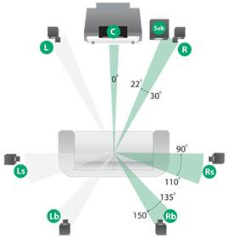
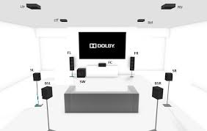
Object-Based Audio Rendering on Immersive Speaker-Layouts
Examples of Immersive Speaker Layouts
Dolby ATMOS 11.1
Speaker Layouts
DTS / DD+ 7.1 Speaker Layout

Slide 22
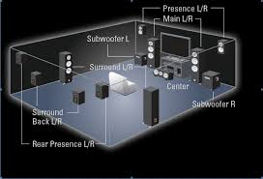
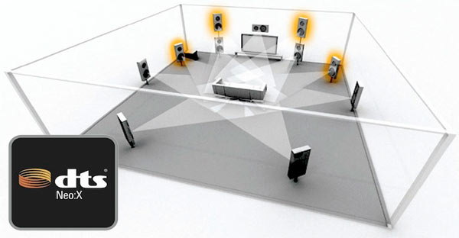
Object-Based Audio Renderer on Immersive Speaker-Layouts
Examples of Immersive Speaker Layouts
DTS-X 7.2.4 Speaker Layout
DTS Neo:X 11.1 Speaker Layout

Slide 23
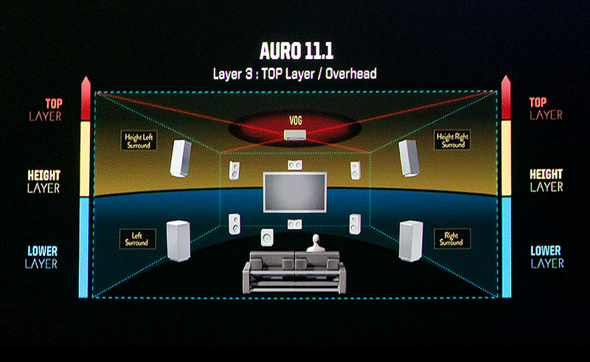
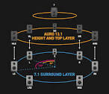
Object-Based Audio Renderer on Immersive Speaker-Layouts
Examples of Immersive Speaker Layouts
Auro-3D 11.1 Speaker Layout
Auro-3D 13.1 Speaker Layout

Slide 24
Object-Based Audio Renderer on Immersive Speaker-Layouts
Observations on most recent Immersive Speaker Layouts
The additional speakers and their positions are fixed as recommended by the Home-Theatre AVR vendors & content creators.
A couple of front wide speakers are added in front to cover azimuth angle better.
About 2 to 3 speakers at higher elevations are also added to cover audio coming from higher elevation angles.
In some cases, there are direct overhead speakers which are fitted in the ceiling (or its effects are “virtually” created by upward-tilted speakers using ceiling reflections)

Slide 25
Object-Based Audio Renderer on Immersive Speaker-Layouts
Two Main Techniques.
VBAP – Vector based amplitude Panning: Mapping object audio to Virtual Speaker Array
HOA – Higher Order Ambisonics : Creating desired “Sound-Field” at listeners’ sitting position
VBAP (Vector Based Amplitude Panning):
A large array of “Virtual” Speaker Positions are assumed to surround the listener. Audio-Objects and their motions / positions w.r.t. the listener are mapped on a larger set of “Virtual” Speaker Positions.
Audio signals for each object is mapped on this virtual speaker positions using VBAP method
The audio associated with virtual speakers is then mapped to standard user speaker layouts using pre-defined down-mixing matrices & set of delays.

Slide 26
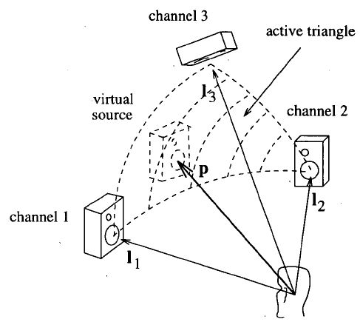
VBAP based object rendering on Immersive Speaker-Layouts
Vector Base Amplitude Panning [Pulkki 1997]
3D-VBAP describes/derives sound-field of an object kept on unit sphere by means of 3 relevant channel unit vectors.
These channel position vectors need not be orthogonal to each other – correspond to “nearest” speaker positions. (real or virtual)
When the 3 channel position vectors are orthonormal (e.g. on x, y, z axis), 3D-VBAP mapping gets simplified to 1st order mapping.

Slide 27
VBAP based object rendering on Immersive Speaker-Layouts
Vector Base Amplitude Panning [Pulkki 1997]
P = [g1 g2, g3] x [L1, L2, L3]’ = object Position & loudness vector.
where [g] is gain 3x1 vector,
L = [L1, L2, L3]’ is 3x3 matrix formed by of x,y,z co-ordinates of Virtual Speaker positions L1, L2, L3.
P is Audio Object representation vector with direction & amplitude
[g1, g2, g3] = P * L⁻¹
Typically, the space around the listener is divided into 80 to 100 valid triangular meshes or region. The object is mapped in one of the regions
The object-audio stream is created by encoding P values and sent as meta-data for the object.
At the renderer, the matrices L⁻¹ are pre-computed and stored for the triangular meshes.
The gains g1, g2, g3 are calculated as (P * L⁻¹) for the object. The gains are applied to the audio object PCM data to create the audio-signals to be played at the virtual speaker positions

Slide 28
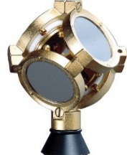
HOA based object rendering on Immersive Speaker-Layouts
Higher Order Ambisonics [Gerzon 1970]
Creates a sound field generated by audio-object(s) when it gets captured by directional microphones located at the listener’s position
First Order Ambisonics fields
Second Order Ambisonics fields
An Ambisonic Microphone
HOA channels are encoded and these channels are decoded and then mapped onto any standard “user speaker layouts” from 5.1, or 7.2.4 or 13.1”. These mappings are easy and less complex.
HOA technique makes it easy to modify the sound-field for different user (listener) orientations (required mainly in VR & Computer Gaming)

Slide 29
Rendering on Headphones using intermediate audio of Immersive Speaker-Layouts
In industry, typically the following technique is used (in non-gaming) application to render the object-based content on headphones.
Decode and render the object–based content for an Immersive Speaker layout.
Map the immersive speaker layout audio signals to headphones using “BinAural” Rendering
Advantages are:
The same content can be decoded for immersive speaker layout, theater, or headphones.
Reduced Complexity if the stream carries standard immersive channel configurations as sub-stream then this can be done as multi-channel decoding followed by Bin-Aural Rendering.

Slide 30
BinAural Rendering : Immersive Speakers -> Headphones.
Left Rear Speaker Signal Lsr
HRTF_LeftEar_Lsr
Depending upon the fixed φ & θ angles
of Front, Rear & Overhead Speakers
w.r.t. Left and Right ear of the listener
HRTF_Left and HRTF_right are applied & mixed as below.
HRTF_RightEar_Lsr
Right Rear Speaker Signal Rsr
HRTF_LeftEar_Rsr
HRTF_RightEar_Rsr
Left Front Speaker Signal Lf
HRTF_LeftEar_Lf
+
HRTF_RightEar_Lf
Right Front Speaker Signal Rf
HRTF_LeftEar_Rf
+
HRTF_RightEar_Rf
Overhead Speaker Signal Oh
HRTF_LeftEar_Oh
Let’s Listen to “YouTube: Hear New York City in 3D Audio” (BinAural Audio)
Duration of Interest: 1.30-6.00 min
HRTF_RightEar_Oh

Slide 31
Industry Trends for Object-Based Audio
Reference Material based on Object-Audio:
Dolby, DTS and Fraunhofer are introducing their freshly designed audio standard reference IPs which support Object-based audio contents for Cinema, Home theater and Digital broadcasts.
Gaming industry and VR gadgets manufacturers are welcoming this trend in their domains.
For listeners, this trend will provide
Better immersive experience for the latest movie releases and audio contents on their existing home theater setup.
Streaming contents & games on mobile phones / tablets would sound much richer.
The Sports channels & movies will carry more options for user controls to select audio environments for watching their favorite match.
Upgrading to the latest AVRs and SoundBars with “wide front” and ceiling with “overhead speakers” (actual or virtual) will provide the best effects.
For DSP solution providers:
Higher computational burden on Audio DSPs to decode and especially rich post processing to render the content.
Audio DSP gets burdened with 3-D geometry computations, computes related to square-root, sine, cos, matrix operations are required.
Compute Power required to decode this content is going to be 2 to 3x higher, thus battery drain may be higher.

Slide 32
Summary of Object-Based Audio
Each sound source is captured as an object which is associated with “compressed audio” as payload and motion/shape information as meta-data.
For listener using Headphones, objects along with its motions are mapped to left and right ear from a pool of pre-generated “HRTF (Head related transfer functions)” functions.
For listener sitting in living room or cinema theaters, objects along with its motions are mapped onto an array of immersive speaker layouts, using
VBAP, HOA methods.
The content creators also use combination of the above two methods called Bin-aural rendering to render the contents for creating immersive audio perception on the Headphones.

Slide 33
Thank you
Q & A Session?

Slide 34
References
[1] http://youtube search "UDK + SuperCollider for real-time sound effect synthesis - demo 6“
[2] http://alumnus.caltech.edu/~franko/thesis/Chapter4.html (HRTF related discussions & details)
[3] Headphone simulation of free-field listening. I- Stimulus synthesis - J Acoust Soc Am 1989 - Wightman.pdf
("SDO" HRTF by Wightman and Kistler from Department of Psychology and Waisman Center, University of Wisconsin--Madison, Madison, provided a basis for HRTF research)
[4] http://youtube search " RealSpace 3D v0.9.9 Audio Demo – YouTube”
Ref: http://realspace3daudio.com/demos/
[5] http://slab3d.sourceforge.net/ - Simple HRTF code to try out simulations of moving audio-objects.
[6] Virtual Sound Source Positioning Using VBAP, Ville Pulkki, Journal of Audio Engg. Society, Vol 45, No 6, June 1997
[7] Spatial Sound – Technologies and Psychoacoustics, presentation by V. Pulkki in IEEE Winter School in 2012 at Crete, Greece.
[8] An Introduction to Higher Order Ambisonic, Florian Hollerweger, Oct 2008
[9] http://youtube search “Hear New York City in 3D Audio” (1st short clip)

